Slide 1
Interreg V-A Latvia – Lithuania Programme 2014-2020 LLI-444 Sustainable Integration of Novel Solutions into Cultural Heritage Sites/ NovelForHeritage
Anita Škutāne
Project manager
21.12.2021. Jelgava

Slide 2
Achievements in 3rd period
Participation in A.M.3 Activities' planning and coordination meeting 9.09.2021.
Participation in A.T1.1 Expedition to cultural heritage and nature objects (sites) projected by G.Kuphaldt in Estonia and Latvia 22.-23.09.2021.
Participation and organization of A.T3.2 Two wide-format seminars for professionals: landscape architects, cultural heritage and nature sites managers, researchers, historians, artisanals (gardeners) 1st December and 14th December, 2021
Participation in A.M.2 PRIG meeting 21.12.2021.

Slide 3
Exhibition hall in Eleja Manor park

Slide 4
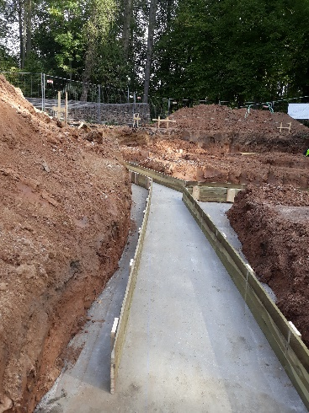
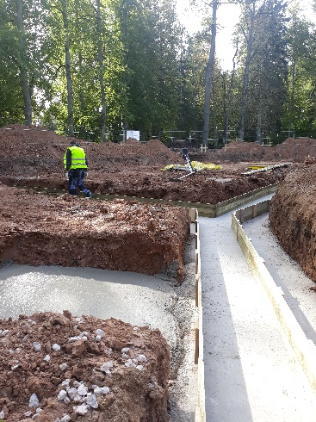
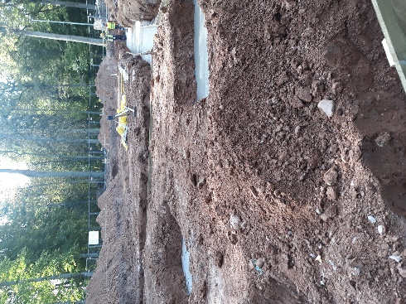
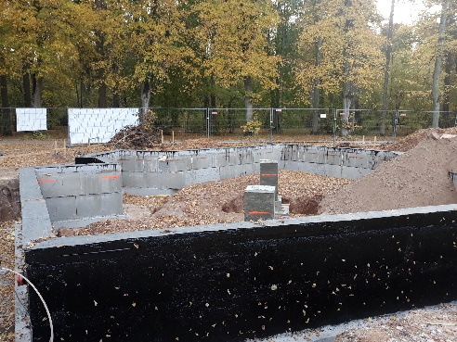
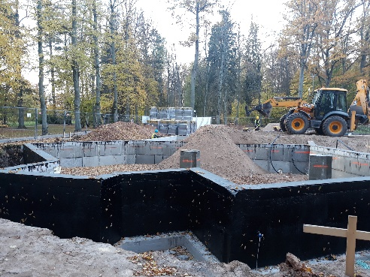
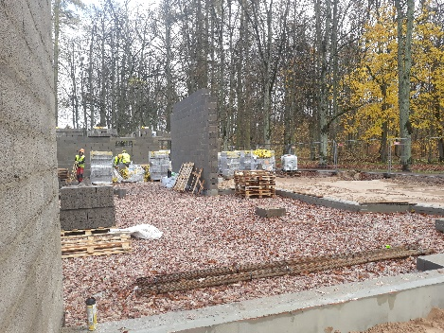
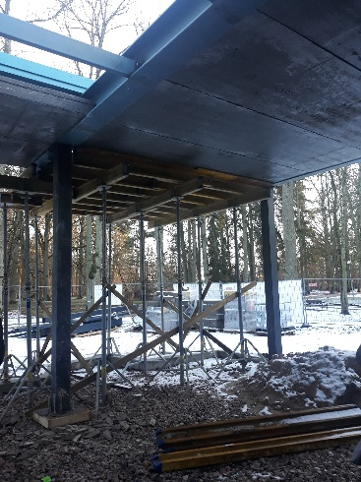
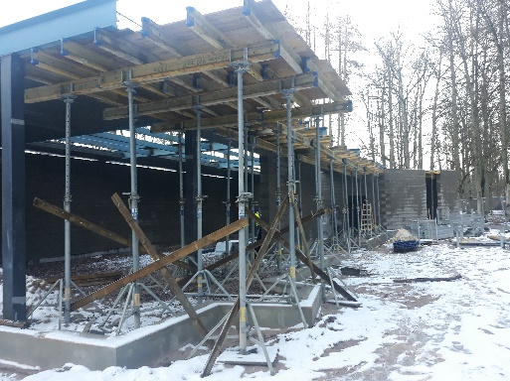
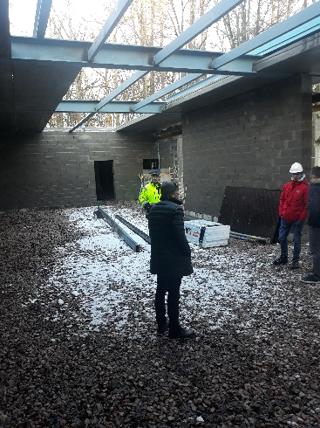
14.09.2021.
27.10.2021.
23.11.2021.

