Slide 1
Sustainable Integration of Novel Solutions into Cultural Heritage Sites
Project partner - PP4:
Nature Heritage Fund (Lithuania)
LLI-444 NovelForHeritage
Kick-off meeting August 27, 2020
Notes:
No notes needed ☺

Slide 2
Sustainable Integration of Novel Solutions into Cultural Heritage Sites
Nature Heritage Fund, NHF (Gamtos Paveldo Fondas, GPF)
is active in all Lithuania focusing on strengthening protected areas as epicentres for sustainable development in the country
NHF since 2001 has implemented 101 project funded by various international financial instruments or state budget.
Notes:
The main fields of action:
- Restoration of damaged and degraded nature areas (swamps restoration)
- Preparation of the management plans for protected areas (NP and RP, Strict nature reserve)
- Integrated planning of river basins
- Promotion of sustainable farming
- Promotion of sustainable tourism and ecotourism
- Promotion of traditional sustainable businesses - Strengthening of administrational capacities of protected areas administrations - Development of nature conservation policy amendments and environmental lobbying - Environmental education and awareness raising

Slide 3
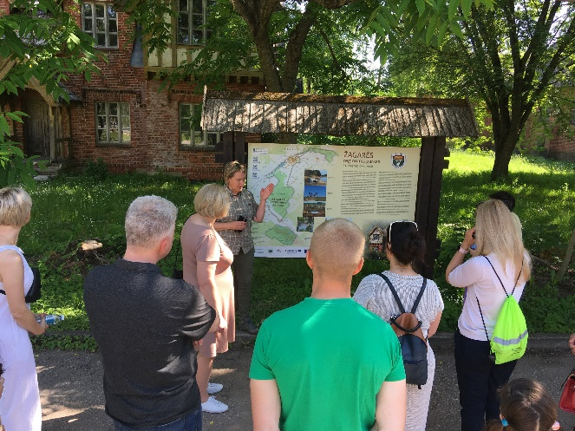
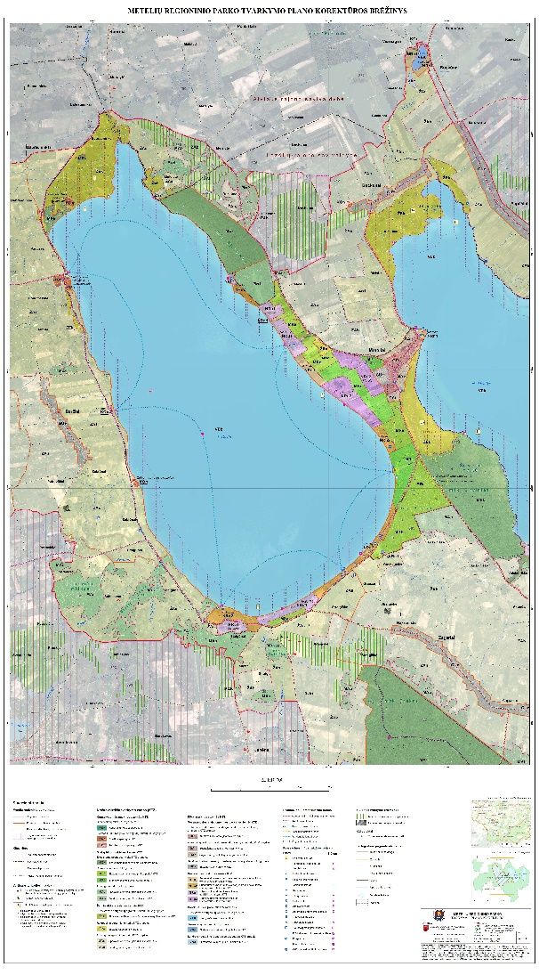
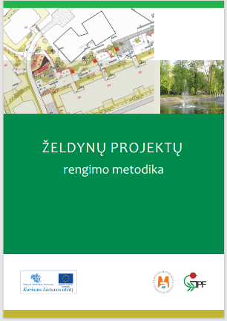
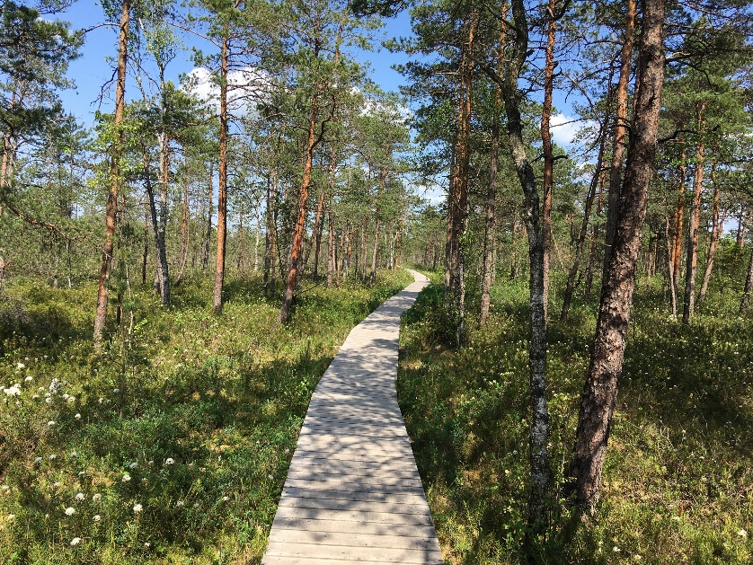
Sustainable Integration of Novel Solutions into Cultural Heritage Sites
NHF competencies to be provided to the partners and role in the project: Parks’ management - best practice transfer Development of thematic tourism routes, methodological and educational tools 4 staff members shall be working on project implementation
Project will make Eleja Manor park and Žagarė Manor park more attractive for tourists

Slide 4
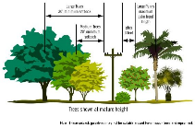
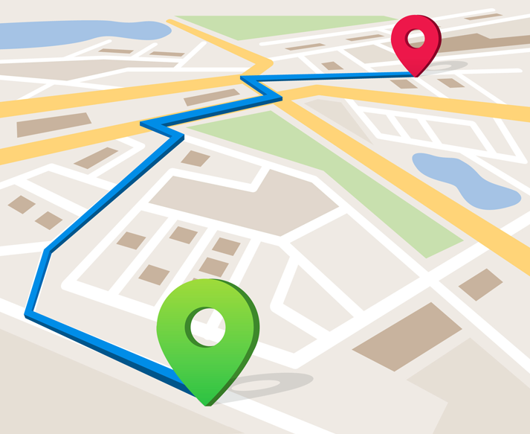
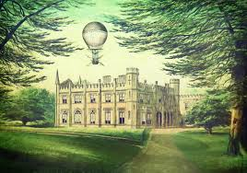
Sustainable Integration of Novel Solutions into Cultural Heritage Sites
2 walking routes for Žagarė Manor Park will be developed:
the dendrological
the landscape architecture
Leaflets, presenting new routes (LT, LV, EN). 6000 copies will be printed.
Notes:
PP4 NHF staff will develop content, prepare descriptions and maps (Marijus) of routes.
External service will be procured for design (visualisation), translation (LT, LV, EN languages) and printing of the leaflets presenting new routes. 6000 copies will be printed.
(Equipment will be acquired (perka ŽRP) within WP I for possibility to explore routes in bad weather (rainfall, storm, heavy snowing) conditions.)

Slide 5
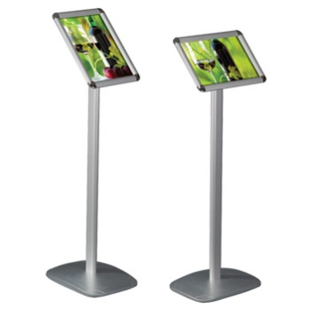
Sustainable Integration of Novel Solutions into Cultural Heritage Sites
Outdoor educational programme for pupils aged 12-16, for learning heritage and nature values (outdoor action, educational game for bigger groups).
50 informatively-educational stands for Žagarė Manor Park (layouts-preforms;16 about cultural heritage and arch., 34 – about dendrological objects; LT, EN)
Notes:
The programme will contain teacher and student work sheets/lessons on culture heritage and nature related topics.
About 70-90 pages of different materials will be prepared.
PP4 NHF staff will develop initial concept of games.
External services will be procured for methodologically correct content, design and layout, making illustrations, drawings, sketching for educational programme.
Development of texts will be done by PP4 NHF staff.
External services will be procured for: translation of texts from LT in EN, procurement of photos to illustrate information, preparation of design and layout in PDF format, printing.
Production of stands will be done using other sources of PP2 ZRP (production costs are not included in the budget of the proposed project).

Slide 6
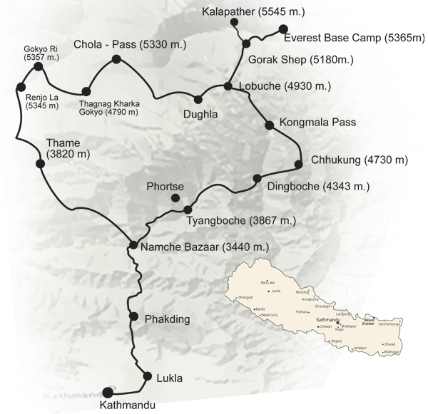
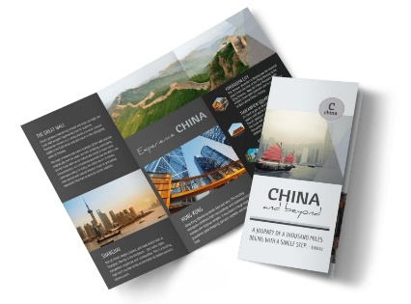
Sustainable Integration of Novel Solutions into Cultural Heritage Sites
The travel route itinerary, capturing the circle route of Jelgava, Dobele, Tervete, Zagare, Joniskis, Eleja, outlining main points of interest, nature and culture heritage, information on local services availability
web map application will be developed. It will be downloadable via computers, smart phones, tablets
description and map shall be prepared. There will be 8000 LV, 8000 LT, 4000 EN copies
Notes:
Travel route shall be based on web map application already prepared under the completed project Explore Zemgale by Bicycle (LLI-264) basis, yet it shall be presented in the extended version and shall include descriptions and mapping of the nature and culture objects of several Interreg Latvia-Lithuania projects of similar nature and same territory.
In particular, the travel route shall include objects of interest identified under projects Explore Zemgale by Bicycle, 4Seasons Parks, the new projects LLI-453 Traces of Crusades and LLI-444 NovelForHeritage.
The partners of all projects shall be consulted in order to make the product a complimentary rather than duplicating. At present, webmap application is only available for LLI-264, thus, by making an extended webmap, it shall allow the traveller to have a much greater territorial coverage of objects.
It is planned, that the travel route itinerary shall begin in Jelgava and stretch through Duobele, Tervete, Zagare, Joniskis, Eleja, going back to Jelgava thus making a circle route that could be titled “The circle of heritage”. In addition, the cooperation among projects and partners on both sides of the border shall result in greater visibility, coordination and attract more visitors.
Webmap application (will be developed by PP4 staff) will be accessible through mobile phones and thus be useful to bike travellers, hikers, families, groups of friends, schools, and so on.
For those interested in traditional information presentation shall be offered a printed route booklet with descriptions and map.
In addition, it is planned that during project event planned under Activity T3.3 where representatives of above projects, and other related Interreg projects implemented in Zemgale shall be invited to attend.

Slide 7
Paldies!
Nature Heritage Fund
Gintaras Venckus, g.venckus@gpf.lt
Lina Jankauskienė, l.jankauskiene@gpf.lt

