Slide 1

Interreg V-A Latvia – Lithuania Programme 2014-2020
LLI-444 Sustainable Integration of Novel Solutions into Cultural Heritage Sites/ NovelForHeritage
Anita Škutāne
Project manager
27.08.2020. Jelgava

Slide 2
Project in brief
Partnership
LP: Jelgava Local Municipality
Latvia University of Life sciences and Technologies
Directorate of Žagare Regional Park
Nature Heritage Fund

Slide 3
Project in brief
Project objective: to increase the tourism potential of cultural heritage objects – manor parks by adding contemporary approach, objects and services in classical manor parks
Implementation period: 01.07.2020. – 30.06.2022.
Project activities include preparation of research materials on G.Kuphaldt in digital format to be used for improvement of both parks` infrastructure; development of mobile application allowing visitors to navigate the tourism sites in Eleja and Žagare;
Infrastructure/ improvement works in 2 parks: construction of exhibition hall in Eleja Manor park; development of interactive indoor exposition for visitors in Žagare Regional Park Visitors’ Centre with outdoor educational activities for pupils for learning cultural heritage and nature values and new walking routes – dendrological and landscape architecture – in Žagare Manor park;
Activities: organization of open-air workshops for students in parks and seminars for wide range of professionals

Slide 4
Expected results
As a result of the project both manor parks will become more attractive as tourism objects. New knowledge of parks management and infrastructure will help to increase the attractiveness of manor parks as tourism objects, interesting both for visitors with professional interest in landscaping and for general public.
Increase in expected number of visits to supported sites as a result of improved management and infrastructure of 2 cultural heritage sites – manor parks
4000 visitors more in 2022 in comparision to 2019

Slide 5
Project Monitoring Committee (PMC)
PMC is composed of decision makers from each partner who are not involved in daily work of the project - Head of organization and field expert
PMC will consist of appointed persons, one or two from each partner organization
At least two Project Monitoring Committee (PMC) are foreseen. Will be combined with PRIG meetings. Report on progress, results will be presented.

Slide 6
PMC tasks
PMC main responsibilities:
Overseeing the implementation of the project activities
Ensuring that project results are achieved and deliverables are prepared in due time
Monitoring risks and implementing measures for their reduction
Supervision and strategic guidance

Slide 7
PMC MEMBERS
Partner | PMC members
LP | Aija Tračuma Līga Lonerte | Vice Chairman Executive Director
PP2 | Daiga Skujāne | Professor of Landscape Architecture and planning Dpt.
PP3 | Mindaugas Balciunas | Director
PP4 | Gediminas Raščius | Director

Slide 8
Project Implementation Group (PRIG)
PRIG includes the overall Project Manager and coordinators appointed by each partner as well as financial managers and other experts (if applicable).
At least 4 direct PRIG meetings are planned:
2 in LV, 2 in LT.
According to the project budget of PP4: 5 times in total: 3 times, 1 day each meeting, in Jelgava, LV; 2 times, 1 day each meeting in Žagare, LT,
PP3: 3 times, 1 day each meeting, in Jelgava, LV

Slide 9
PRIG TASKS
Responsibility of PRIG:
preparing and submitting the progress and financial reports
overseeing progress of the project according to the project work plan
monitoring and discussing project costs and resource reallocation
ensuring coordination of activities between partners within each component and between components
Internal project monitoring
proposing of budget reallocation and time schedule changes according to the needs of the project, if necessary.

Slide 10
PRIG members
Partner | PRIG members
LP | Anita Škutāne Inese Cinovska Līga Baumane | Project manager Project manager`s assistant Financial manager
PP2 | Natalija Ņitavska Jūlija Mangale Iveta Lāčauniece Silvija Rubene Aiga Spaģe | Project coordinator Financial manager Expert, landscape architect Expert, landscape architect Expert, landscape architect
PP3 | Modesta Bielskienė Giedrė Rakštienė Dalė Jarulytė | Project coordinator Project assistant Financial manager
PP4 | Lina Jankauskienė Raminta Mikalauskiene Gintaras Venckus | Project coordinator Financial manager Landscape architecture specialist

Slide 11
Activities' planning and coordination meetings
3-4 specific working groups, related to planning and implementation of activities: open-air workshops, trainings, wide-formal workshops, elaboration of for increase of attractiveness, visibility and attendance of cultural heritage sites - manor parks will be formed. They will have 4 direct and up to 4-6 online meetings for ensuring smooth preparation and provision of joint activities. Members of these groups will be staff of partners taking part in specific activities to be planned. Leader of each group will be staff member of the partner responsible for implementation of the specific activity. In some cases they will be the same persons as PRIG members.

Slide 12
The main PROJECT documents
Subsidy contract
Partnership agreement
Programme manual
FC guidelines
Application form
Communication guidelines
Technical documentation submitted for the project

Slide 13
Reporting periods
Reporting must be done during 10 working days after the period ends!
As sooner you will report, as faster we will get back your expenditures!
Partner report No: | Reporting period: |  | Deadline for submission of partner report to financial control:
 | Start date | End date
1 | 01.07.2020 | 31.12.2020 | 15.01.2021
2 | 01.01.2021 | 30.06.2021 | 14.07.2021
3 | 01.07.2021 | 31.12.2021 | 14.01.2022
4 | 01.01.2022 | 30.06.2022 | 14.07.2022

Slide 14
Financial flow
Please plan the money flow for the project!
Activity | LP and project partners submit their reports to the FC | FC verification and issuing of FC certificates | LP prepares and submits the consolidated progress report or final report to the JS | MA makes the 1st payment (70% of reported eligible costs) to the LP | JS assesses the consolidated progress report or final report | MA makes the 2nd payment of (30% of reported eligible costs) to the LP
Deadline | 2 weeks from the end of the reporting period | 2 months after the partner report is submitted via eMS | 2 weeks after the FC has issued FC certificates | 2 weeks after the consolidated progress report or final report is received | 3 months after the consolidated progress report or final report is received | 2 weeks after the consolidated progress report or final report is approved by the JS
Total max time passed since the end of the reporting period | 2 weeks | 2,5 months | 3 months | 3,5 months | 6,5 months | 7 months

Slide 15
Some tips!!!
Poster A3 (each priority in different colour)
Article/ research – use disclaimer that the EU is not responsible for the provided information!
Additional EU flag, if other logos are bigger than EU flag
Information for homepage (digital fiche in LV, LT languages)
Stickers and plagues – claimed via LP
Any changes better to inform before!

Slide 16
Project partner presentations – planned activities within the project
LP1 is responsible for WP M, WP I (LV), WP C
M MANAGEMENT
M.1. Kick-off – 27.08.2020.
M.2. 4 PRIG meetings and 2 PMC meetings
M.3. Activities planning and coordination meeting (4 direct and 4-6 online)
M.4. Audit and reporting

Slide 17
Project partner presentations – planned activities within the project
T.3. MEASURES TO PROMOTE RECOGNITION OF CULTURAL HERITAGE SITES AND TOURISM OFFER AND TO ENCOURAGE CLUSTERING OF STAKEHOLDERS
T.3.1. Joint trip/ event of LV and LT journalists, tourism operators and culture and nature bloggers to the manor parks (3rd period)
T.3.3. Joint conference (4th period 05.2022)
Notes:
Activity is planned with aim to promote the two addressed manor parks: Eleja Manor Park and Žagare Manor Park by introducing with them and services they offer LV and LT journalists, tourism operators and culture and nature thematic bloggers. One-day trip of 12-16 participants: a) tourism operators, organising thematically relevant short-term tours, b) journalists from specified architecture and landscape media, as well from media writing about culture, tourism, leisure time, c) popular culture and nature thematic bloggers will be organised. Particular programme will be developed for the trip and send together with invitation. Verbal communication will be established in line with written invitation. If number of bodies who will express interest to take part in the trip will be larger than budget possibilities, those to be approved for the trip will be selected based on “offered benefits and their added value” principle. During the trip the group will attend and get acquainted with both sites and offered services, will take part in activities organised for them, will meet parks’ maintainers, guides and other specialists, who would provide information and give experiences. LP1 JLM will cover catering and event provision costs arising while the group will visit Eleja Manor Park, PP3 ZRP – Žagare Manor Park. Transport costs will be paid by LP1 for the LV participants, by PP3 for LT participants.
One-day cross-border conference will be held aim to demonstrate to national stakeholders of both countries (LV and LT) work done, results achieved and to raise their awareness on manor parks as sites attractive for tourism from perspective of leisure time travellers, as well as of visitors having professional interest. Location: Jelgava, LV. LP1 and PP2 will be responsible for overall organisation and provision of the conference. Representatives of all partners, as well of other stakeholders from LV and LT: regional authorities, culture and nature heritage supervision bodies, culture and nature tourism operators, other bodies, managing manor and castles parks, will be invited. Professionals: landscape architects, cultural heritage and nature sites managers, researchers, historians, artisanals (gardeners) will be invited as experts, providing justified views an opinion, raising constructive dialogue and proposing ideas for further developments. Representatives of other G.Kuphaldt sites from Estonia, Poland, Ukraine, Belarus, Russia, other regions of Latvia, Lithuania will be invited. During the conference research materials, developed tools will be demonstrated, new exhibition hall in Eleja visited. In order to transfer best practices from preciously implemented projects (LLI-313, for example), project partners will be invited to the public events of LLI-444 project in order also get information on different park management angles and approaches, including Activity T.3.3. Joint conference.

Slide 18
Project partner presentations – planned activities within the project
I.1. DEVELOPMENT OF INFRASTRUCTURE AND PURCHASE OF EQUIPMENT FOR SERVICE DEVELOPMENT
I.1.1. Construction of the exhibition hall in Eleja Manor park, including elaboration of the set of documents: strategy, concept, visualisations and use of multimedia and digital technologies (A.T2.1.1).
Notes:
The new exhibition hall (423,4 m2) will be constructed in Eleja Manor Park according to the design project, approved by the construction board and the state cultural monuments protection inspection. The exhibition hall will be used to expose permanent exhibition of G.Kuphald landscape architecture heritage, development of manor parks and gardens, as well temporary exhibitions and other events related to architecture, cultural heritage, and related thematic. The original beams of the Eleja Manor Park Tea House will be integrated in the exposition.

Slide 19

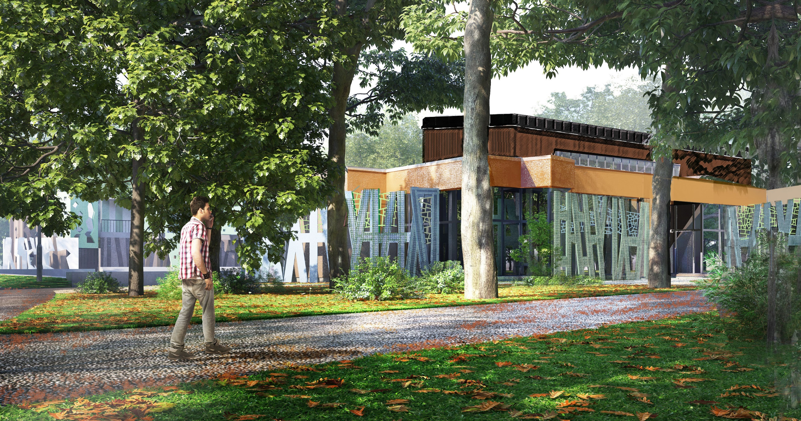
Exhibition hall in Eleja Manor park

Slide 20
Project partner presentations – planned activities within the project
C COMMUNICATION (in cooperation with PP3 in LT):
C.1. Start-up activities:
Digital project fiche (LV and LT languages);
Press release (LV and LT languages).
C.2. Publications: 4 in national and regiona media
C.3. Digital activities:
Publications in partners websites;
6 publications in social media;
3 publications on Programme website
C.4. Promotional materials: 4 informative posters, permanenet plague in Eleja manor park, stickers of eqipment in Žagare manor park

Slide 21
Thank you for your attention!
Anita Škutāne
Jelgava Local Municipality
+371 63048446, 29130936
anita.skutane@jelgavasnovads.lv

