Slide 1
LLU activities in project
Interreg V-A Latvia – Lithuania Programme 2014-2020
Sustainable Integration of Novel Solutions into Cultural Heritage Sites
NovelForHeritage LLI-444
01.07.2020 - 30.06.2022

Slide 2
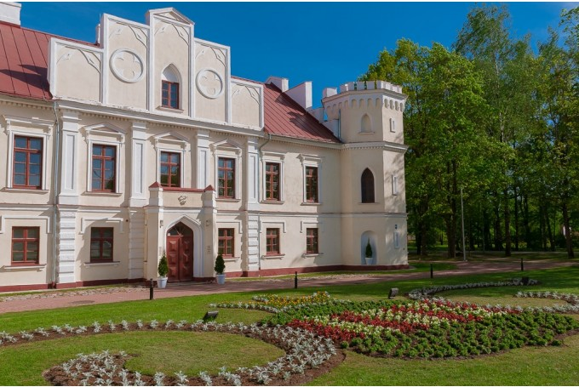
Latvia University of Life Sciences and Technologies
Faculty of Environment and civil Engineering is the second biggest faculty of the University, where new engineers-construction, environment and water management specialists, land surveyors, as well as landscape designers and planners, are prepared.
Department of Landscape Architecture and Planning in Valdeka palace;
All levell study programmes ~ 120 students, 14 lecturers;
More that 25 years experience;

Slide 3
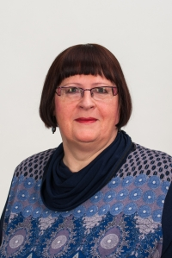
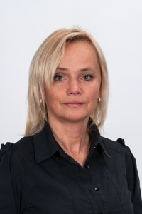
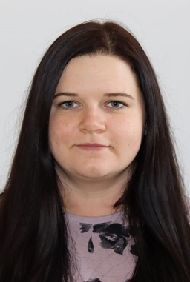
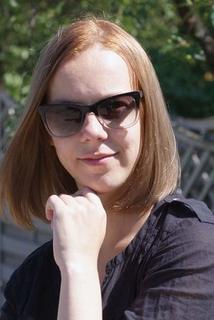
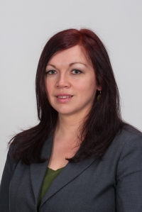
Our team
Silvija Rubene, project researcher
Iveta Lāčauniece, project researcher
Aiga Spāģe, project researcher
Jūlija Mangale, project coordinator
Natalija Ņitavska, project manager

Slide 4
T1 Implementation
T.1.Gathering, exchange and development of knowledge for the integration of contemporary concepts, forms and content into cultural heritage and nature sites - manor parks
Period – 07.2020-02.2021
WP includes measures for acquisition of the existing and development of new knowledge, competencies and elaboration of tools necessary for increase of the attractiveness of the two involved manor parks. It will be achieved through:
a) joint expedition to other G.Kuphaldt projected parks un gardens,
b) research of information and knowledge of G.Kuphaldt heritage,
c) organisation of open air workshops for development of new concepts, solutions, ideas,
d) development of a handbook about management of manor parks and other green areas.

Slide 5
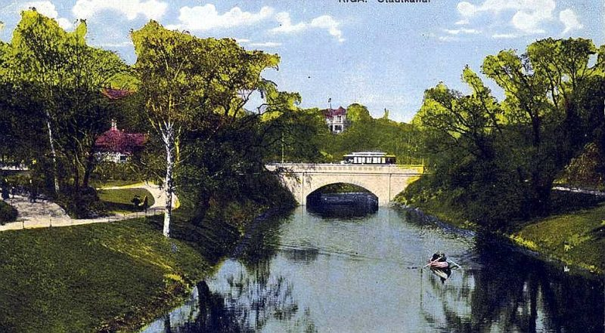
T1 Implementation
T1.1.Expedition to cultural heritage and nature objects (sites) projected by G.Kuphaldt in Latvia, Lithuania and Estonia – 1
Period - 07.2020-10.2020
Joint 4 days expedition to G.Kuphaldt projected and/or developed parks and gardens in Latvia, Lithuania and Estonia.
Greenery of the Riga canal bank in the 20th century.

Slide 6
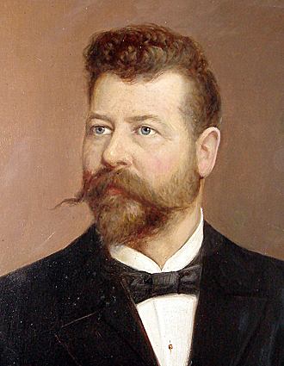
T1 Implementation
T.1.5. Research of historical materials and knowledge on G.Kuphaldt parks and gardens and creation of the set of materials
Period - 07.2020 - 02.2021
Heritage of G.Kuphaldt - knowledge, approaches and methods used in planning, development and management of parks and gardens is a treasury still widely applied in sites initiated and/or developed by this significant landscape architect, as well in other parks and gardens developed later in the Programme area, other locations in both countries and elsewhere in Europe.
Georgs Frīdrihs Ferdinands Kūfalts

Slide 7
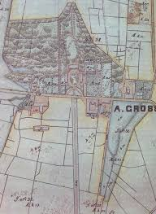
T1 Implementation
T1.2. Two open air workshops for landscape architecture students in the manor parks
Period - 07.2020-10.2020
Two joint open air workshops (2 days each) for LV and LT landscape architecture students in the manor parks will be organised. It is foreseen to have from 30 to 40 participants in the each workshop, where 15-20 students per country will take part: landscape architecture students of PP2 LLU (LV) and students of Aleksandras Stulginskis University (ASU), LT.
Eleja manor parks map

Slide 8
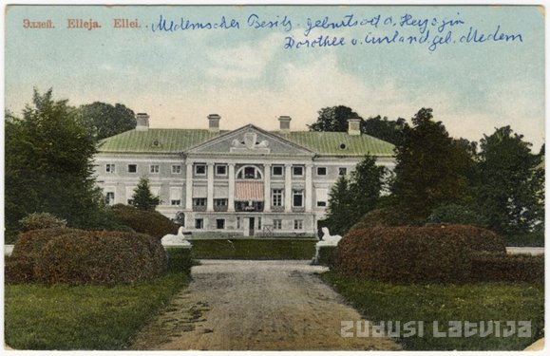
T2 Implementation
T.2.2.Development of joint visual-textual educationally-informative material (booklet/brochure) on Eleja and Žagare cultural heritage and nature sites and G.Kuphaldt heritage
Period - 10.2020-07.2021
Joint visual-textual educationally-informative material (booklet/brochure) on Eleja and Žagare cultural heritage sites – manor parks and G.Kuphaldt heritage will be elaborated as promotional material to be used for dissemination and presentation of sites joint thematic, target groups and services offered.
Eleja manor

Slide 9
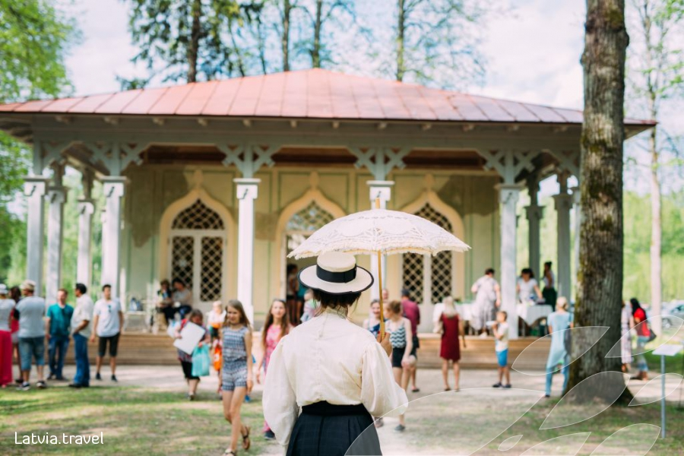
T3 Implementation
T.3.2.Two wide-format seminars for landscape architects, cultural heritage and nature sites managers, researchers, historians, artisanal (gardeners)
Period – 06.2021-09.2021
Wide-format seminars for tourism professionals, landscape architects, cultural heritage and nature sites managers, researchers, historians, artisanals (gardeners) one in Eleja, one in Zagare.
Eleja manor park – tee house

Slide 10
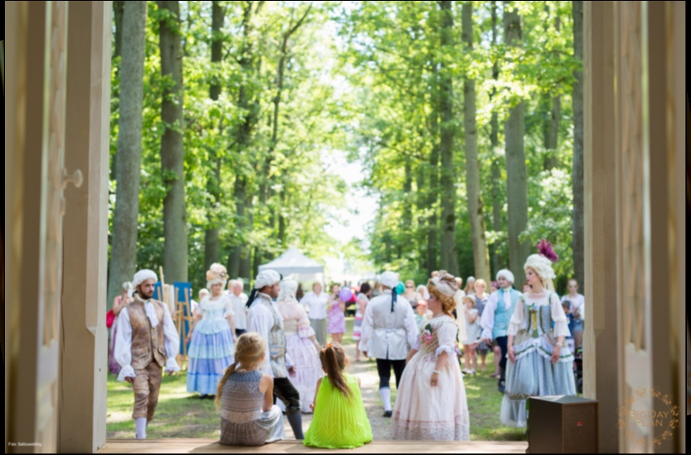
T3 Implementation
T.3.3 Joint conference
Period – 05.2022
One-day cross-border conference will be held aim to demonstrate to national stakeholders of both countries (LV and LT) work done, results achieved and to raise their awareness on manor parks as sites attractive for tourism from perspective of leisure time travellers, as well as of visitors having professional interest.
Eleja manor park – tee house

Slide 11
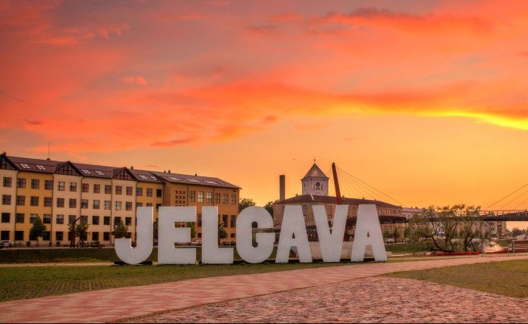
Welcome to Jelgava!

