Slide 1
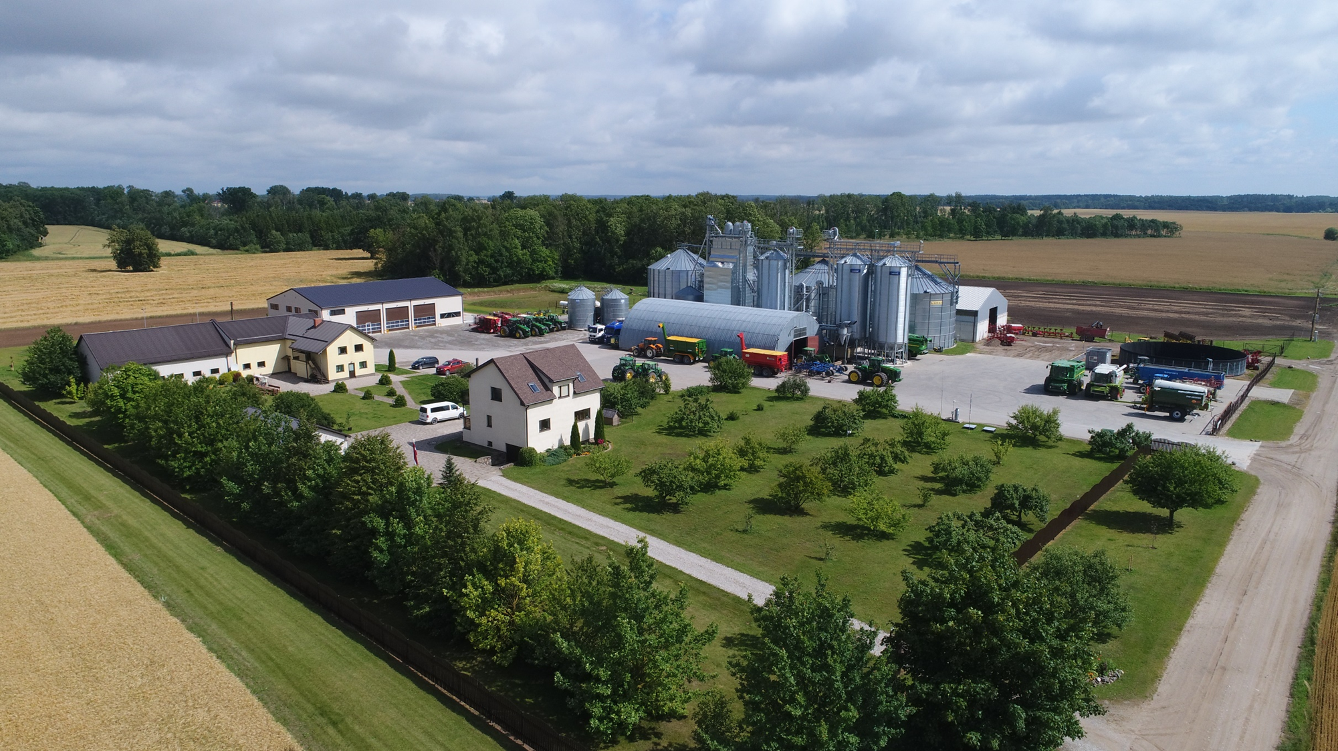
FAMILY FARM «VILCIŅI 1»
Established after the collapse of USSR on 1992 on 74 ha of reclaimed agricultural land
In 2021 over 2,370 ha of land for crop production
Location: Jelgava region, Zaļenieki parish;
20-24 employees in the farm
In 2003 the first steps in technology of precise agriculture
Also have hotel, restaurant and windmill Rožmalas
.

Slide 2
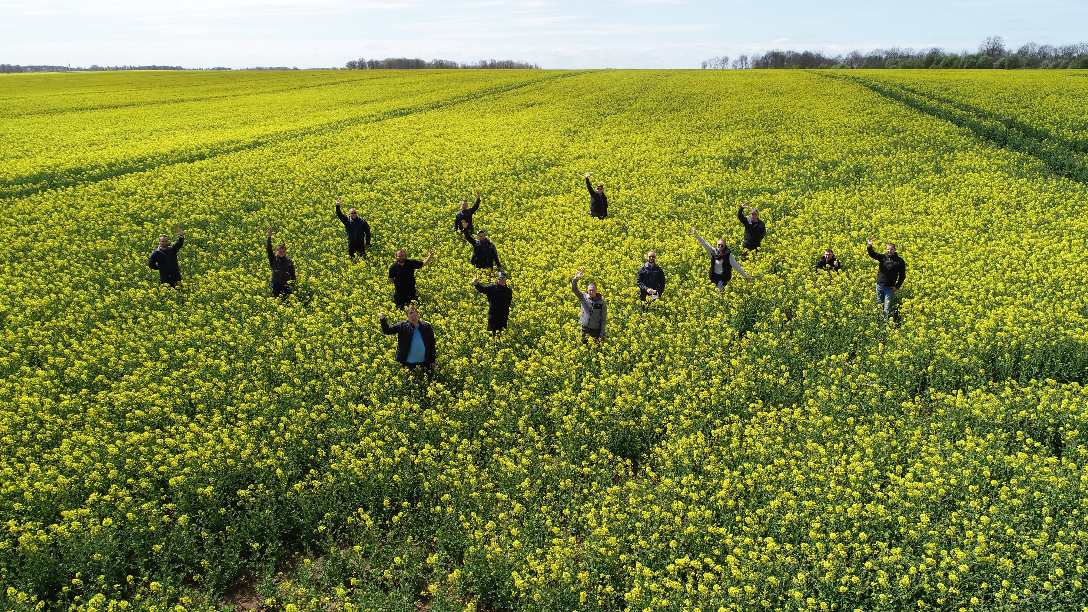

Slide 3
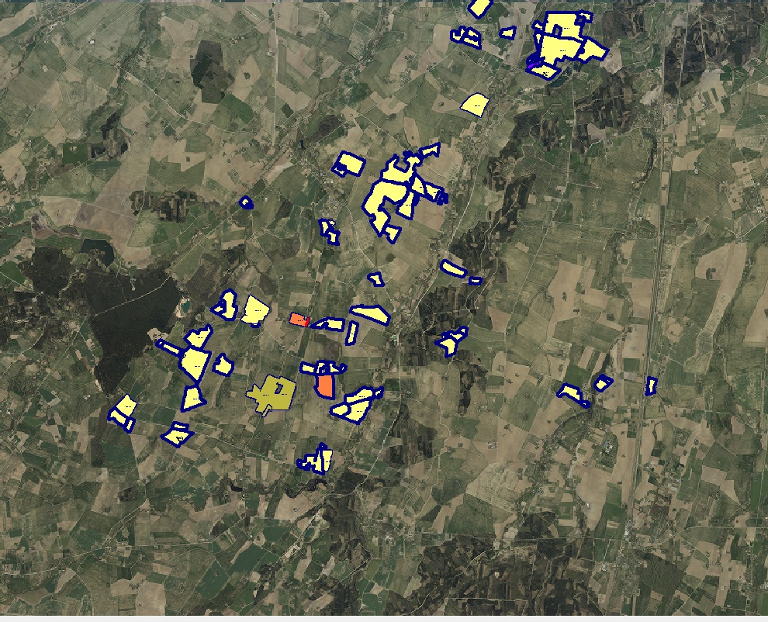
Structure of crops:
70 % winter wheat
20 % winter OSR
4 % field beans
5 % graas seed (Perrenial ryegrass, Festuca rubra)
1 % fallow
The total area above 2370 ha;
Average field 24 ha,
Fields located in 10 parishes, radius 90 km

Slide 4
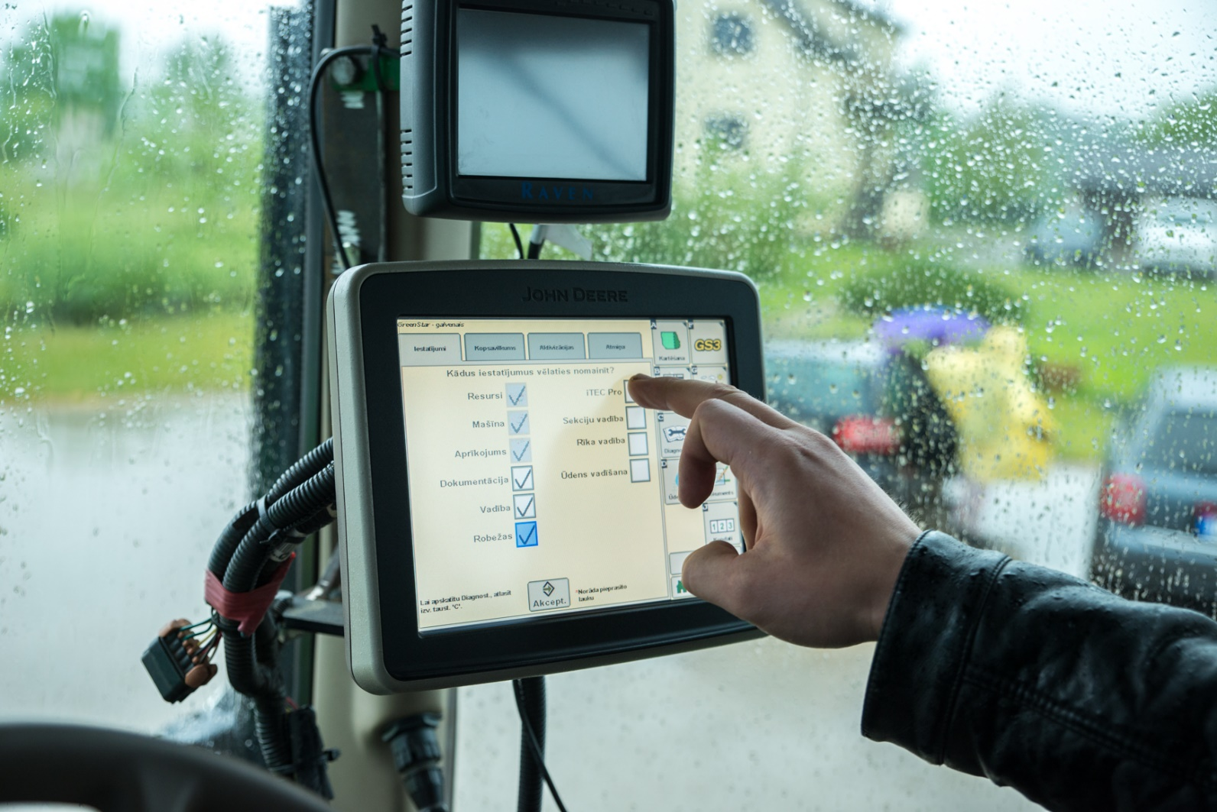
Precise technologies
tractors with automatic steering
Greenseeker Nitrogen sensors
spreader with section control
sprayers with section control
grain dryer with air recirculation and automatic control;
GPS tracking for all tractors
meteorological stations with plant disease forecasts
agricultural software

Slide 5
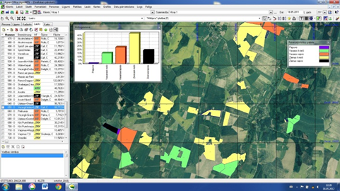
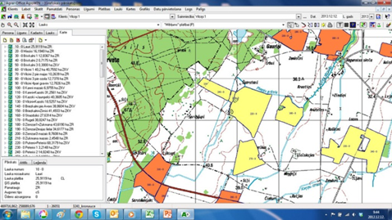
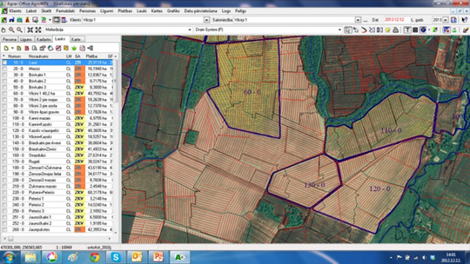
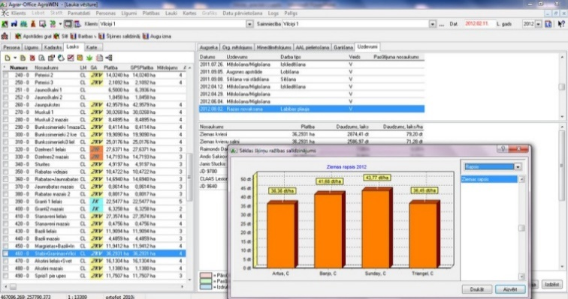
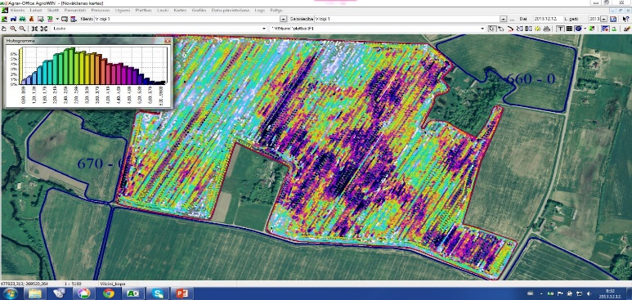
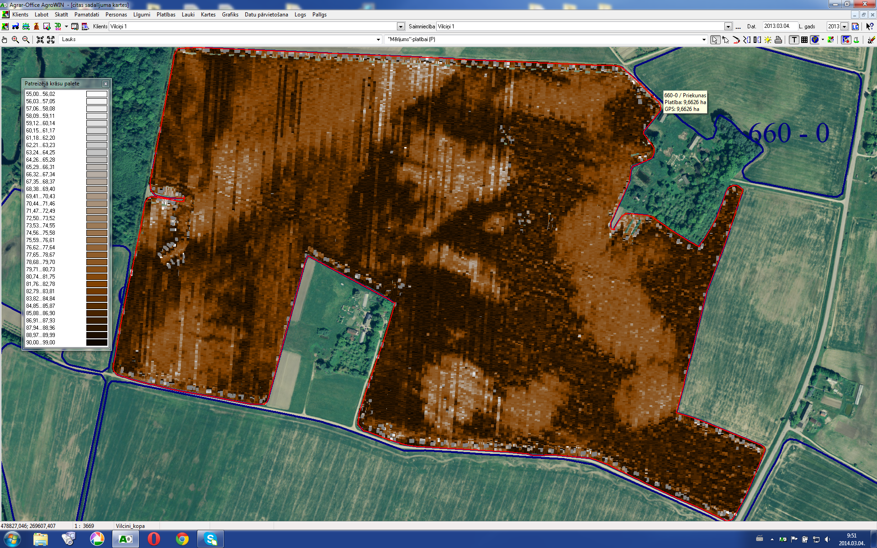
Next Farming Office
Next Farming AG Office software:
for field history records
for mapping
for fertilizing plans
for financial analysis
Ortofoto + field structure
Topografical map
Drainage map
Field history and analyses
Yield map
Fuel map
Notes:
Yield map

Slide 6
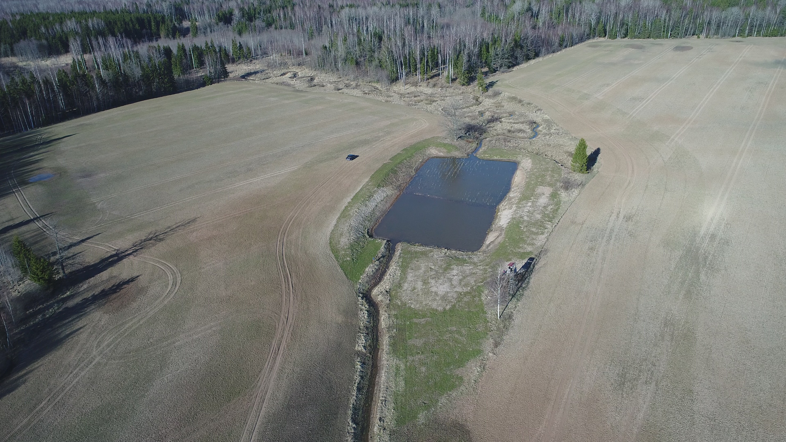
Constructed wetland
Goals:
to control and reduce the inflow of biogenic elements into natural water courses and bodies of water
to control soil erosion
to enrich the water with oxygen
to naturally promote self-purification of water

Slide 7
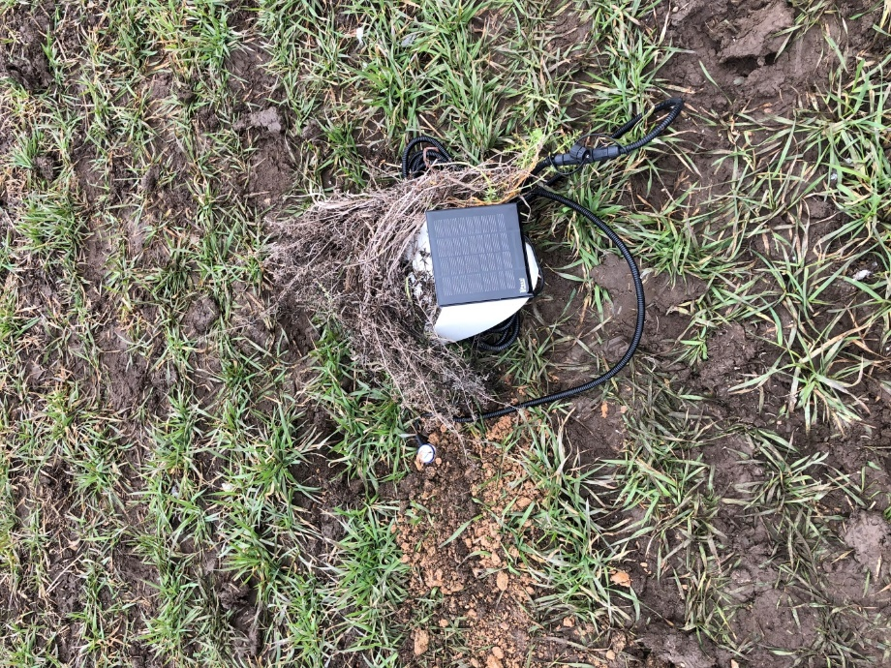
Smart Groundwater and Weather Sensors
Aims to develop a web-based system for the integration, transformation and utilisation of large amounts of data from agrometeorological and groundwater measurements.

Slide 8
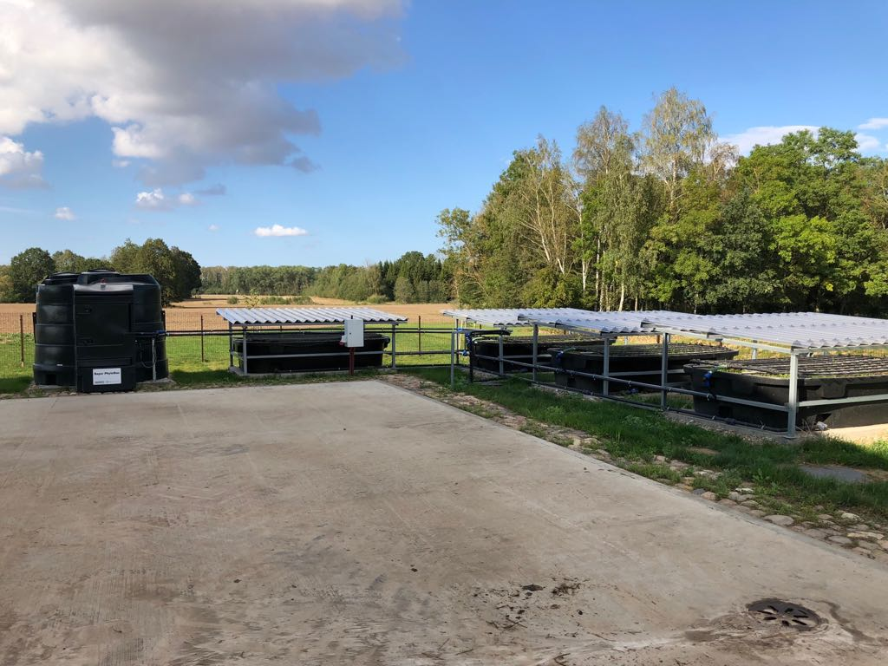
PhytoBac
The Phytobac system enables contaminants typically originating from the filling, cleaning and washing of spray equipment, to be retained and degraded by microbial means, i.e. bioremediation.
The container is filled with a biomix of 70% topsoil and 30% chopped straw.
This allows to prevent possible emissions to the surface water or sewer.

Slide 9
Meteostations with forecasts
Weatherlink – weather forecast, current situation, history, mobile application.
FieldClimate – wheather forecast, current situation, history, mobile application, disease models.
Notes:
Wheatherlink Davis, FieldClimate

Slide 10
Why do farmers have an important wind speed? National legislation limits the performance of rural works – spraying may be carried out if the wind speed does not exceed 4 m/s.
The country's official network of meteostation is not sufficiently dense.
Wind speed at 10 m height is determined in the national meteorostations, important for farmers at 2 m height. As part of the project, this meteostation is installed, where the wind speed is measured at two heights, which is important to understand or have any correlation and what these wind rate differences are.
The installation of this meteostation is important not only for us, but also for other farmers around us, in order to be able to assess the actual wind situation before spraying.
Notes:
Intensīva lauksaimniecības teritorija, kurai ir svarīga precīza meteoinformācija. Valsts oficiālais meteostaciju tīkls ir nepietiekami blīvs.
Valsts meteostacijās nosaka vēja ātrumu 10 m augstumā, lauksaimniekiem tas ir svarīgs 2 m augstumā.
Projekta ietvaros ir uzstādīta šī meteostacija, kur tiek mērīts vēja ātrums divos augstumos, kas ir svarīgi, lai saprastu vai ir kāda korelācija un kādas ir šīs vēja ātruma atšķirības.
Šīs meteostacijas uzstādīšana ir svarīga ne tikai mums, bet arī citiem apkārt esošajiem lauksaimniekiem, lai spētu novērtēt reālo vēja situāciju pirms smidzināšanas.

Slide 11
Conclusions
A different wind at different heights, a difference between the technology of the meteostation and the location.
One common methodology for recording data is important and how it should be applied to the farmer and the national authorities.
Notes:
Atšķirīgs vējš dažādos augstumos, atšķirība starp meteostacijas tehnoloģijām un novietojuma. Svarīga ir viena kopīga metodika datu uzskaitei un kā to visu pielietot lauksaimniekam un valsts institūcijām.

Slide 12
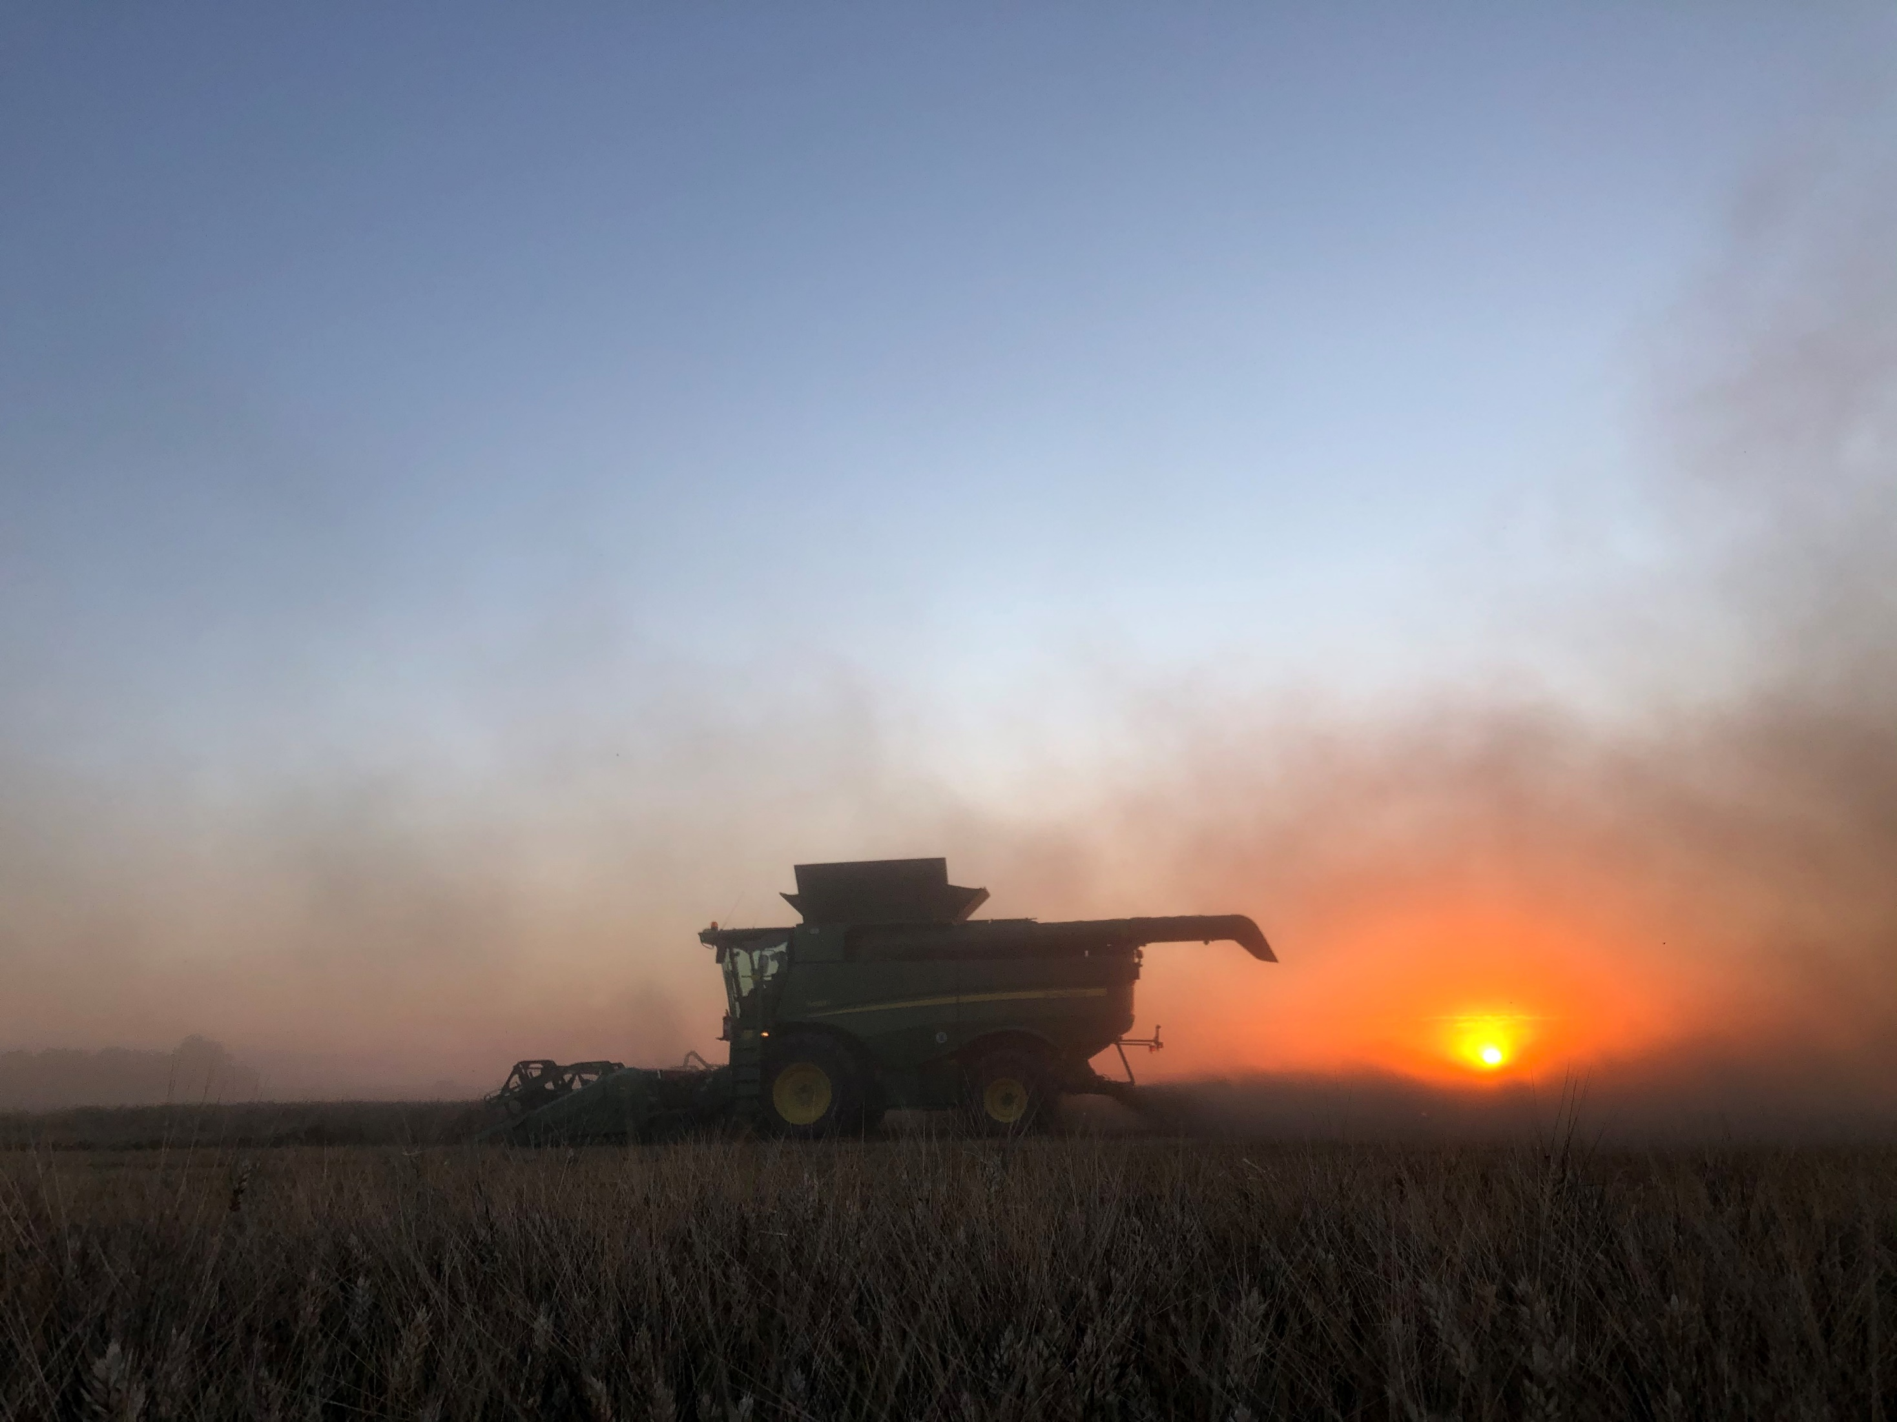
Thank you for your attention

