Slide 1
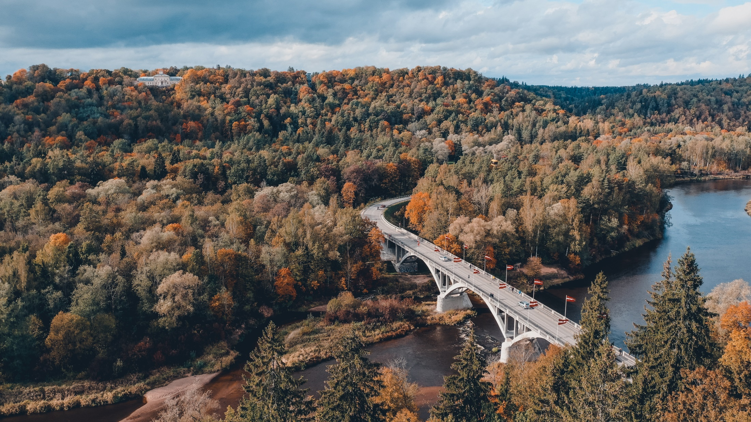
Discover Latvia
To those, who have already seen everything
Notes:
To those, who are already familiar with Latvia (Old Riga, Monument of Freedom and Turaida castle). Who have already visited Traida Castle and the Baltic sea and Jūrmala. A chance to see Latvia from a different point of view/in a different perspective.

Slide 2
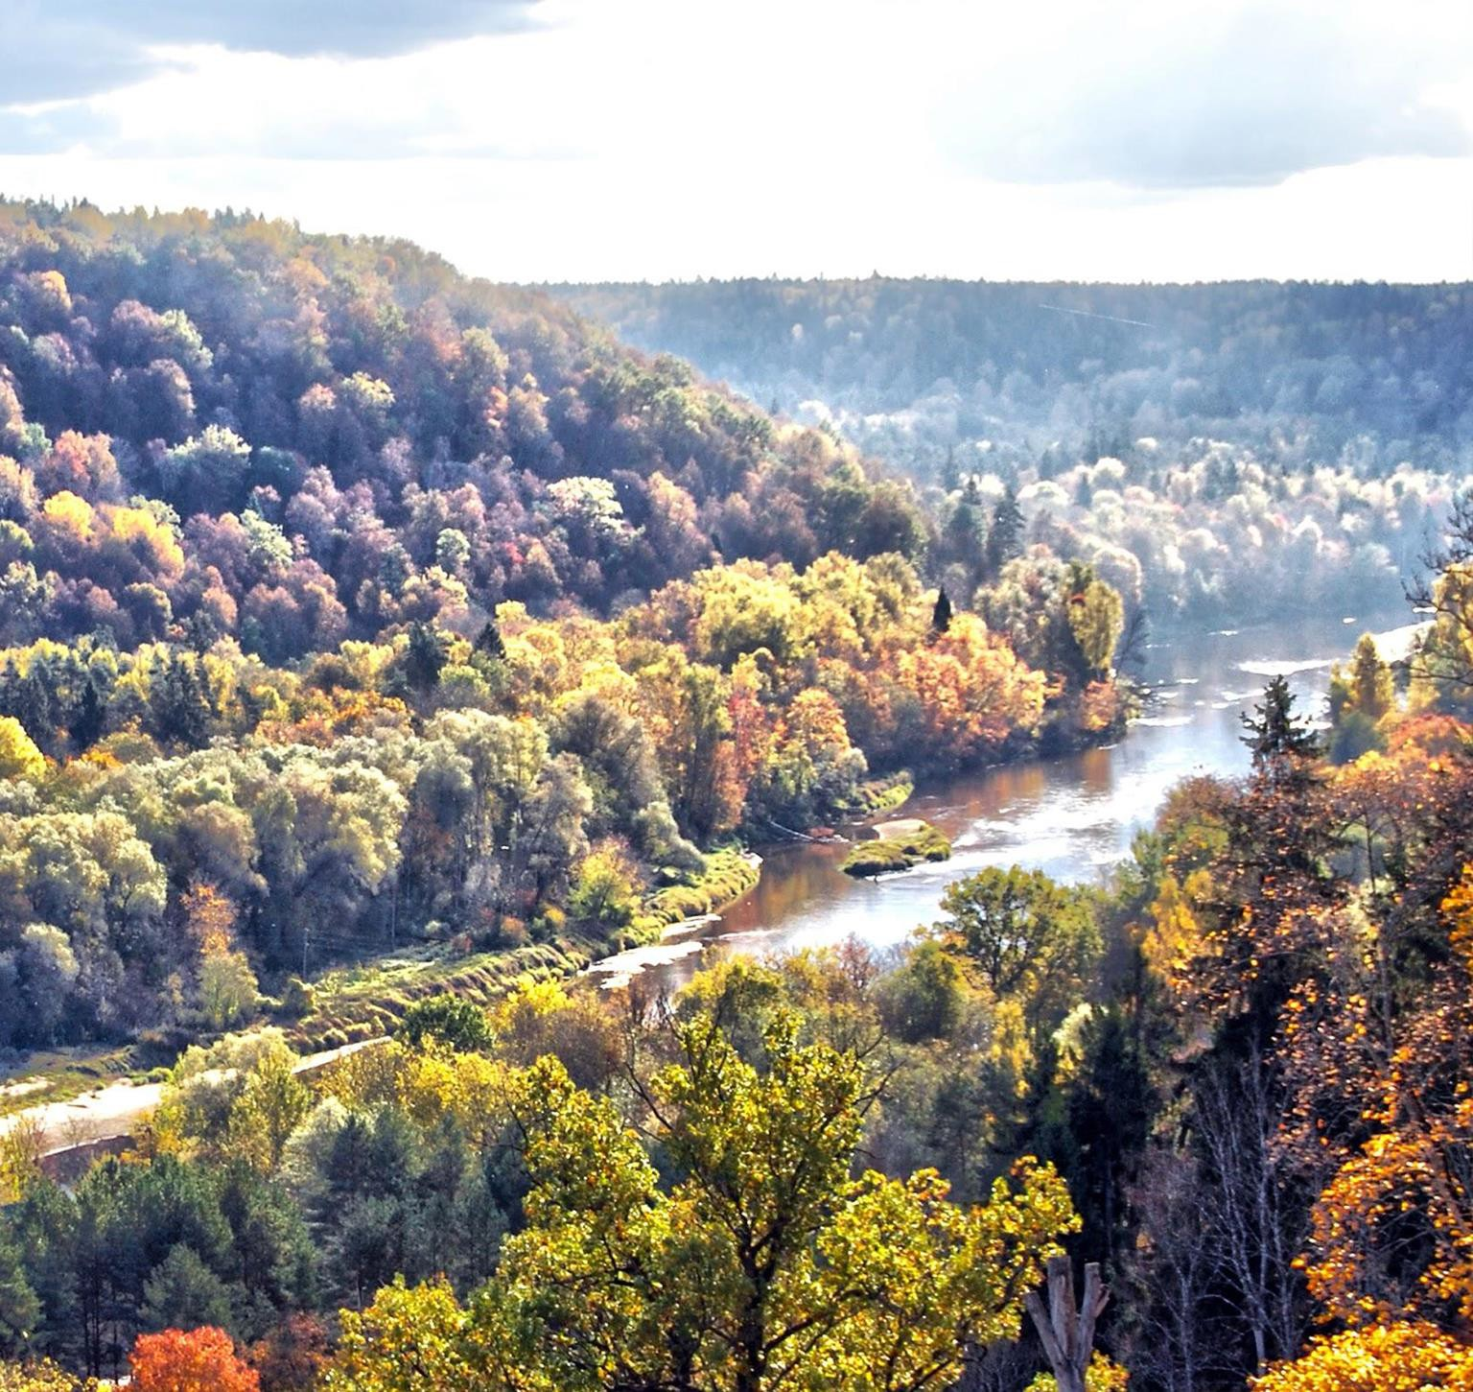
Location
Situated in Northern Europe, on the coast of Baltic Sea, linking the East and the West.
64,589 km² of scenic plains and rivers, lakes and hills, including a majestic coastline.

Slide 3
Latvia in
Europe

Slide 4
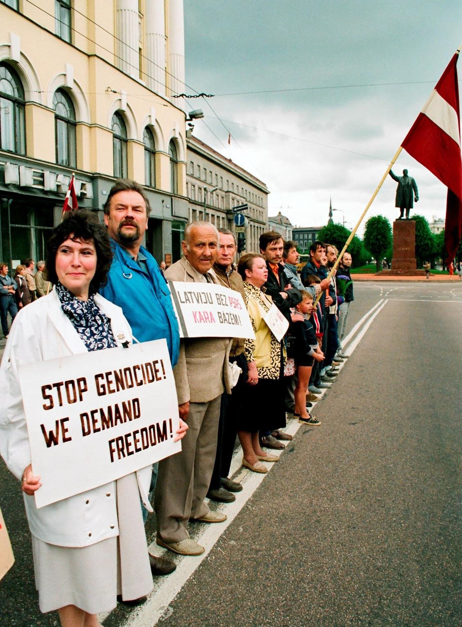
Freedom
After 50 years of Soviet and Nazi occupation (1940-1990), Latvia declared the restoration of independence in 1990 and regained it fully in 1991.

Slide 5
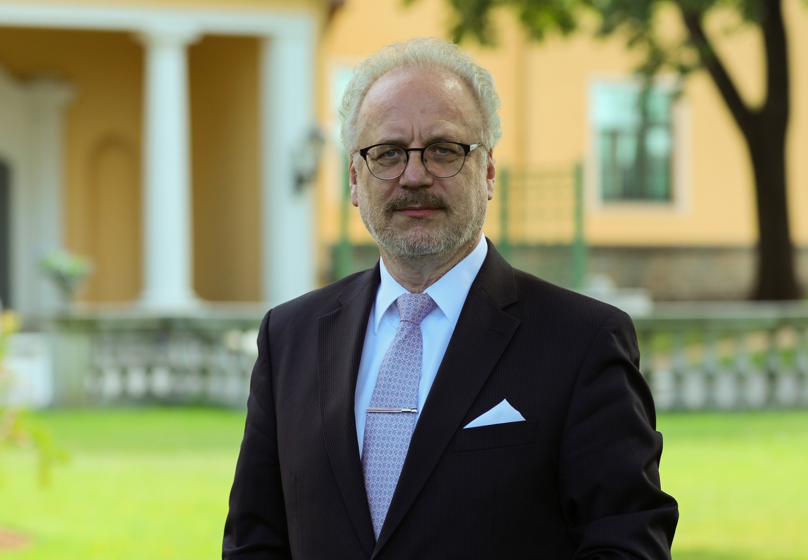
Egils
Levits
President

Slide 6
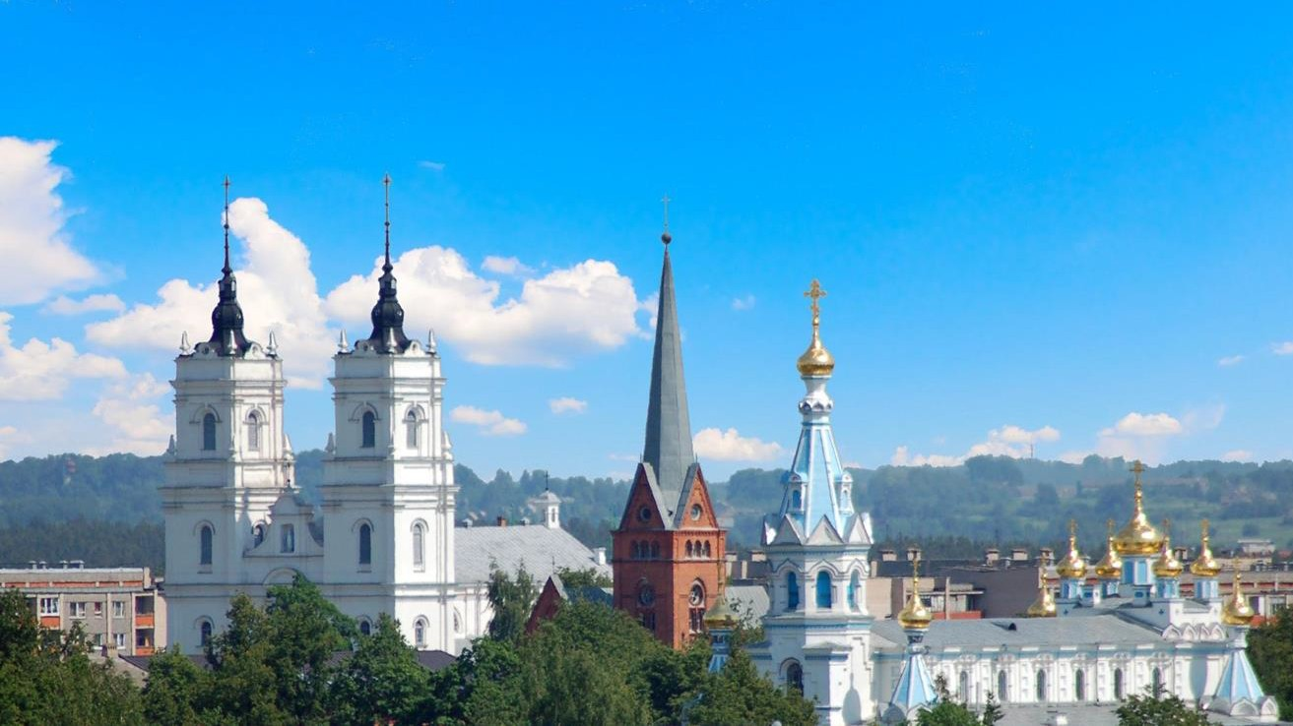
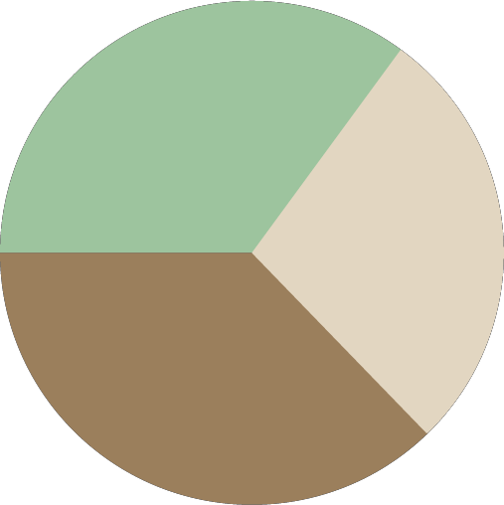
Religion
34%
Lutheran
27%
Eastern Orthodox
37%
Roman Catholic
Most believers in Latvia follow Christianity. Ecumenical tradition is important.
Latvian seasonal holidays have strong pre-Christian traditions.

Slide 7
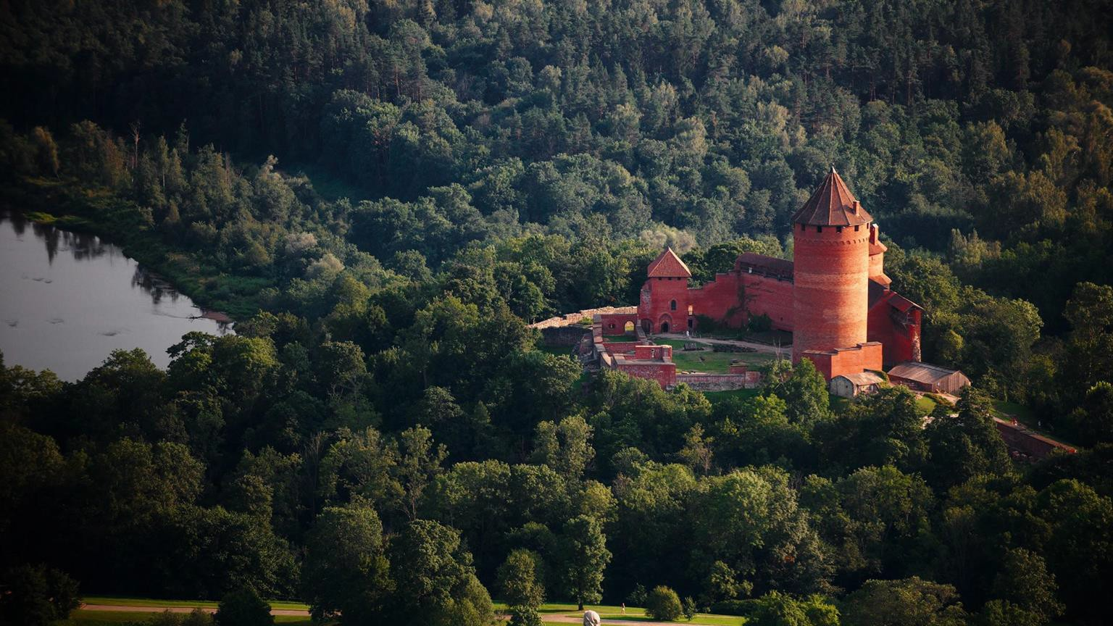
Heritage
Latvian cultural heritage dates
back well over a thousand years.

Slide 8
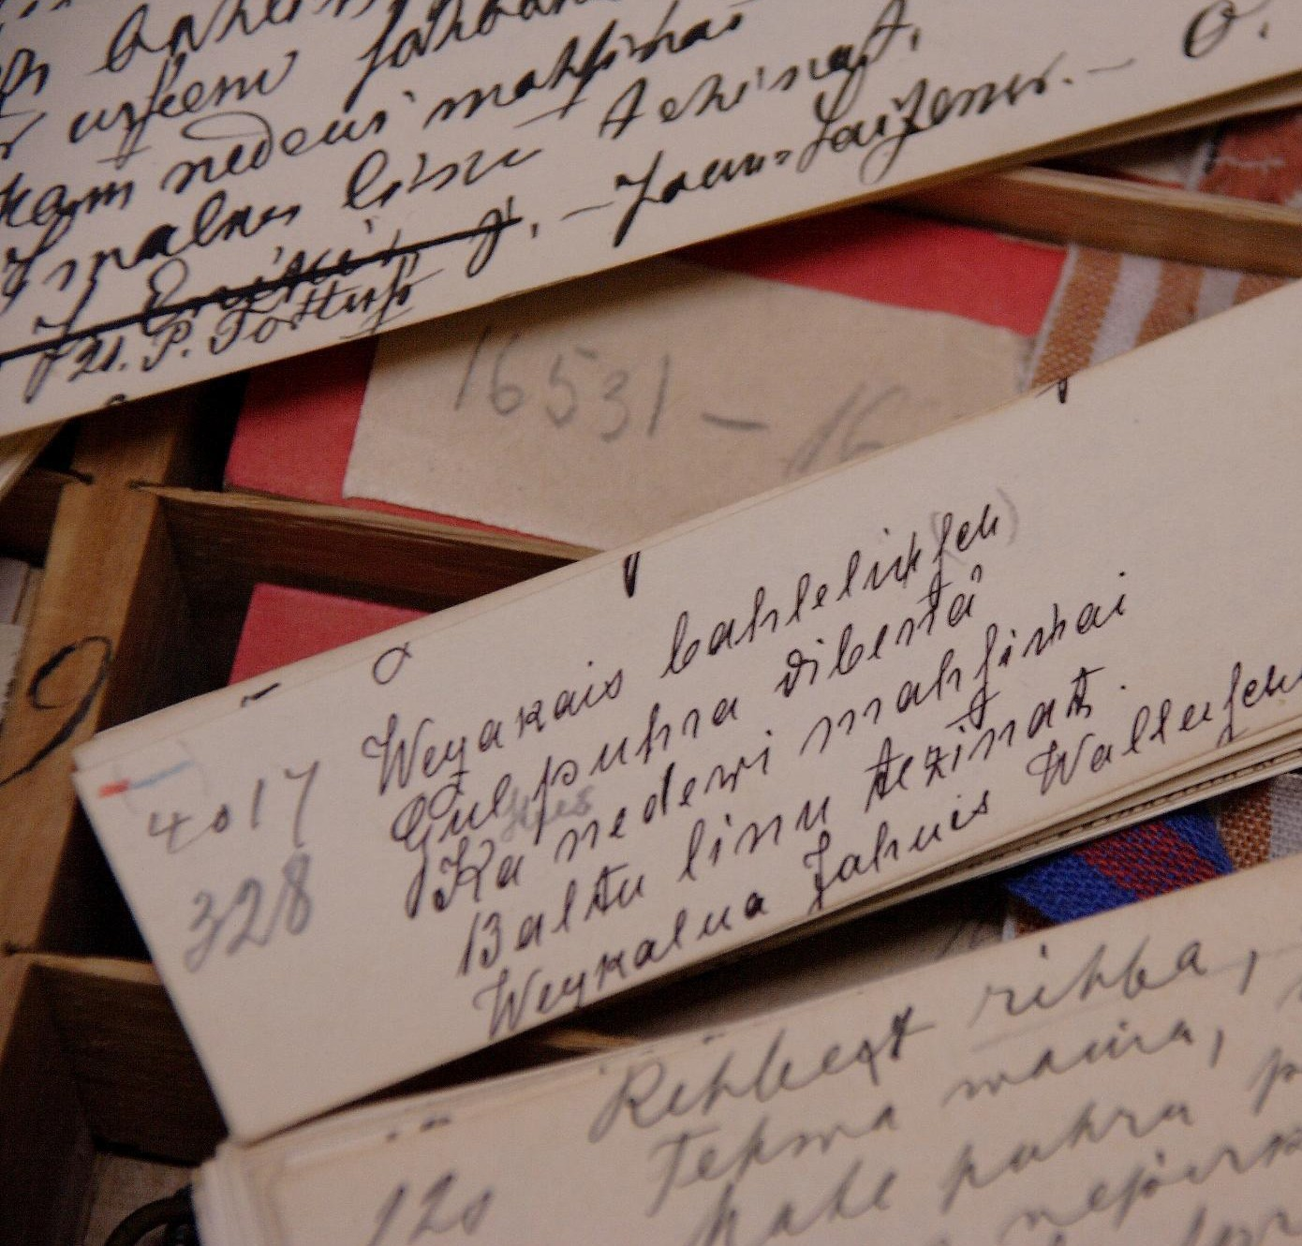
Language
Latvian is a Balt language, but neither Slavic nor Germanic.
Folksongs Dainas are a part of the UNESCO Memory of the World Register.
Popular foreign languages are English, Russian, German.

Slide 9
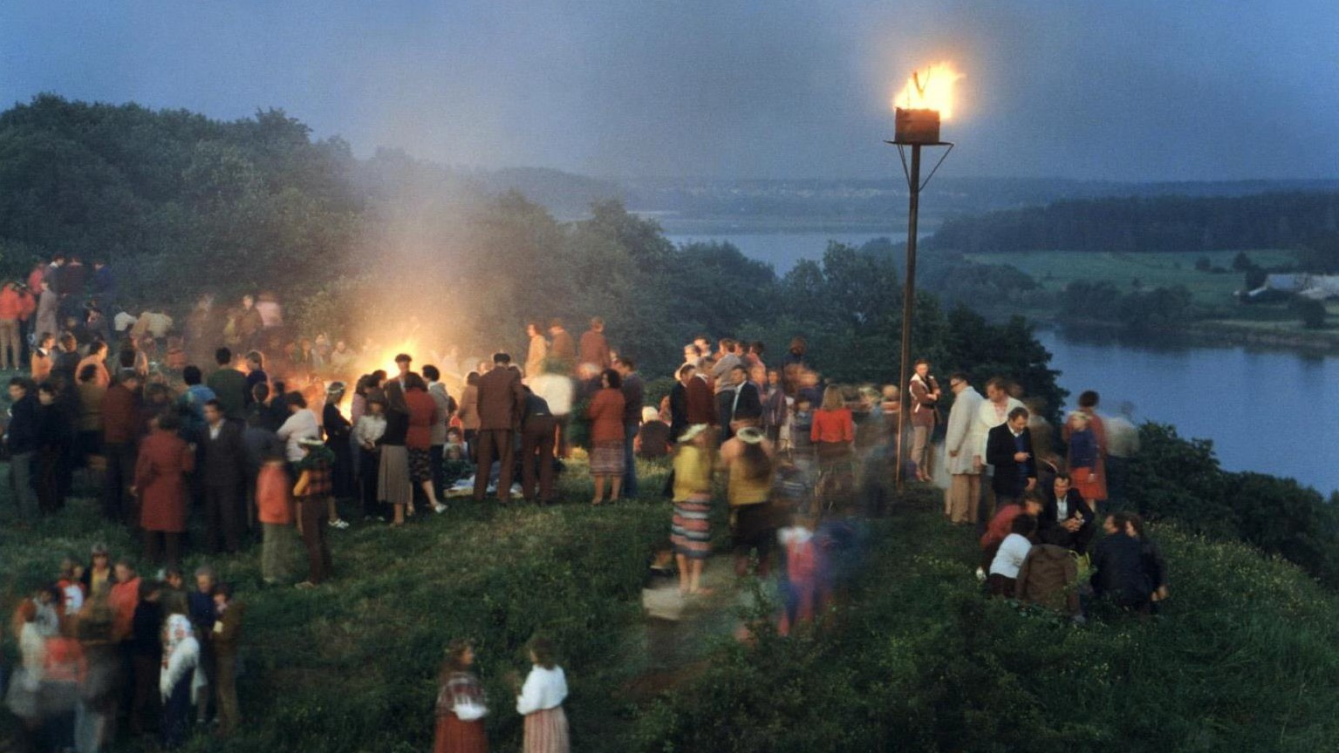
Summer Solstice
The celebration of the summer solstice Jāņi is one of the oldest and most popular pre-Christian traditions in Latvia.

Slide 10
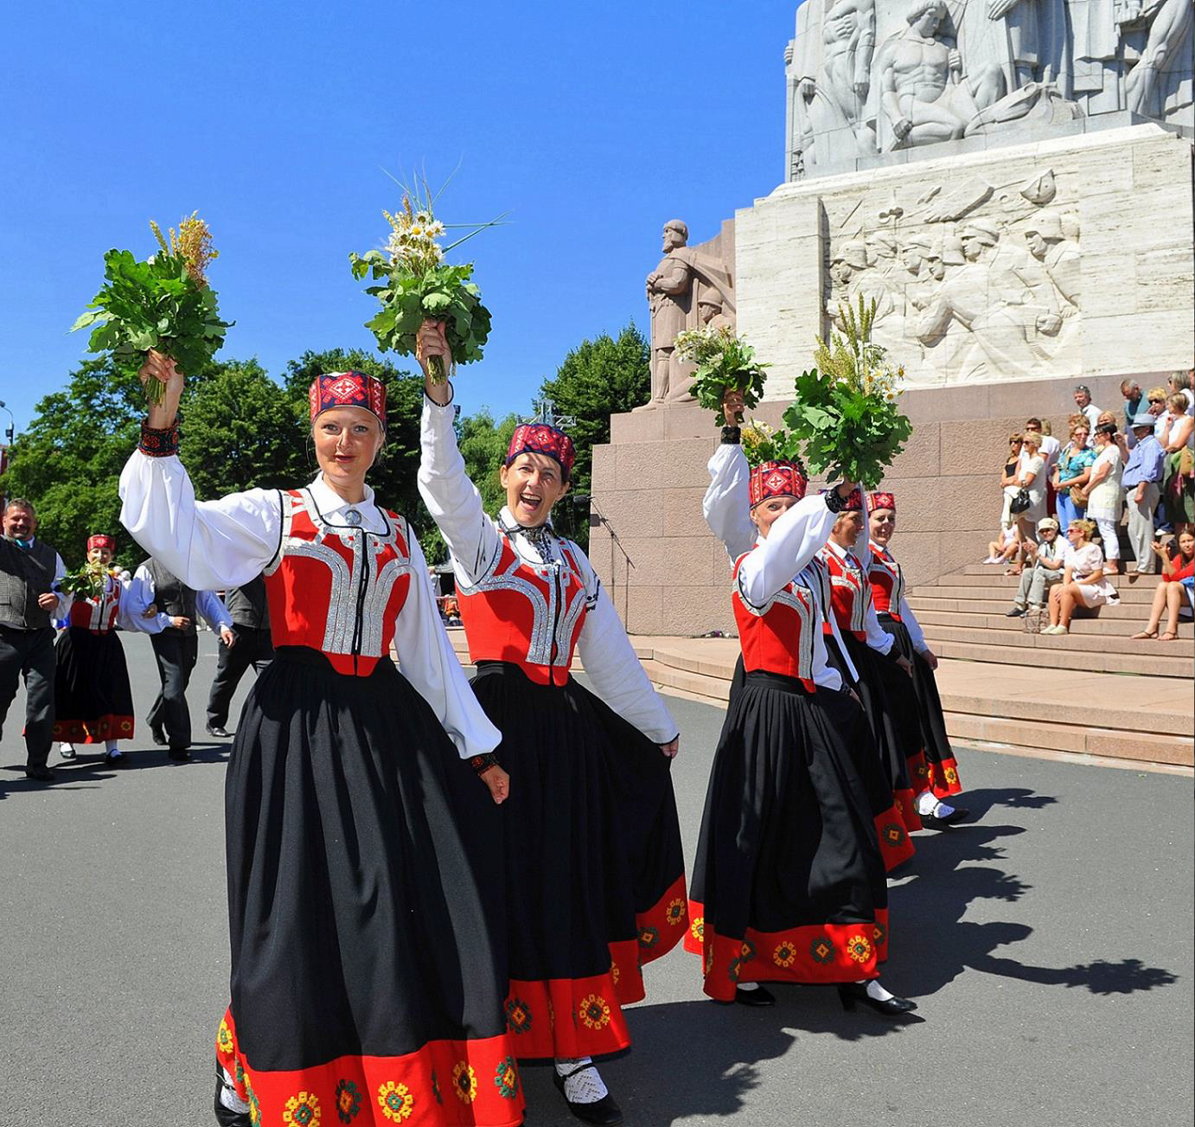
Song and
Dance Celebration
The Nationwide Song and Dance Celebration has thrived for 150 years.
40,000 participants,
2 million spectators.
UNESCO Masterpiece of the Oral and Intangible Heritage of Humanity.

Slide 11
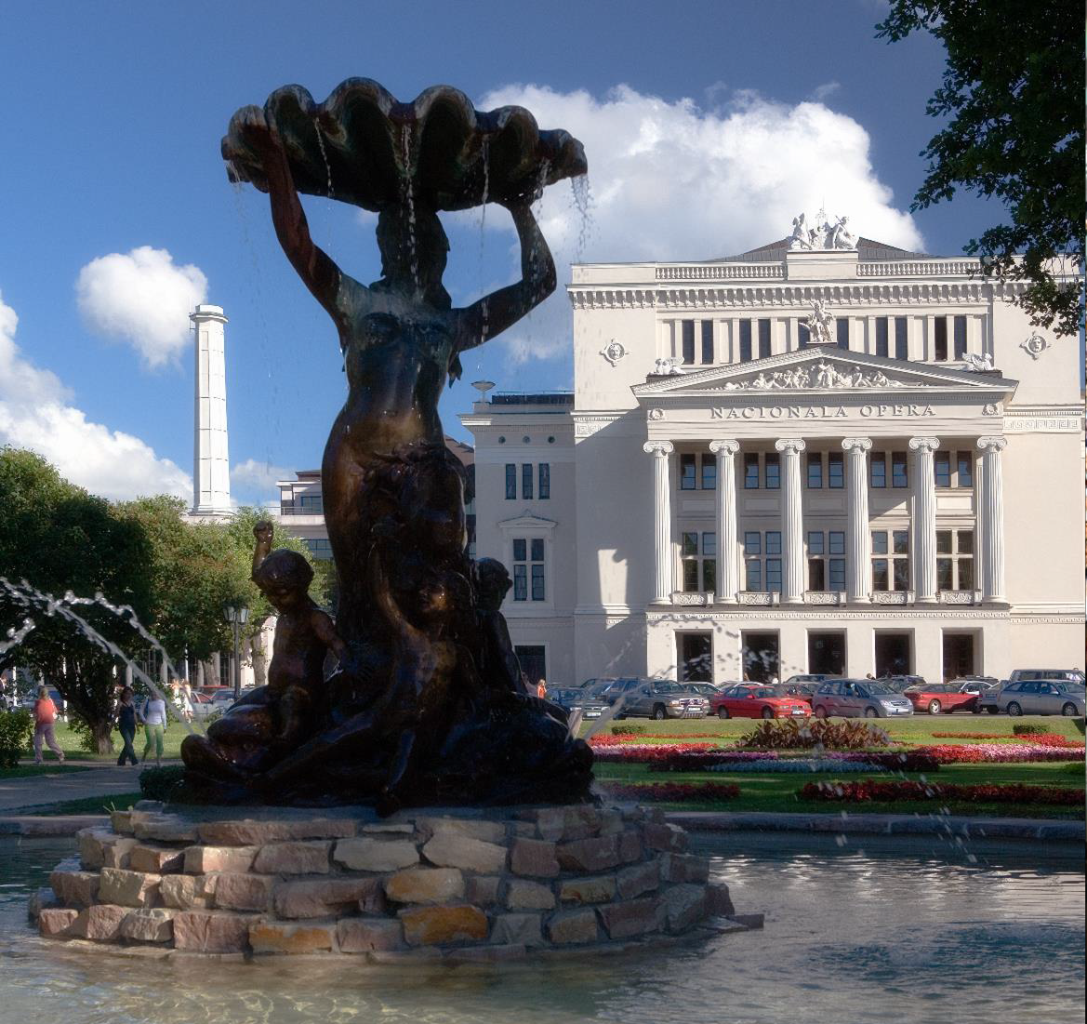
Performing
Arts
Latvian performers have stunned audiences all around the world.
Music, opera, ballet, theatre, cinematography, animation...

Slide 12
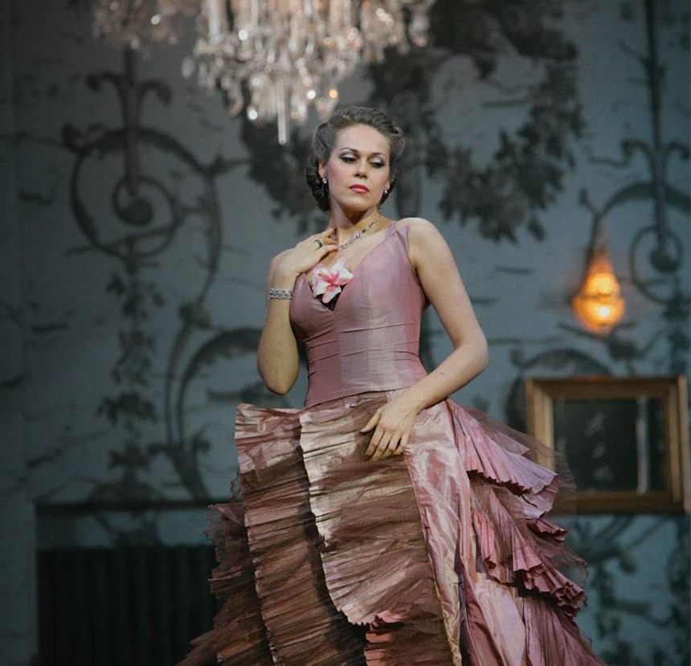
Classical
Pearl
Our opera singers, conductors, musicians and composers perform on the most prominent stages.
Elīna Garanča, Kristīne Opolais, Mariss Jansons and Pēteris Vasks are some of the most famous Latvian musical figures globally.

Slide 13
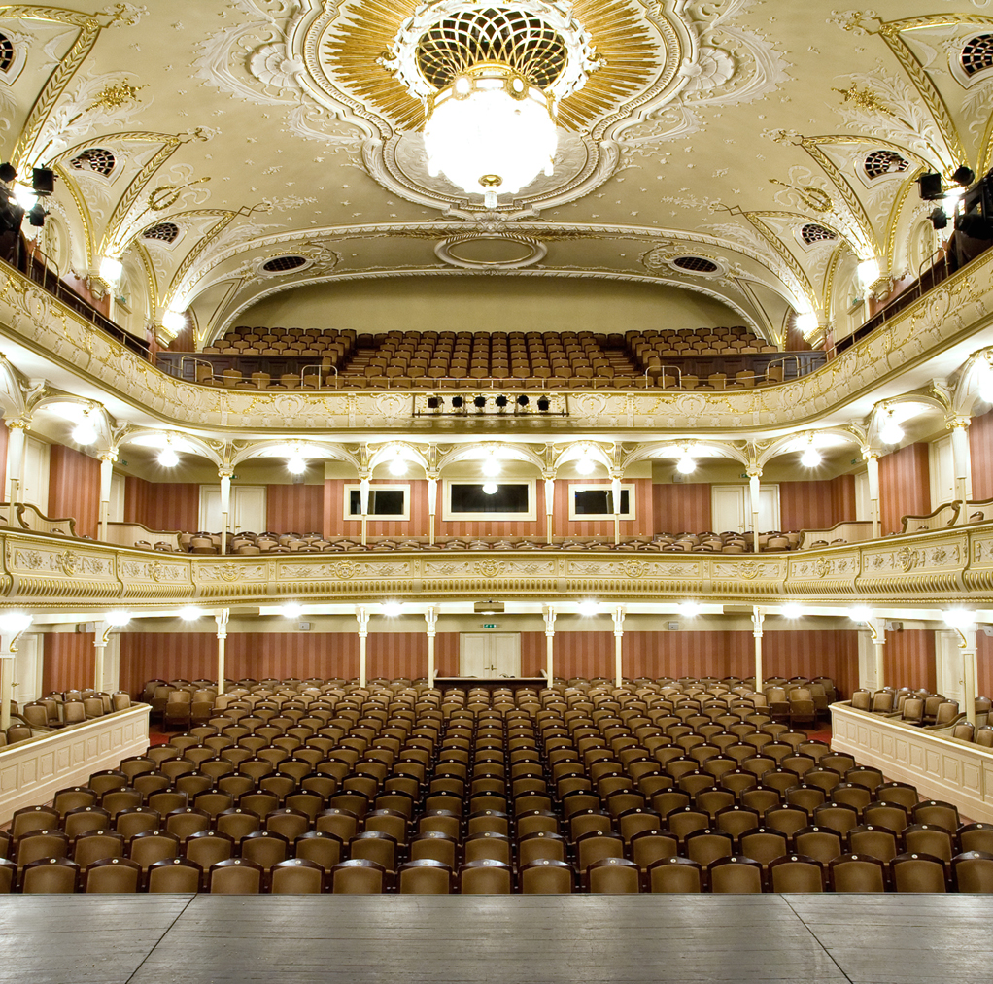
Theatre
Going to the theatre is a much loved occasion. Riga has the busiest theatre scene, but all cities and towns have their own stages, including open-air theatres.
Alvis Hermanis is one of the leading directors in Europe. Other big names in theatre are Vladislavs Nastavševs, Andrejs Žagars, Māra Ķimele.

Slide 14
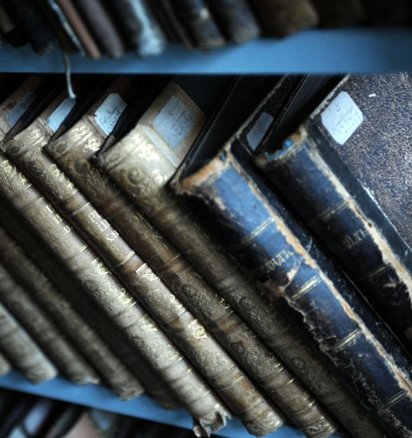
Literature
Lit­er­a­ture and writers helped crys­tal­lize the idea of the Lat­vian state and bring forth the courage to lay its foun­da­tions.
Inga Ābele, Nora Ikstena, Kārlis Vērdiņš, Inese Zandere, Jānis Joņevs are just few contemporary Latvian talents whose works have been translated into English, French, Czech and other languages.

Slide 15
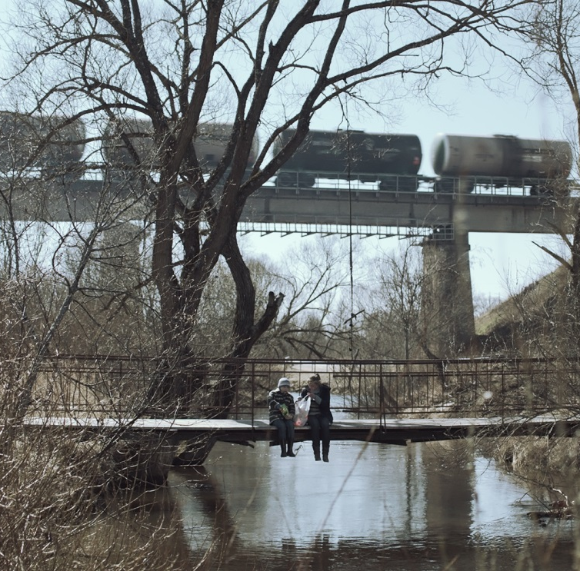
Film Industry
The Lat­vian film in­dus­try will charm you with un­usual sto­ries and tal­ented sto­ry­tellers.
Laila Pakalniņa, Jānis Nords and Renārs Vimba are international recognition film directors.
Latvia also is a great place for shooting both historical and contemporary films.

Slide 16
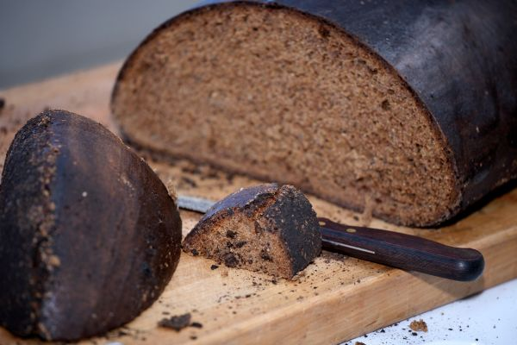
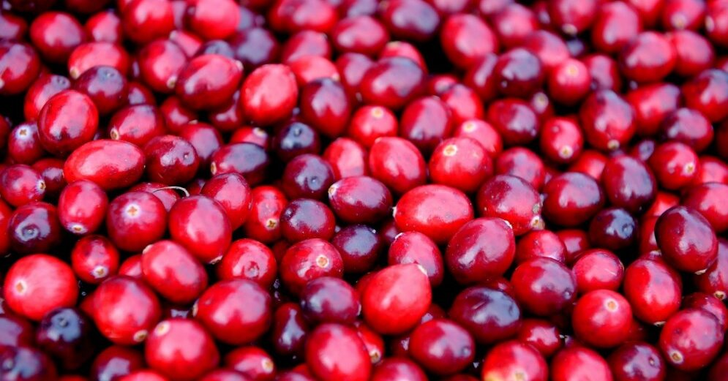
Speciality Food Items
Rich in fibre, vitamins and antioxidants, rye bread is the monarch of Latvian cuisine.
Succades from high-quality dried fruits, berries and vegetables are excellent snacks.

Slide 17
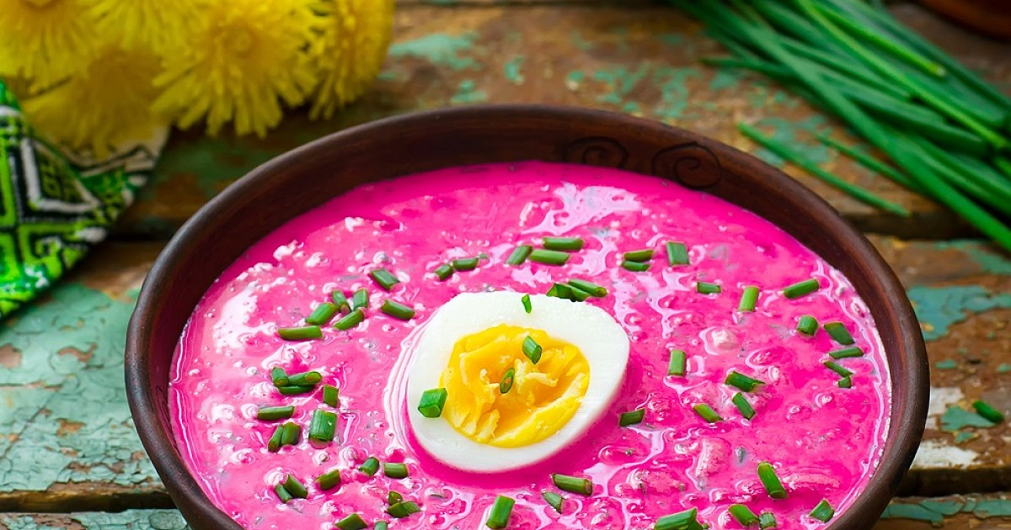
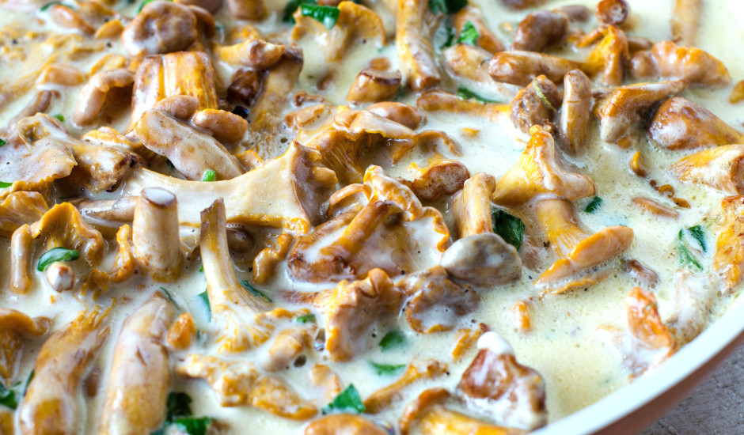
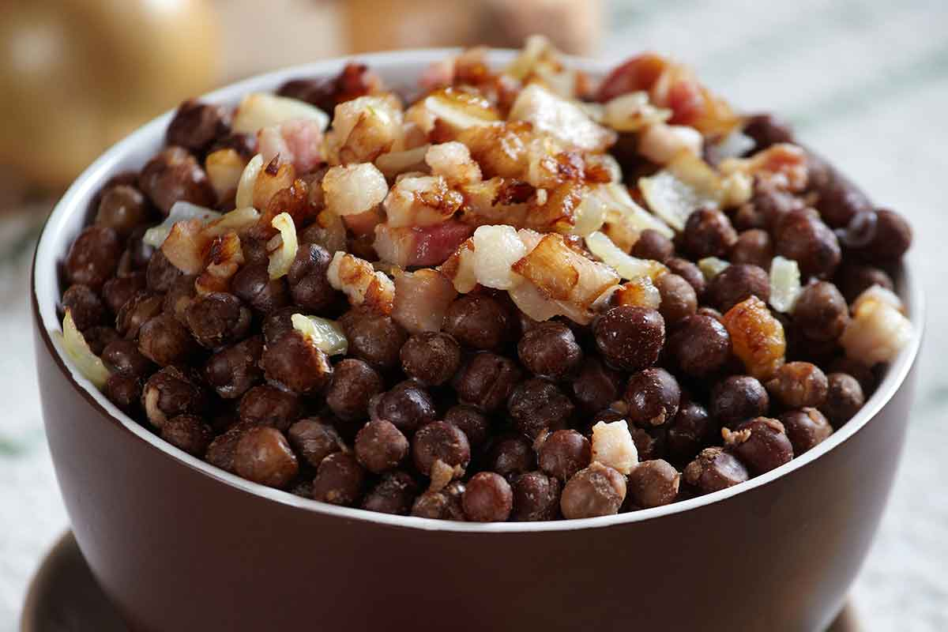
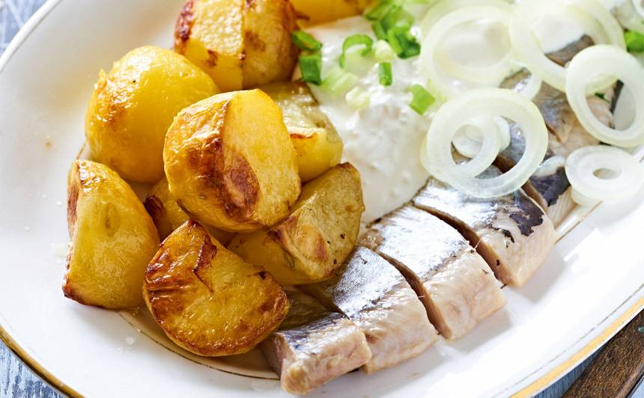

Slide 18
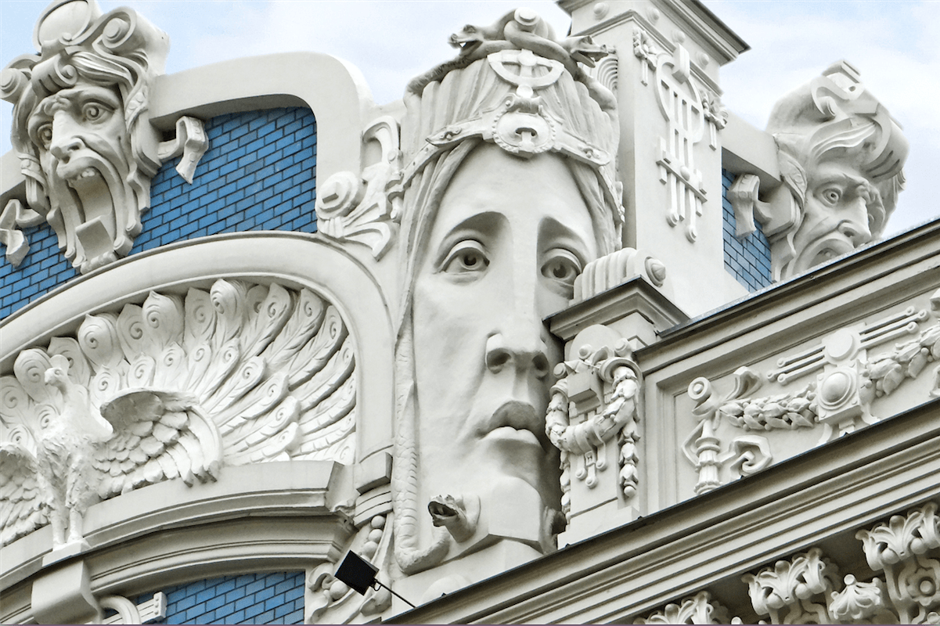
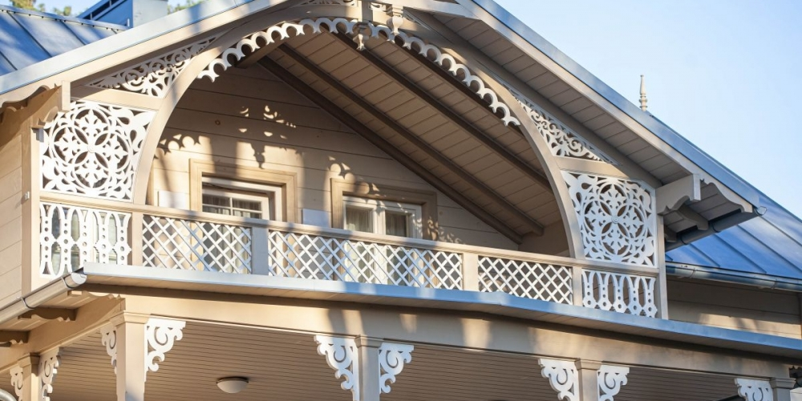
Architecture
Latvia’s rich architectural traditions thrive on imagination and innovation,
evident in buildings.

Slide 19
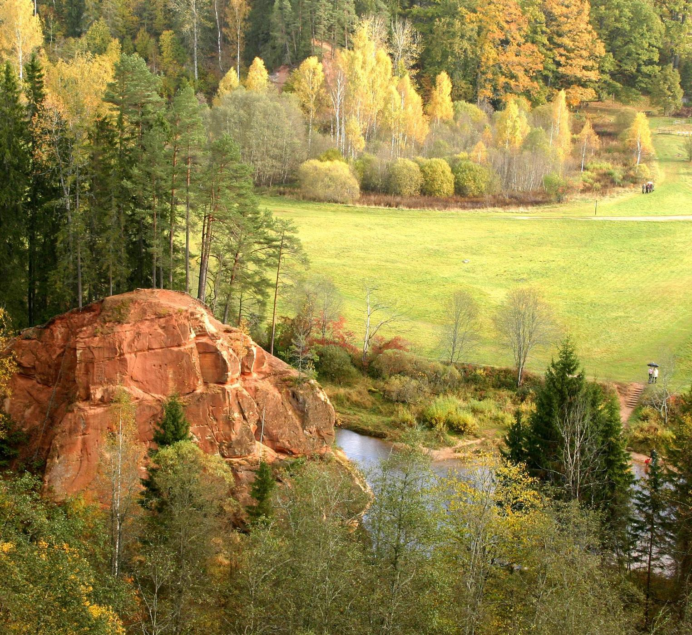
Nature
Latvia can truly be viewed as one huge nature park – white sandy beaches, green forests, clean air and water, and a pristine ecosystem.
Latvia is among the greenest countries in the world.

Slide 20
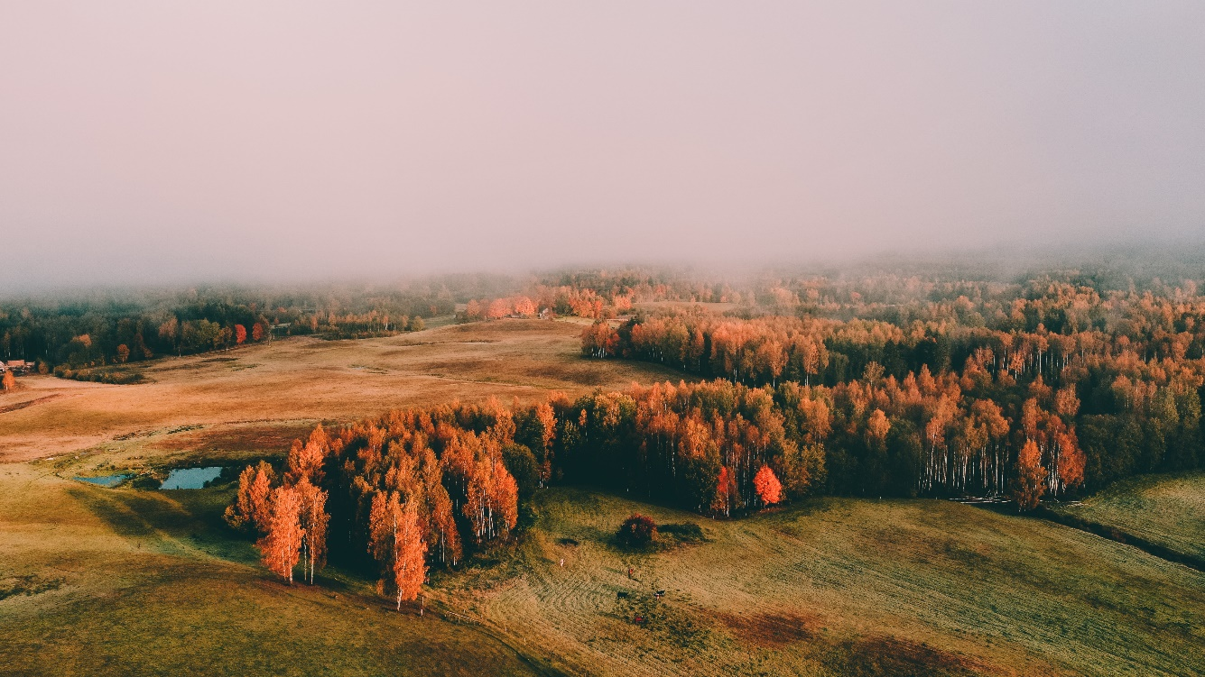
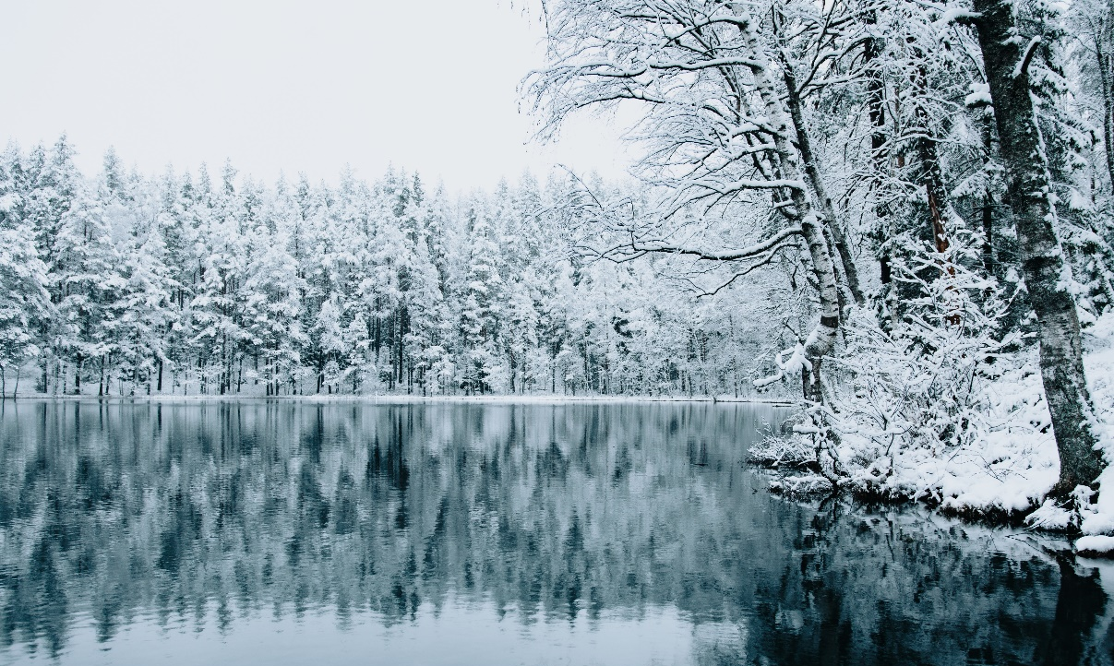
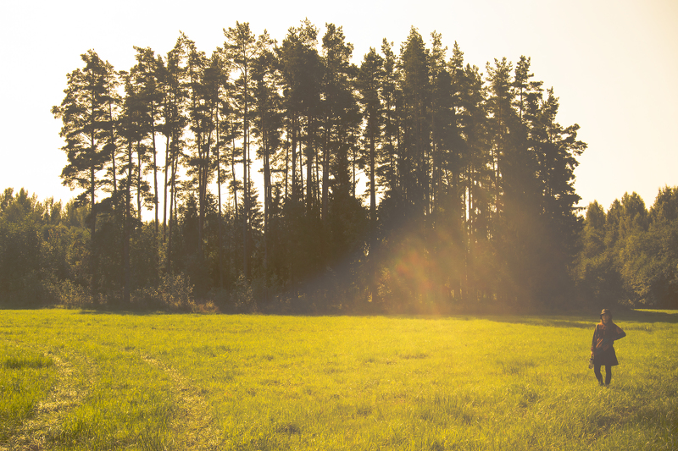
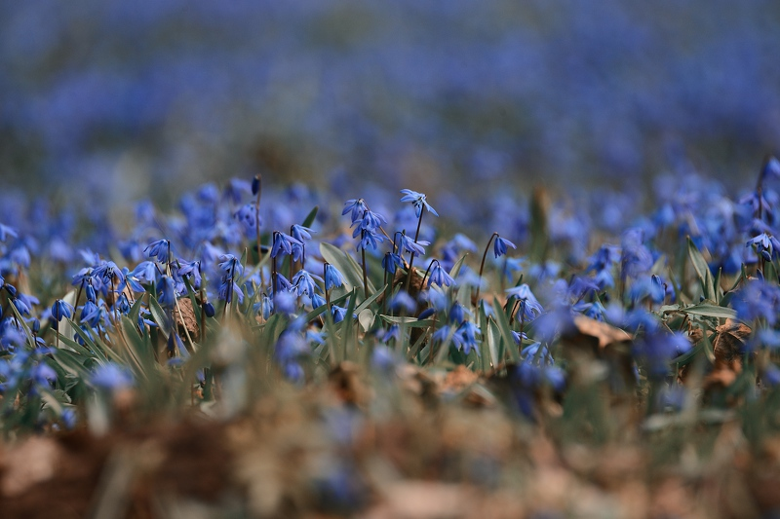
Latvia has 4 beautiful seasons,
that will amaze you

Slide 21
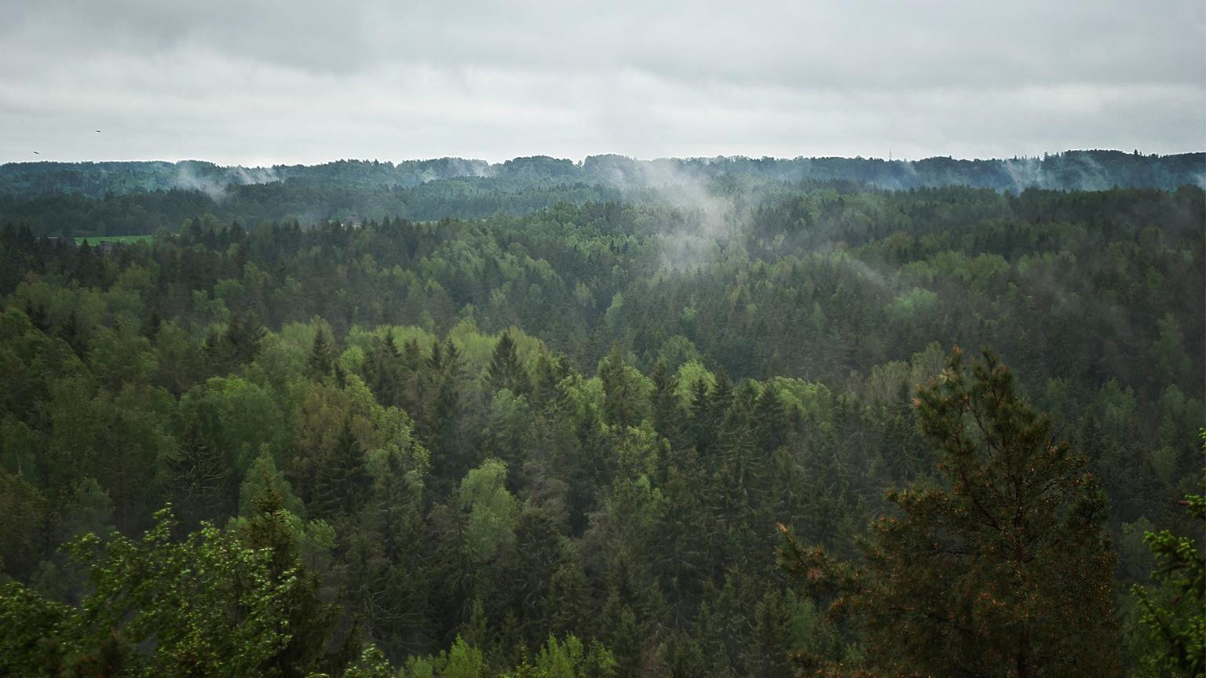
Forests
Only half of Latvia is not covered by lush forests.

Slide 22
The longest beach in Europe. 500 km of white sand coastline. 2 256 lakes and
12 500 rivers.
Waters

Slide 23
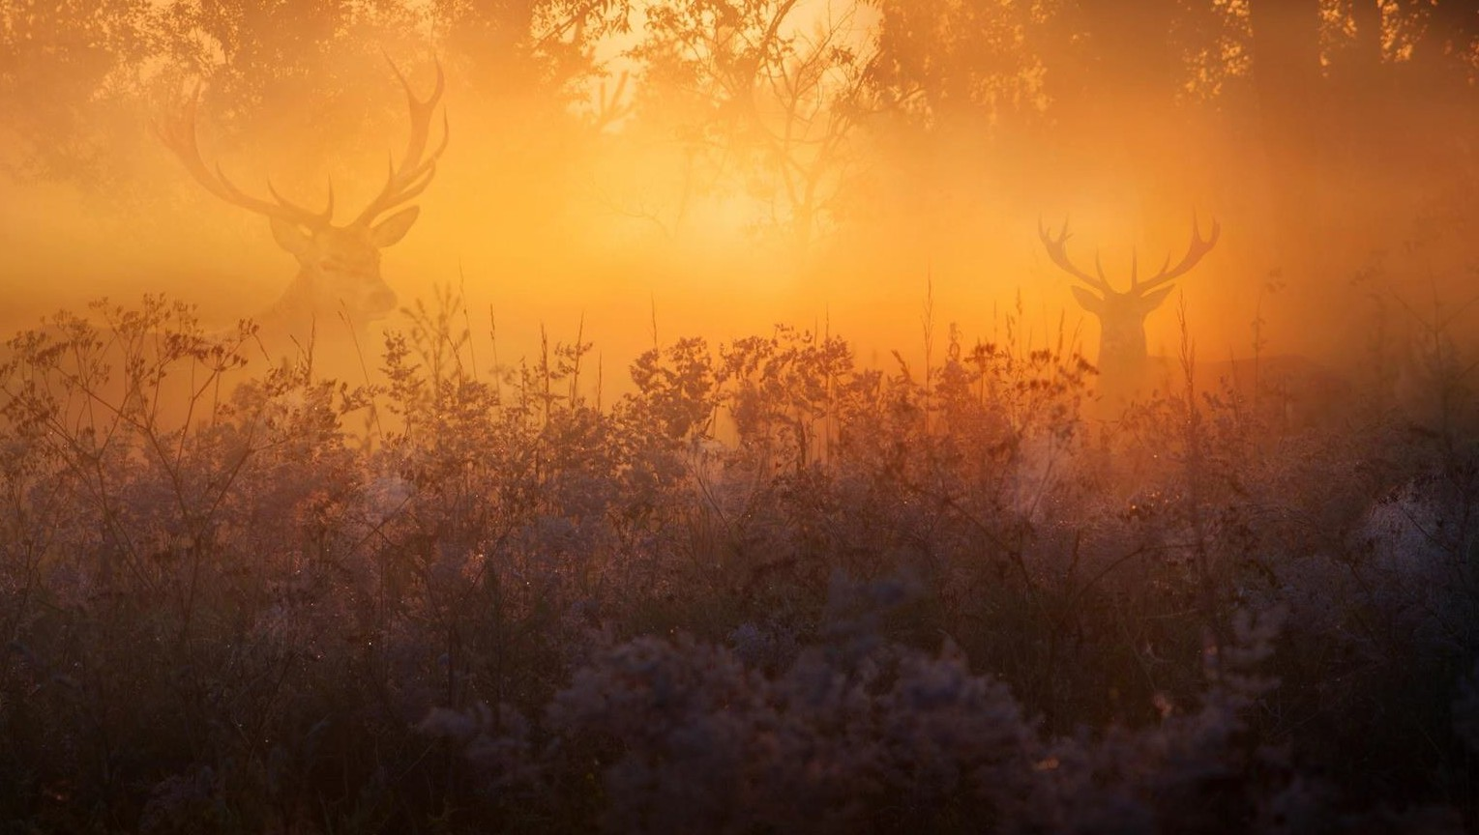
Wildlife
Latvia is home for variety of species, including many extinct in the rest of Europe.

Slide 24
Visit Latvia

Slide 25
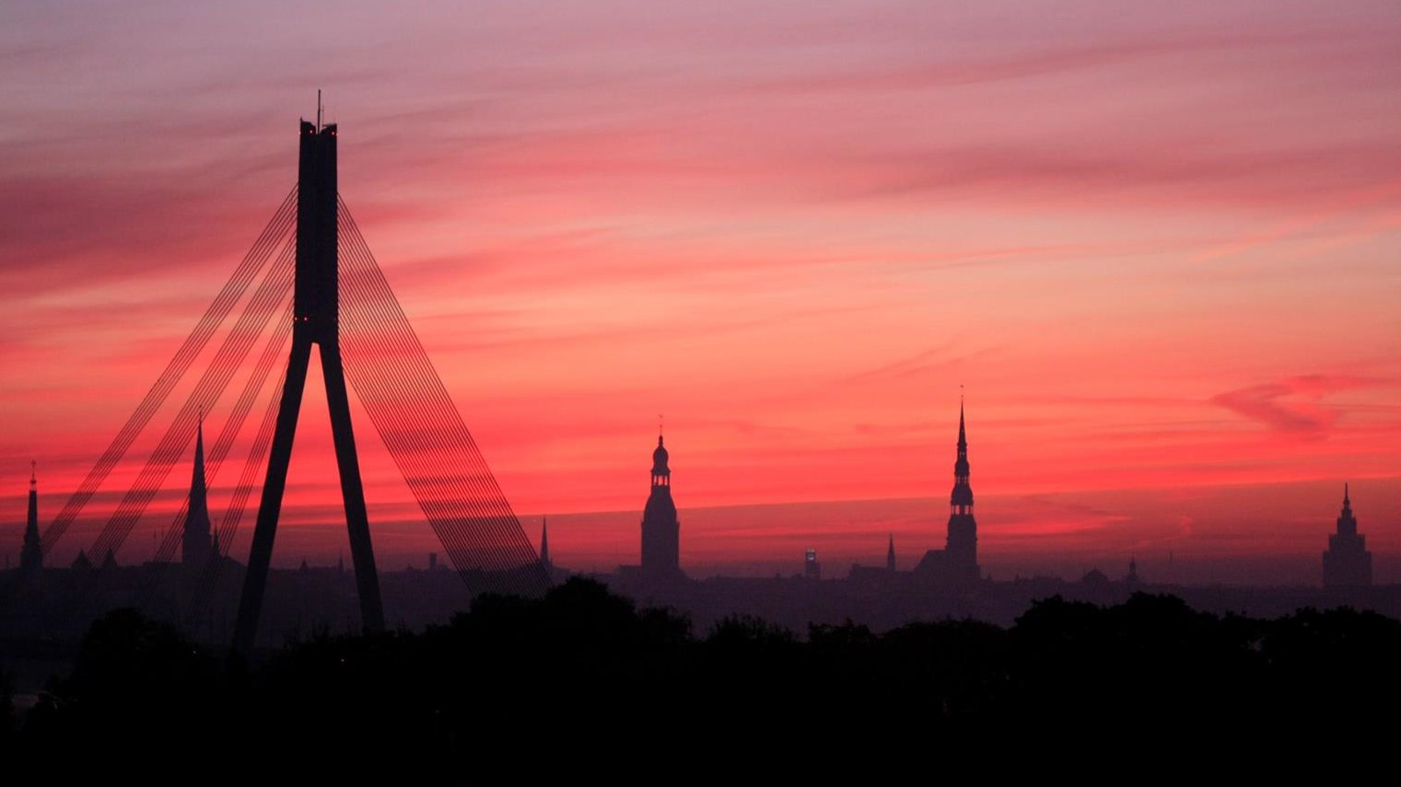
Rīga
Population – 698,529
The capital of Latvia, founded in 1201. Home to ⅓ of Latvia’s population. Financial and economic hub.
Popular tourist destination.

Slide 26
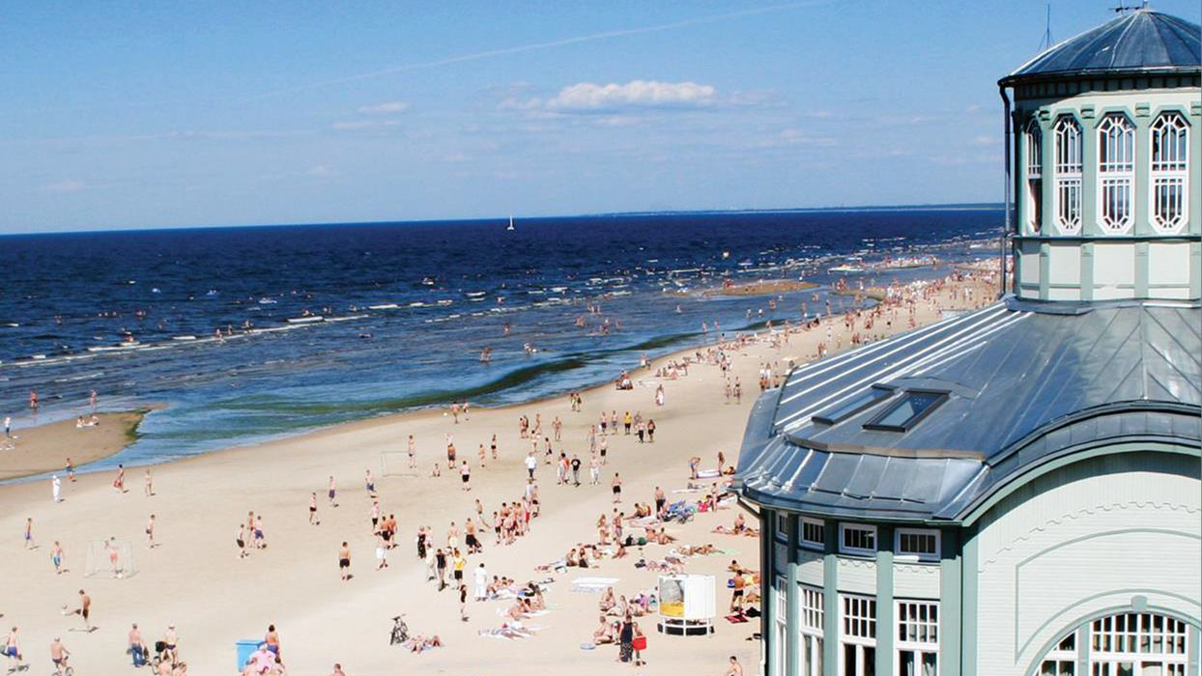
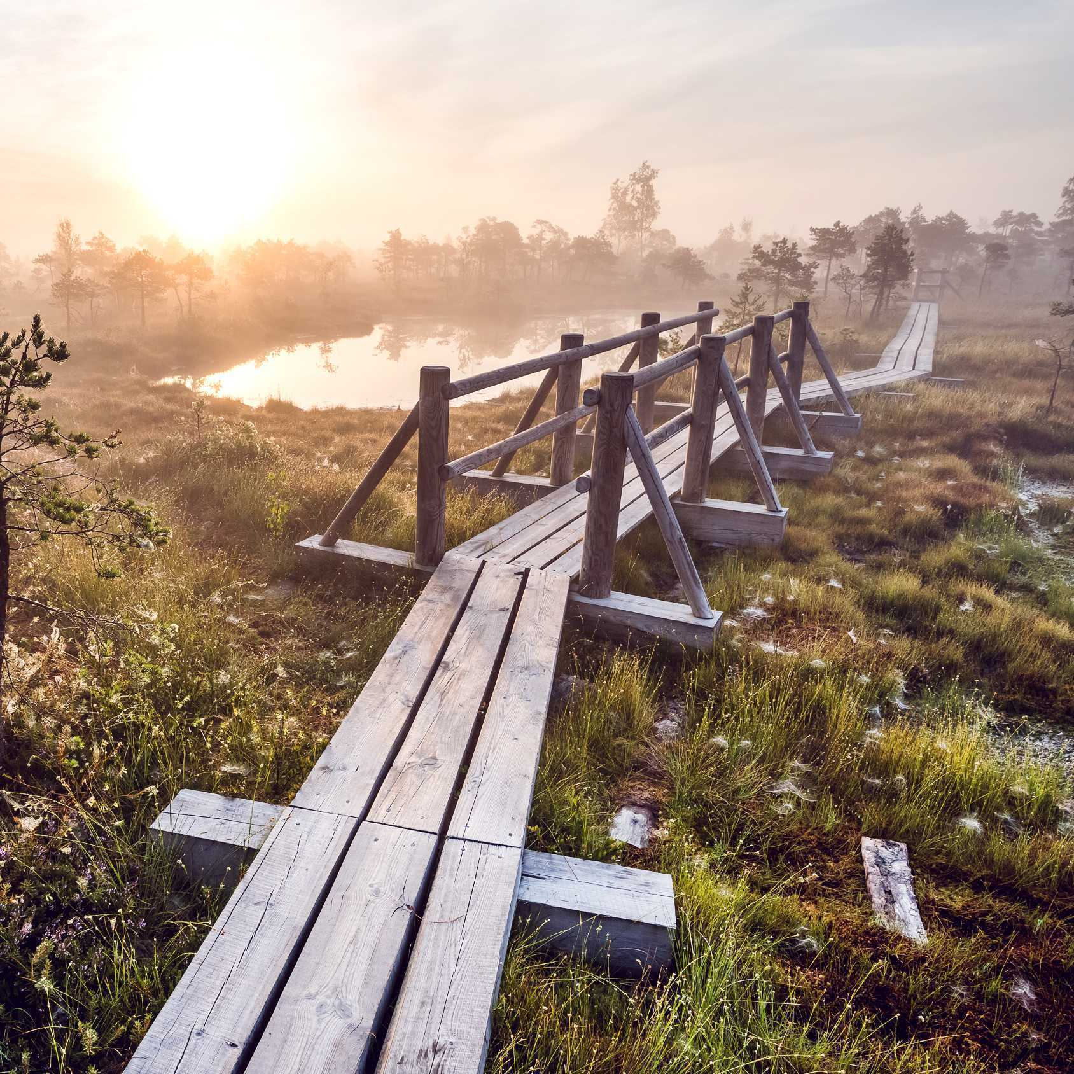
Jūrmala
Population – 57,371
The largest resort city in the Baltics, famous for its ideal sandy beaches and exclusive spas.

Slide 27
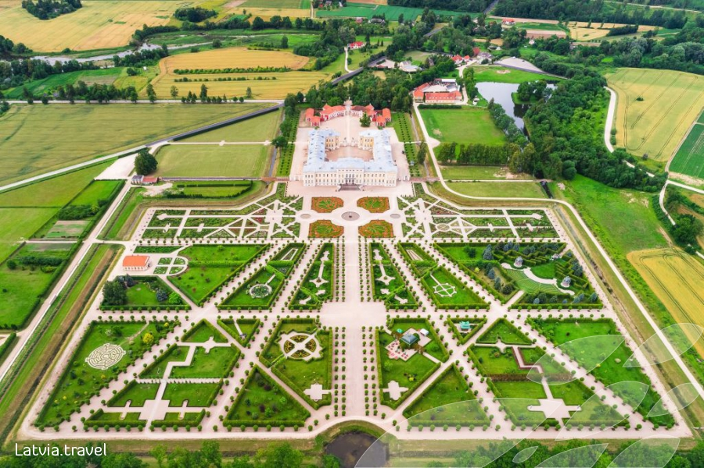
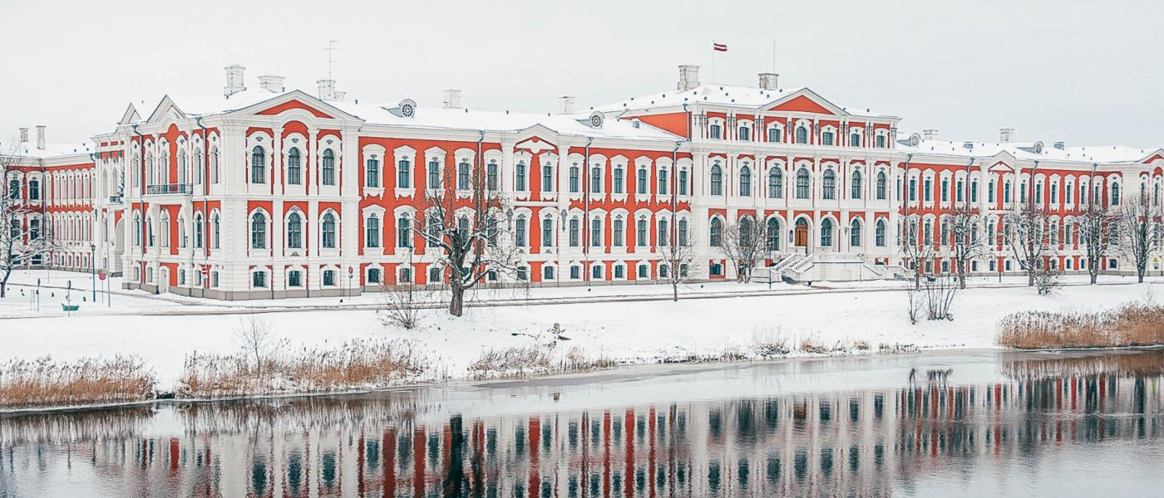
Rundāle and Jelgava Castle

Slide 28
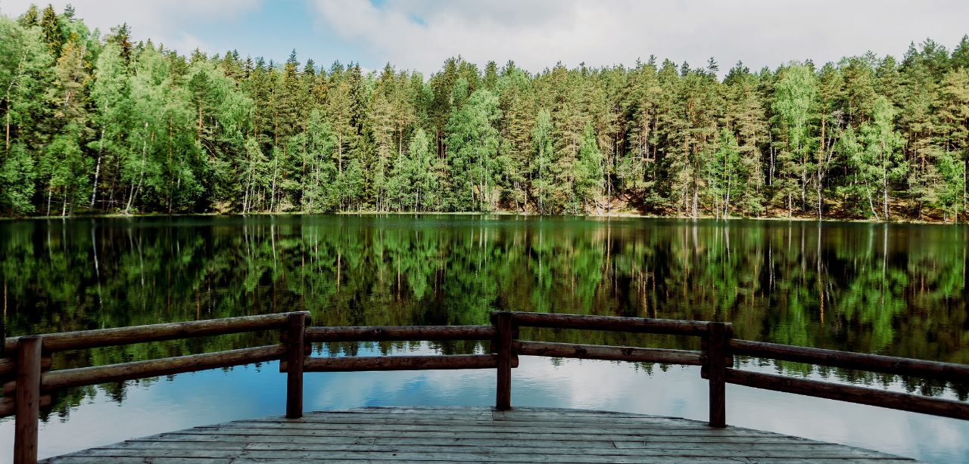
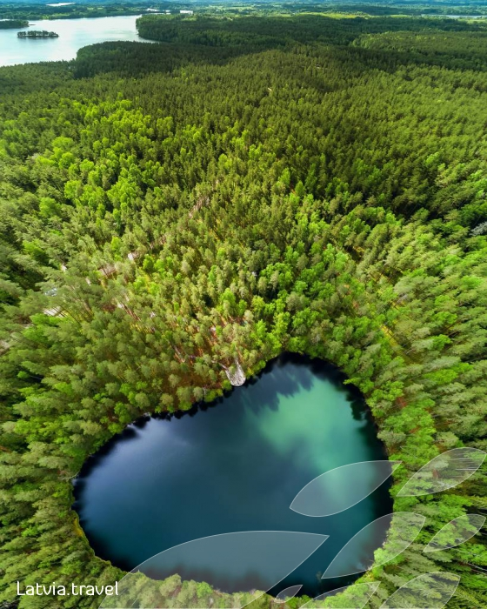
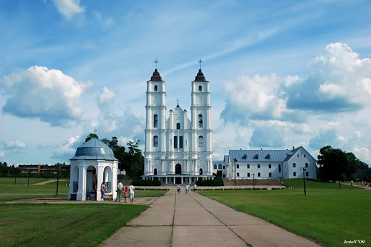
Aglona Basilica
Čertoka lake

Slide 29
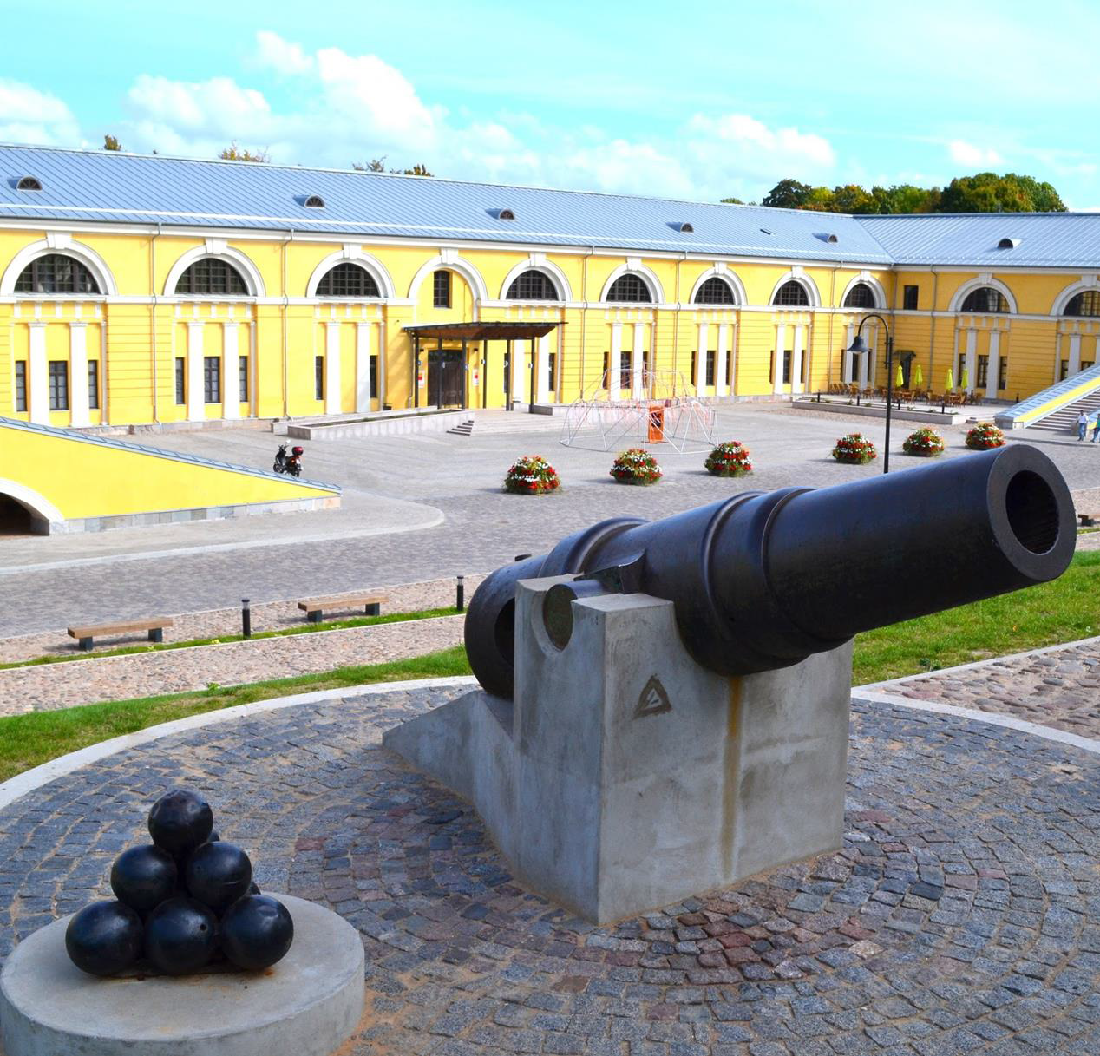
Daugavpils
Population –95,467
The leading city of the „land of thousand lakes” - Latgale.
Hometown of Mark Rothko, expressionist painter in USA.

Slide 30
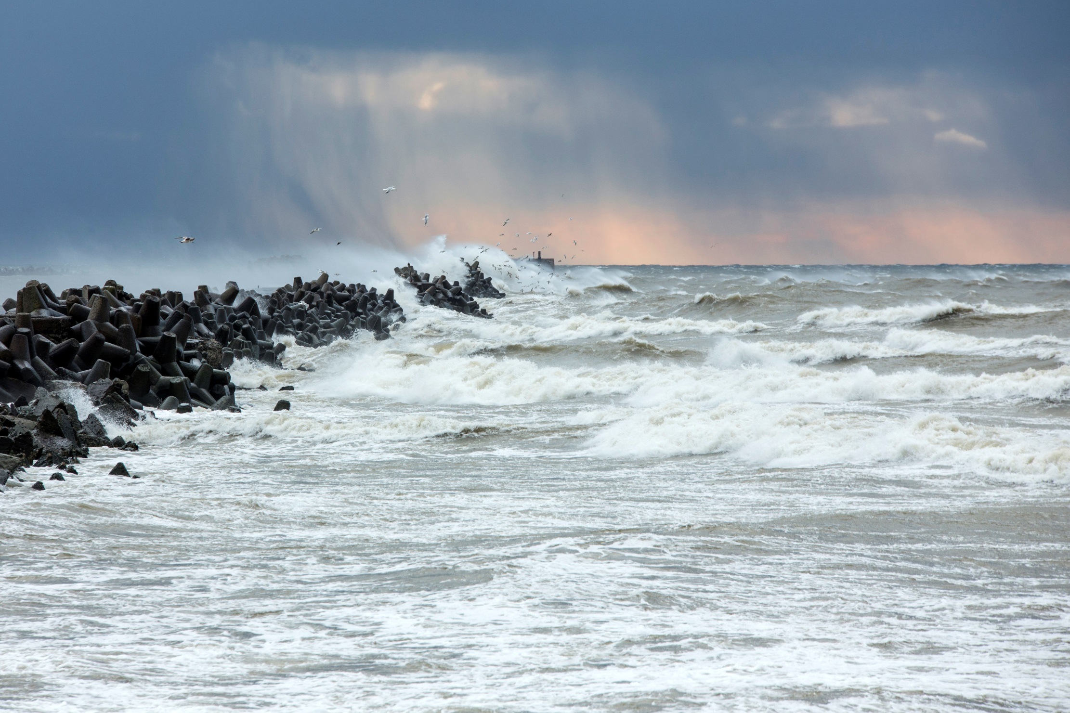
Liepāja
Population – 78,144
Important ice-free port hosting a 1890’s naval base.
„The city where the wind is born”.
Latvia’s rock-and-roll capital.

Slide 31
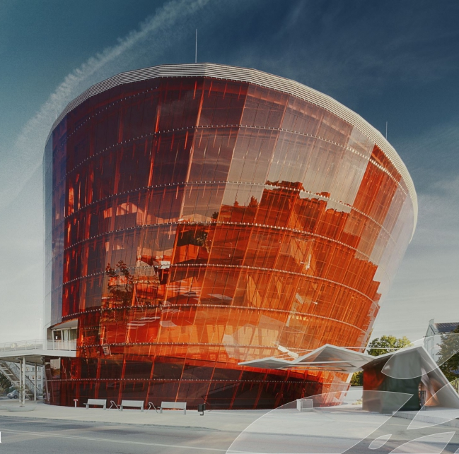
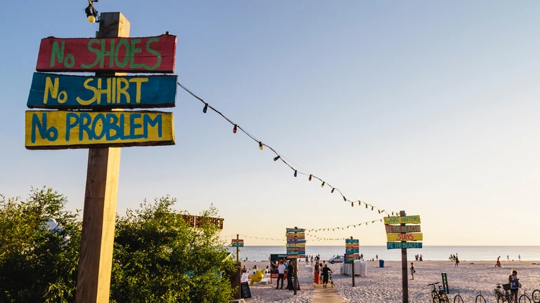
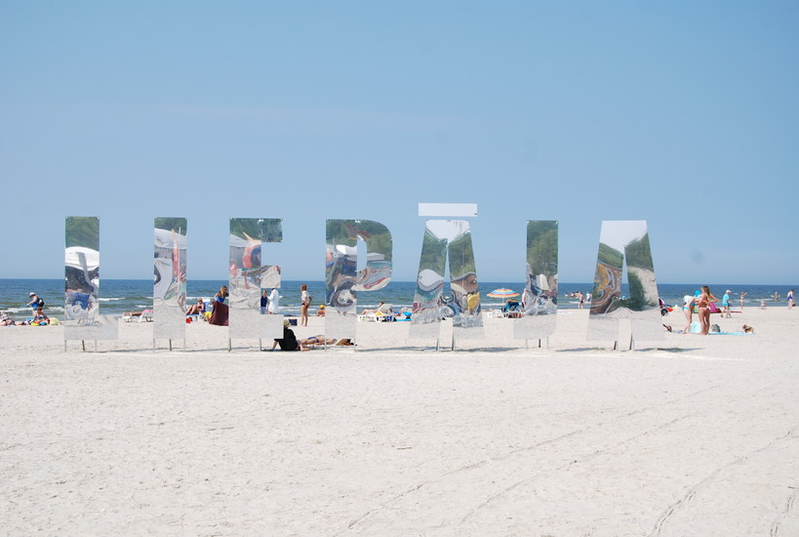
Concert Hall «the Great Amber» in Liepāja

Slide 32
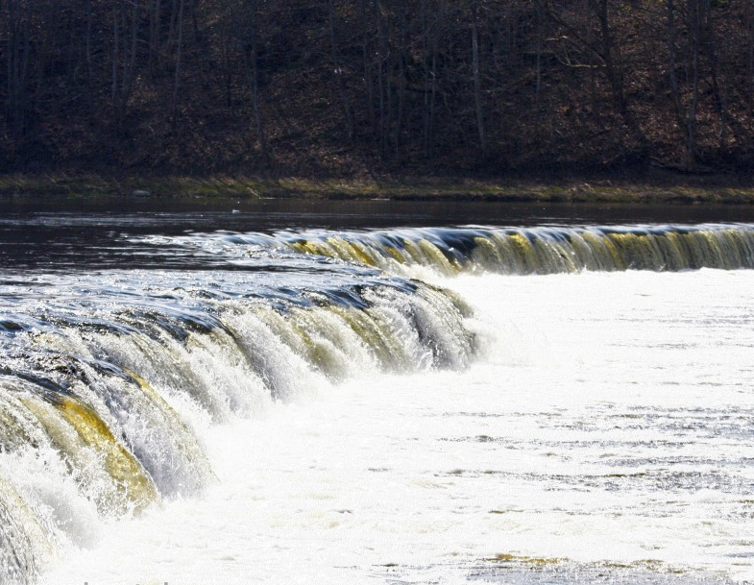
Kuldīga
Population – 11,768
One of the longest brick bridges in Europe overlooks the widest waterfall in Europe “Venta Rapids”.

Slide 33
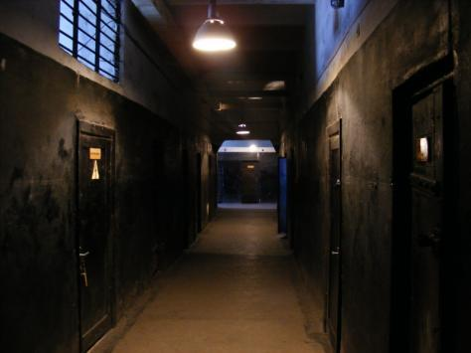
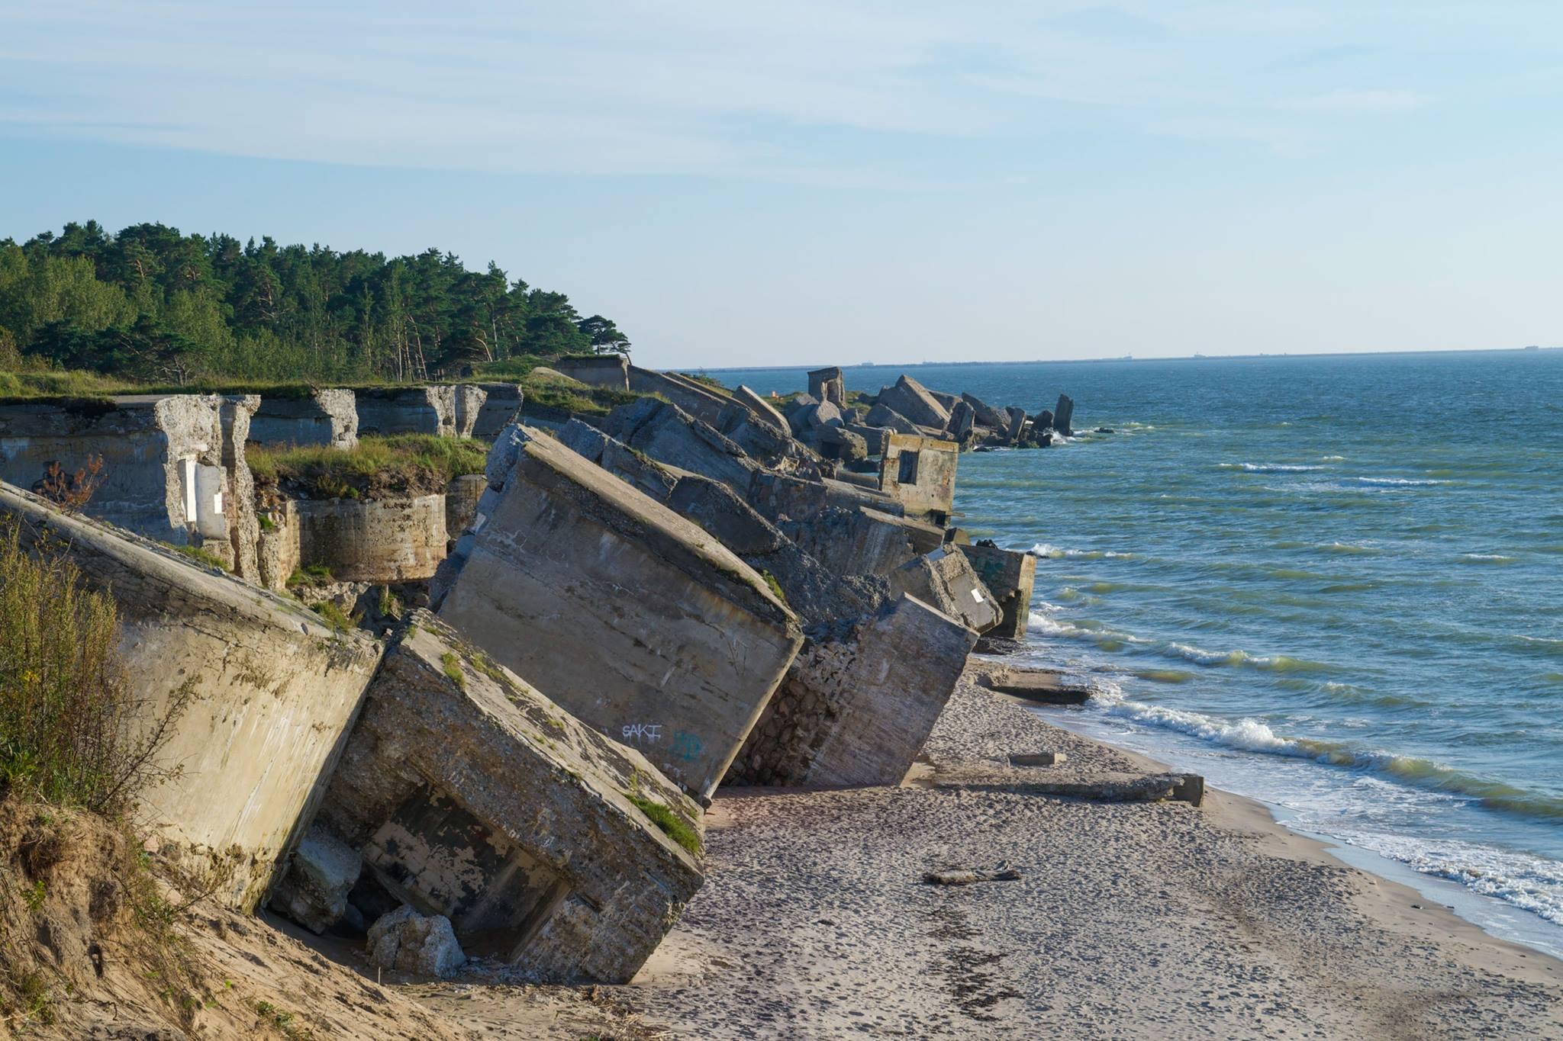
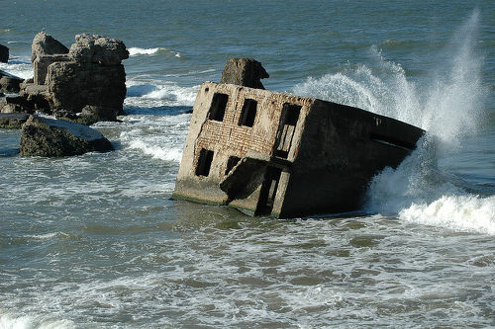
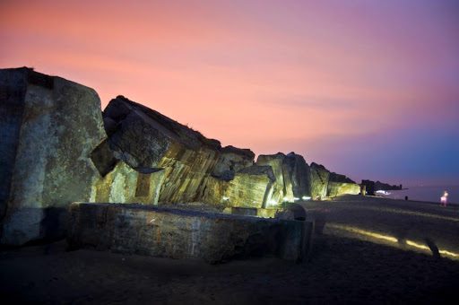
Karosta prison and the Northern forts

Slide 34
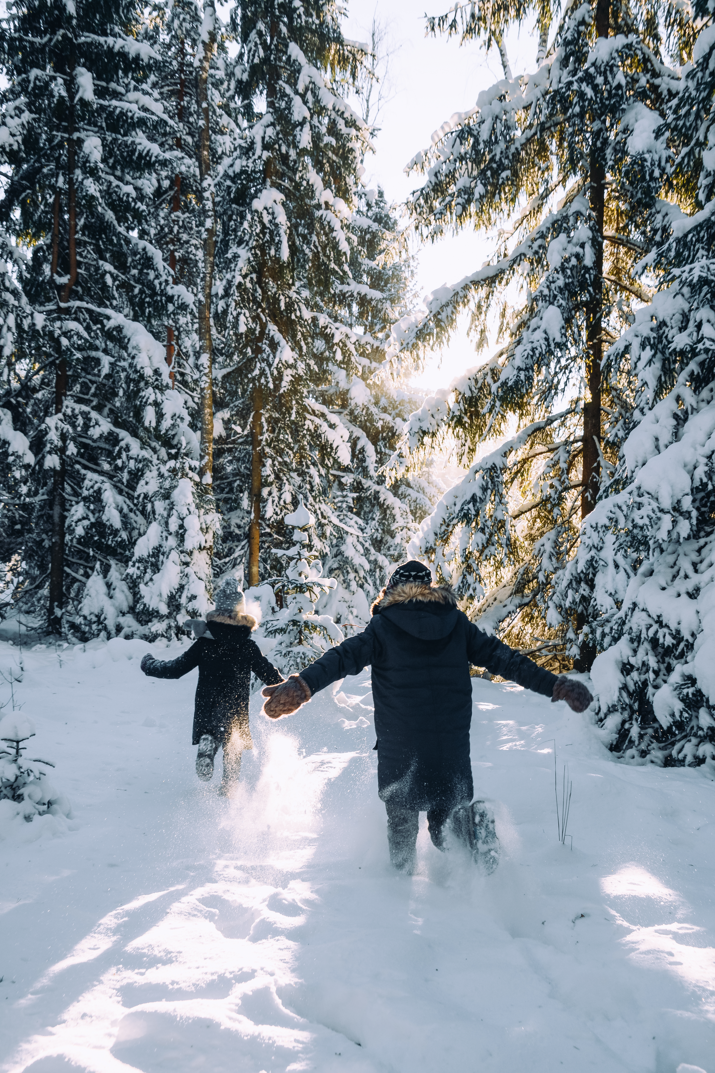
Discover Latvia...
...again!

