Slide 1
Vocabulary

Slide 2
What is vocabulary?
Receptive vocabulary: words understood in context, either heard or read.
Expressive vocabulary: words able to be used, either spoken or written.
Listening ➔ Speaking ➔ Reading ➔ Writing
Notes:
1 min

Slide 3
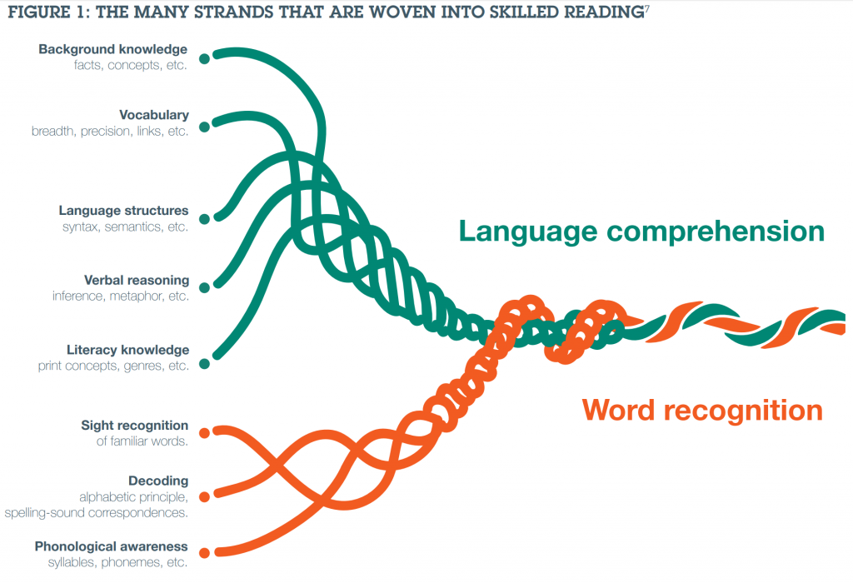
EEF - Improving Literacy at KS2
Notes:
2mins
Dr Hollis Scarborough’s Reading Rope – EEF ‘Improving Literacy at KS2’.
Y2 is where they combine.
I wonder if there’s enough of the Language Comprehension in EYFS / Y1?

Slide 4
Why is vocabulary important?
Q: How many words do you know?
A: Likely to be 50,000 to 60,000.
There’s a lot of words.
There are more than 1 million words in the English language.
Notes:
PARTICIPATION 2 mins
We’re surrounded by words from the moment we’re born: heard, spoken, used and received.
The English language has well over a million words – we can’t know them all, and neither can the children in our classes, but we can help them develop the ‘word-hoard’ of 50,000+ words needed to succeed in school and the wider world.

Slide 5
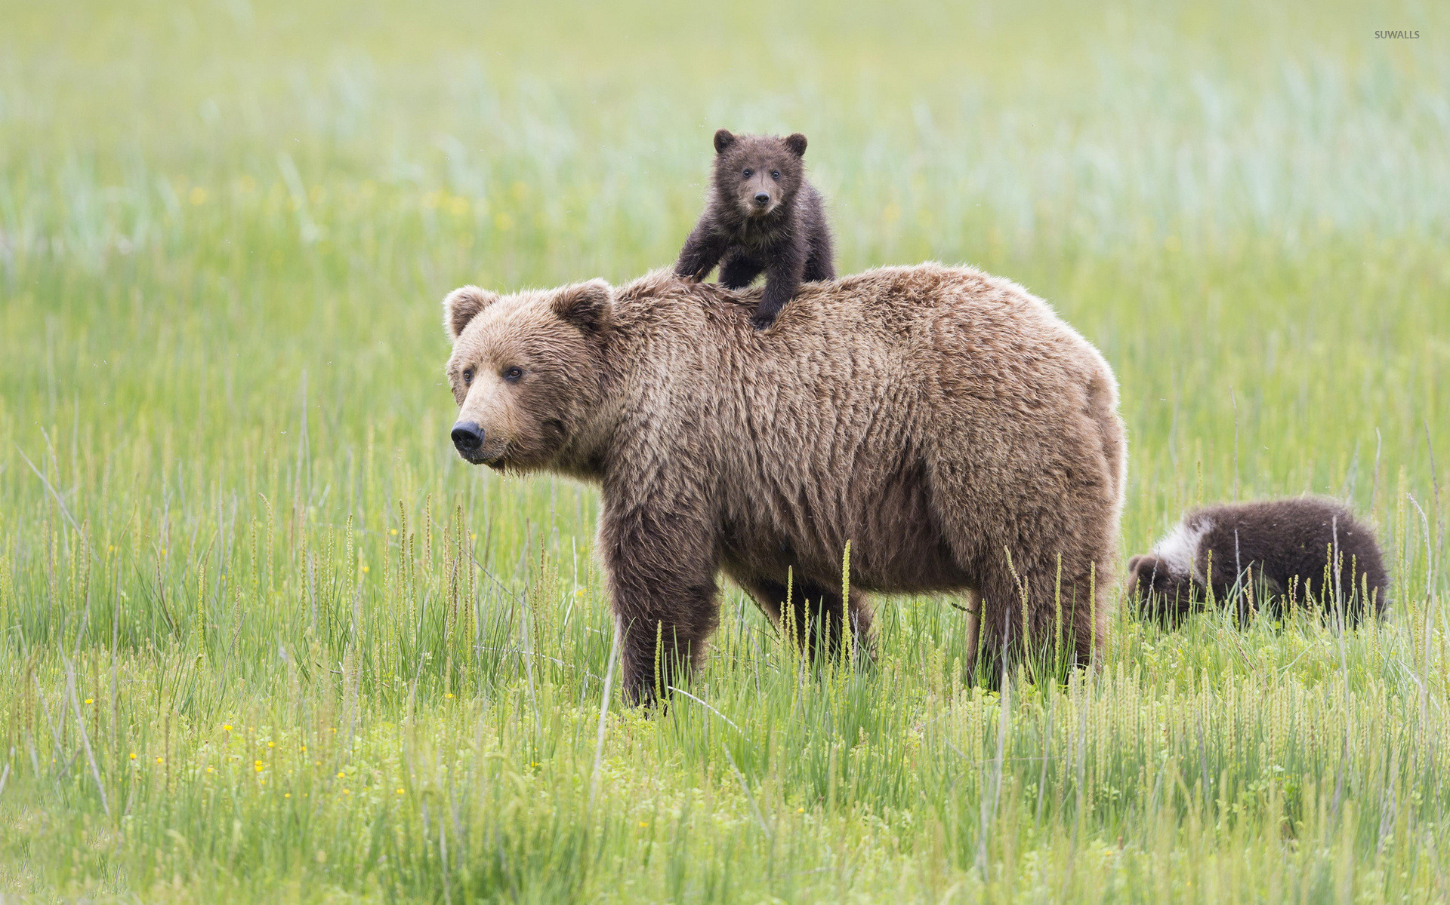
What am I thinking of?
1
Notes:
What am I thinking of?
Describe an animal, person, object or anything, using a rich variety of language. For example: “It’s lives on land. It has sharp teeth. It is very big. It is loving and protective of it’s cubs.”

Slide 6
Applause applause
2
nervous angry bored
Notes:
Applause applause
Give children three words and ask them which they would rather be described as (or rather do) and clap more or less or not at all when one is pointed at to show their enthusiasm for the word choice. Discuss why.

Slide 7
Why is vocabulary important?
It’s about more than English.
Vocabulary size is a ‘convenient proxy’ for a whole range of educational attainments and abilities – not just skill in reading, writing, listening and speaking, but also general knowledge of science, history and the arts.
A wealth of words, by E. D Hirsch Jr
Notes:
3 mins
Elaborate on this
Does this match your experience of children in your classes?

Slide 8
Why is vocabulary important?
Achievement
Along with socio-economic status, vocabulary is one of the significant factors proving relevant to achievement.
Spencer, Clegg, Stackhouse and Rush (2017)
Self-esteem and self-expression
When was the last time you read a page, had no idea what it said, and was then asked questions about it? It’s tough.
What if that happened day in, day out?
What happens if you can’t express yourself?
Notes:
2 mins
Achievement in A*-C in Maths, English Language and English Literature.
Vocabulary skills at age 13 strongly predict both Maths and English Literature GCSE results more strongly than socio-economic background. – Spencer, Clegg, Stackhouse and Rush (2012)
Vocab is linked to postcode, parental wealth and parental qualification level. Spencer, Clegg, Stackhouse and Rush (2012)

Slide 9
Word study
3
definition
not having nervous, angry or other strong emotions
in a sentence
Other ideas:
word family
good for / not good for
word association
shades of meaning
syllables
word class
root word
calm
words that mean the same / different
picture

Slide 10
Word families
4
roleplay
play
playful
player
replay
to play
a play
plays
playable
playwright
swordplay
playing
playact
Notes:
5min

Slide 11
‘nice’, ‘mean’ and ‘upset’
What might children mean when they say these things of others?
nice
kind
generous
friendly
warm
forgiving
gentle
calm
cheerful
understanding
sensitive
mean
unkind
unforgiving
bad-tempered
rude
offensive
uncaring
abusive
cruel
malicious
upset
sad
distraught
depressed
angry
jealous
worried
troubled
Notes:
5 mins

Slide 12
Can you…?
5
sneer snigger smirk
Notes:
3 mins

Slide 13
True or false?
In the first 4 years of a child’s life, parents in professional families speak 2 million more words to their children than parents in welfare families.
Word gap, not parent education, socioeconomic status or race, explains the vocabulary and language gap at 3, and then the reading and math achievement gap aged 10.
Oral vocabulary at 5-7 is a strong predictor of reading at age 10
If a child is in the lowest 20% in vocabulary knowledge at age five, and you want them to move to an average level within three years, they would have to learn 10 new words a day, every day
Girls master language faster than boys.
Rosalind Horowitz and S. Jay Samuel -2017
Law, Rush, Schoon & Parsons - 2009
Notes:
7 mins PARTICIPATION
First point false (32million).
The sixth point is false – its four times more likely
The bottom one’s false – it’s 20 new words a day
the rest are true.
First two points: Rosalind Horowitz and S. Jay Samuels. – was quite small, American, though similar evidence has been found in larger studies since.
Obviously, it’s averages and doesn’t mean that’s the case in every family with parents who aren’t ‘professionals’.

Slide 14
English has a huge amount of words – three times as many as German and six times as many as French. Sources of information about words are often hard to use. Stahl & Nagy (2005) 70% or words are polysemous: have many different meanings.
Notes:
2 min
Practise 50 times vs Apthorp 2006 = at least six times
Sources of information are hard to use: studies show that about two thirds of students sentences will be wrong by using a dictionary alone.
Consider Cobuild Primary Learners Dictionary

Slide 15
Deep dive
6
How many ways can the class think of to use the word….
slip

Slide 16
Word association
7
History
Music
Geography
Maths
IT
line
Science
English
PE

Slide 17
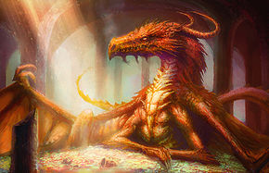
Word storms/maps
8
torso (chest, body)
rays, beams, shafts, sunlight
(sun)
snout (nose)
nostrils
columns (poles)
spines (spikes)
talons (claws)
hoard (pile)
Notes:
Word storms
Ask children to choose a setting like a forest, a house, or school and then ask them to think of all the words they can to build a picture of it. They can use describing words until you have a full description of the setting. This can be great for story starters. You can also do this when you’re describing characters, what they’re doing and how they’re doing it.

Slide 18
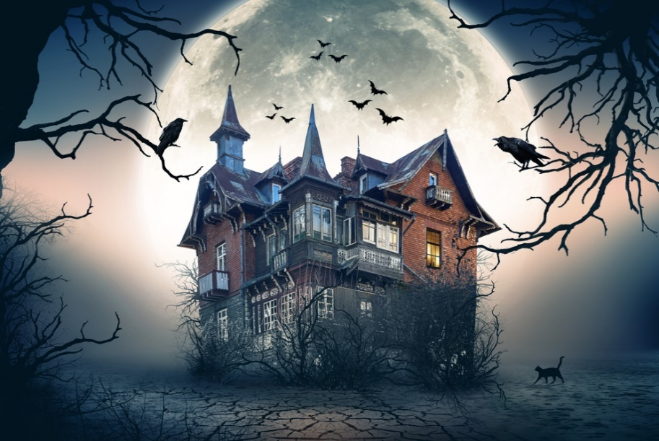
Sorting
9
snooze
swim
tiptoe
waves
calm
glimpse
waft
nervously
carefully
creep
sunbathe
relax
lazily
Notes:
Teachers should sort.
Then create words of their own for someone else to sort – this itself is also a good activity, particularly for different moods.

Slide 19
What % of words do you need to know in a text for it to be understood properly?
What are the challenges facing schools and children?
50% 55% 60% 65% 70% 75% 80% 85% 90% 95%
Notes:
1 min PARTICIPATION

Slide 20
These words are difficult:
Red words: 19/
26/166 = 16%
So 84% known words.
Notes:
2 mins

Slide 21
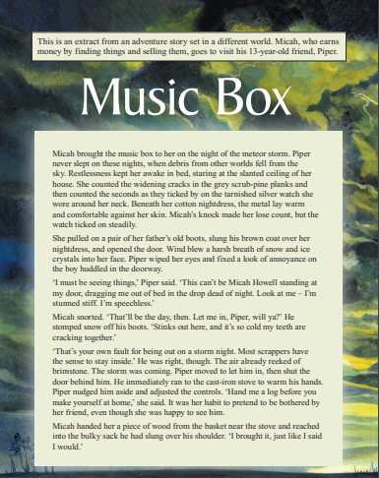
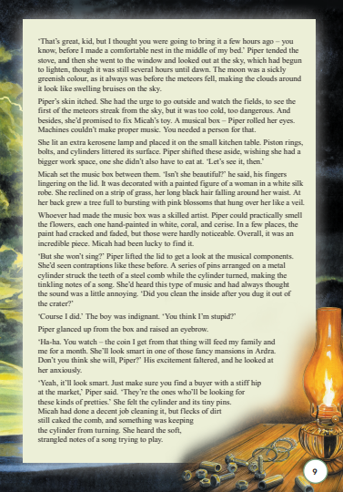
Look at the expectations…

Slide 22
Fluency is key to comprehension
‘Fast-mapping’ (sight vocabulary)
more mental energy where it matters: concepts, clues and questions
more time where it matters
needs repeated exposure…
…so read regularly, focussing sufficiently on the explicit teaching of words.
Vocabulary
You slow down when you don’t know a word.
You re-read.
… so re-read for understanding.
Notes:
Four or five words per second
1/10 mistakes/difficult words is OK
Fast mapping is only going to happen with repeated exposure to words

Slide 23
Fluency is key to comprehension
Poor vocabulary
Poor understanding
Notes:
Four or five words per second
1/10 mistakes/difficult words is OK
Fast mapping is only going to happen with repeated exposure to words

Slide 24
Shades of meaning
10
angry
sad
happy
excited
hot
cold
big
small
Notes:
Consider:
What do these words have in common? They’re all simple words that children are likely to use, so this activity helps enrich their vocab and make their word choices more precise.

Slide 25
Shades of meaning - phrases
11
got my back up
hot under the collar
see red
fly off the handle
blow my top
hit the roof

Slide 26
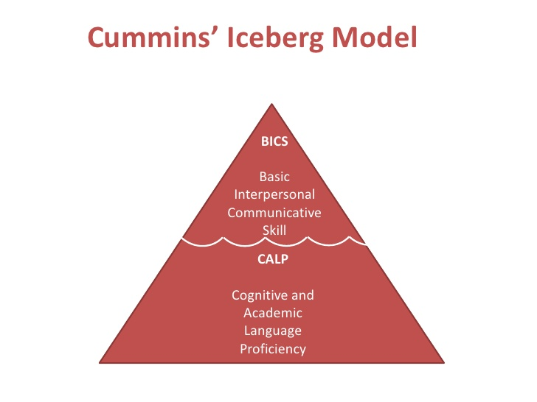
Further challenges:
When English is not their first language
sometimes much more superficial language understanding
can be invisible
word boundaries are tricky
Notes:
1 min
Iceberg model = 1981 = 37 years old
Word boundaries – we need to communicate with gaps between words

Slide 27
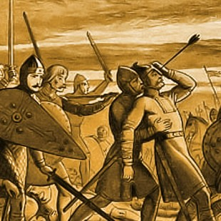
The wider curriculum
Learn to read. Then, read to learn.
Notes:
1 min - Vocabulary unlocks the rest of the curriculum

Slide 28
Incidental and explicit teaching
Incidental teaching of vocabulary
explicit teaching of vocabulary
vs
Briefly mentioning word meanings if obviously tricky ones come up
(ie class novels or topic texts)
Deliberately teaching targeted words within context and giving children multiple opportunities to use them.
Notes:
2 mins - Children with reading difficulties who are exposed to explicit vocabulary teaching benefit three times as much as those who were not.
All children benefitted too.

Slide 29
When would you?
12
gulp

Slide 30
Questioning
13
When have you resisted someone or something?
Why might you banish someone?
Think of three things you could have a fragment of…
What might a bold person say to someone who is timid?
Notes:
Ask children to think of examples to answer questions involving the vocabulary you’re focusing on. This helps to narrow the definition in their mind, as well as giving opportunities for contextualising their understanding of the word.

Slide 31
Cloze sentences
13
The __________creature _________over me.
mighty / petite loomed / peeked
Its _________, deadly claws stretched out towards me.
big / huge / whining
I ________ with fear!
smirked / vibrated / trembled

Slide 32
Have a word rich environment
What is around your classrooms to help children recognise, remember and use a wide variety of words?
labels
learning walls
word walls
displays
word banks
word bookmarks
Notes:
2min -

Slide 33
When thinking about teaching vocabulary, teachers should think about:
the students they’re teaching
the nature of the words they decide to teach
why they’re choosing those words
the way they teach the words
Flanigan and Greenwood, 2007
Notes:
1min
DON’T JUST ASK THEM!

Slide 34
What words should we focus on?
Tier 4 –words that you think are too difficult for this age of child – don’t teach them
Tier 3 – very subject-specifc words
Tier 2 – widely used, academic words, useful in lots of different situations
Tier 1 – everyday, conversational words
Beck, McKeown, and Kucan (2013)
Notes:
1min
Tier 1: happy, go, find, talk, massive, wobble
Tier 2: receive, entertainment, cautiously, revelation, contradict
Tier 3: estuary, reign, conquest, tone, axel
Tier 4: soporific, ineffable (too great to be expressed with words)
Sort words : - 5mins + 3 mins
Three to ten words per section or chapter, depending on the children.
Sorting activity – which words are tier 1, 2, 3, 4.

Slide 35
What words should we focus on?
Select words that:
Are crucial to understand the text
Not a part of the children’s prior knowledge (not tier 1)
Unlikely to be learned independently through reading, or context
Are likely to be encountered in the future and are generally useful – could be used in discussion, writing, other curriculum areas
Notes:
1min

Slide 36
Whole-school strategies
Develop pupils’ oral language
- expect answers in full sentences
scaffold pupils’ answers
allow pupils time to rehearse their thoughts
encourage pupils to think about their use of fillers, such as “like”
repeat pupils’ answers using synonyms, especially more academic ones
1
2
Create an excitement about discovering new words.
Talk about how everyone continues to learn new words throughout life from reading, television, conversations. It is OK not to know what a word means – we can find out. Model this!
Notes:
Oxford Language Report
10 mins for first including time to discuss examples on sheet – ACTIVITY!
5 mins to discuss and share ideas.

Slide 37
Whole-school strategies
3
Pre-teach vocabulary – this allows for much greater understanding when reading or accessing other areas of the curriculum.
4
Plan for plenty of shared reading with the class
good quality texts slightly above their reading age
have copies available for children to read again
give occasional pauses for reminders of word meanings
Discover and explore words in context
books, stories, and common or current events in pupils’ lives, rather than in isolation.
involve pupils in working out the meaning of a word from the context or in developing a definition.
5
Notes:
Plan for plenty of shared reading with the class
Rich literary language draws attention to itself, so the texts read aloud need to be stretching, with vocabulary ideally pre-taught through discussions and explorations of word meanings and their use.
(supported or at their leisure) will aid understanding and retention of vocabulary.

Slide 38
Whole-school strategies
6
Provide visual aids to understanding
Show video clips or pictures to illustrate words or phrases that occur in the book you’re reading. For example, for bitterly cold: watch a video of a snowstorm, handle some ice cubes, act out being “bitterly cold”, draw a picture of people on a bitterly cold day (What are they wearing? How can we show the wind?).
Revisit words often
Build a depth of knowledge of new words by revisiting them, in different ways, and in different contexts.
7

Slide 39
Whole-school strategies
8
Encourage recording and using of unfamiliar words
Provide a cardboard bookmark, or personal word banks in the back of books for each pupil to record unfamiliar words as they read independently. Share frequently to discuss meanings and consider how to use them.
Plan the vocabulary to teach
Make a list of vocabulary that pupils will need to know.
Display, refer to, and revisit this list often.
Share pictures for as many of the words as possible.
Plan opportunities to read aloud.
9
Notes:
Plan the vocabulary to teach
When planning a science or history topic, make a list of vocab
Share pictures for as many of the words as possible, or have children draw them.

Slide 40
Word association
14
plan reveal construct
A magician never shows the audience how the trick is done.
The men thought about how to steal money from the bank.
In the city, there’s often a lot of new buildings.
Notes:
You can ask children to explain their associations verbally or non-verbally.

Slide 41
Word association
15
plan reveal build
crime house idea
Notes:
Give children two sets of three words for them to find associations between. This might be nouns, adjectives, verbs or a mixture of all three. Discuss their reasons for making associations.

Slide 42
What’s wrong?
16
She had a vast smile on her face.
We climbed over the miniscule wall.
Notes:
Get it wrong
Show children a sentence or sentences with incorrectly chosen words and ask them to make a better choice. This helps teach children precise use of language, clarifies the definition of words and their accurate use.

