Slide 1
Whole-School Oracy Development

Slide 2
The plan:
What is oracy?
Why is oracy important?
How can we develop it within schools?
and some games!

Slide 3
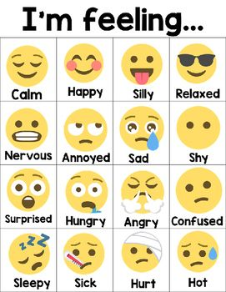
Which emotion?
“It’s going to snow today.”
Think about your…
voice
face
actions

Slide 4
What is oracy?
‘The ability to express yourself fluently and grammatically in speech.’
= speaking and listening
Notes:
Teaching the children to talk fluently….using correct terminology / grammatical structures.

Slide 5
Poor vocabulary
Poor understanding
Notes:
Four or five words per second
1/10 mistakes/difficult words is OK
Fast mapping is only going to happen with repeated exposure to words

Slide 6
Notes:
Cambridge University came up with these with Voice 21.
Cut up and organize under different headings.
Handout and discuss each one separately.

Slide 7
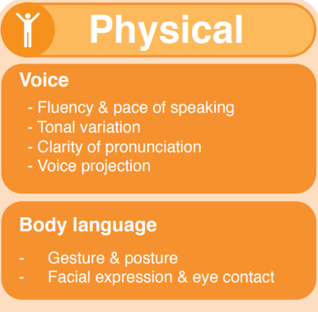

Slide 8
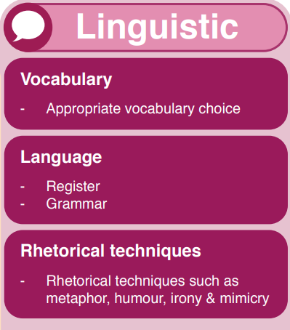
Are children being taught varied vocabulary and useful technical terms?

Slide 9
If I ruled the world…
One player begins by saying “If I ruled the world, I would… because…” and describe what they’d do any why.
The next person must respond by saying “I couldn’t disagree more because…” (even if they don’t disagree!). They must follow this by stating what they would do if they ruled the world.
Good for developing…
logic
reasoning
disagreeing

Slide 10
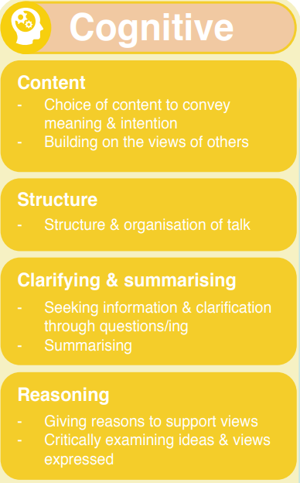

Slide 11
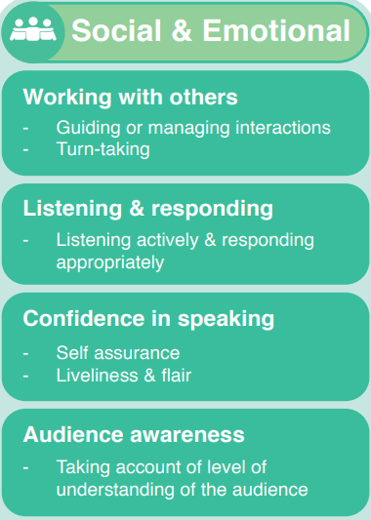

Slide 12
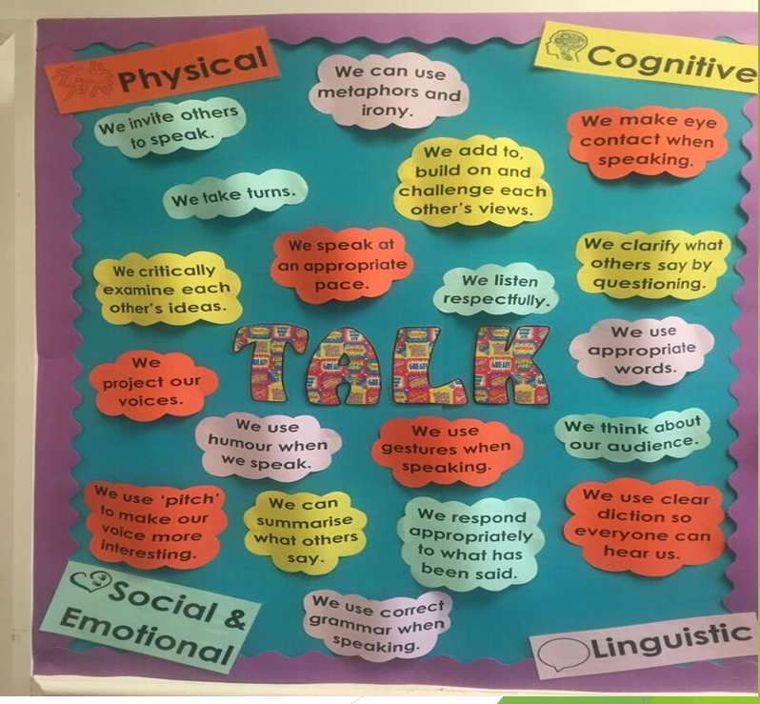

Slide 13
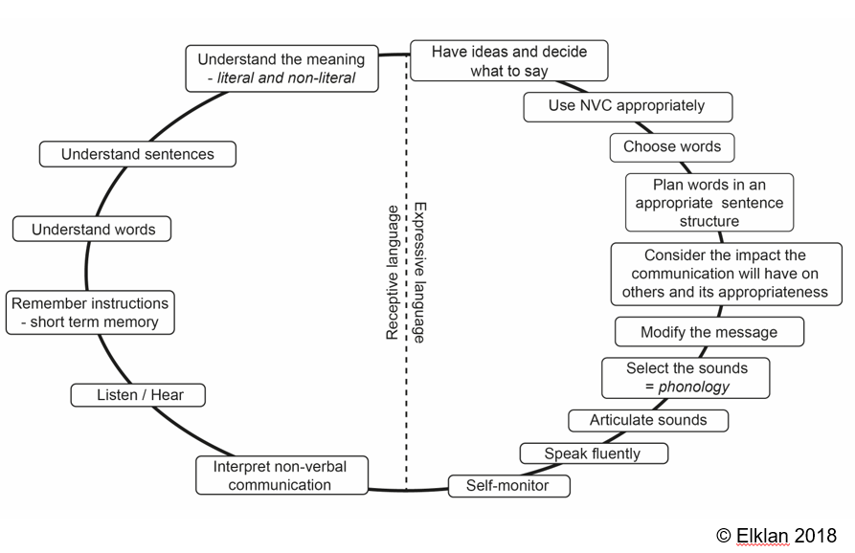
Communication chain
Notes:
For children to be able to communicate there are a lot of processes to go through. It is a complex system of skills which rely on each other
If there is a break in the communication chain at any point, then this will slow down the child’s oral development. It is important that as practioners, we identify any areas where a child may need further support.
Sorting activity to make a chain – receptive and expressive language.

Slide 14
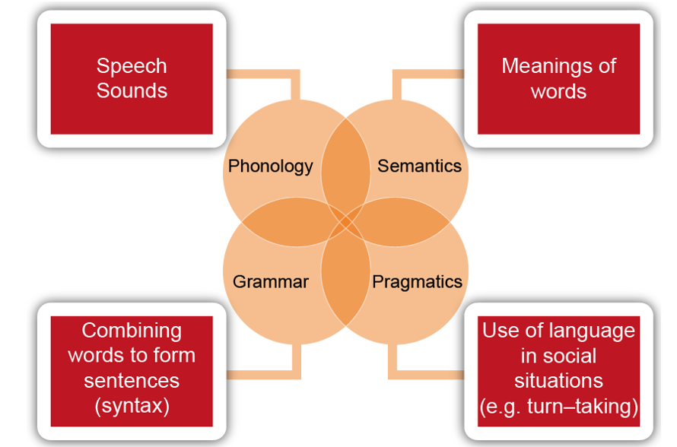
Knowing how to combine words to form sentences involves:
Sounds?
Meanings?
Sentences?
When? How?
Notes:
As part of this communication chain, the actual speaking has issues of its own! Complex skills are needed which need to be taught and learnt.

Slide 15
Question tennis
In pairs, take it in turns to ask questions.
For example:
Who painted this?
When was it painted?
Why did they choose this technique?
What was the painter thinking of as they created it?
Is it based on real life?

Slide 16
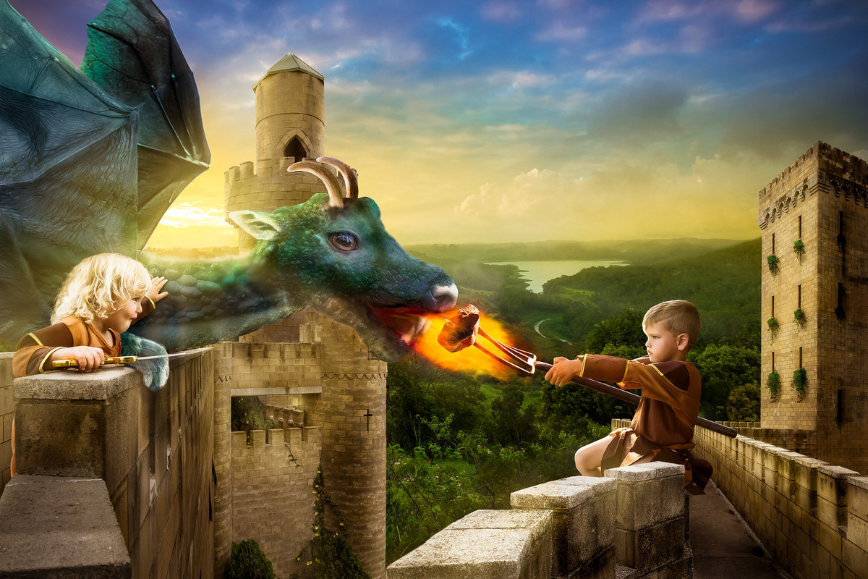
Question tennis

Slide 17
Why is oracy important?

Slide 18
Spoken language and communication is the basis of everything that we do.
https://www.voice21.org/

Slide 20
Oracy is important, but…
It rarely has the same importance as reading and writing in schools.
It’s rarely taught specifically in non-English subjects.
What is it like in your school?
Do an audit.
Notes:
As we know, the lack of oracy skills can be a huge disadvantage for children.
How can we support the development of oracy skills to allow children to have a voice, contribute to society and ultimately lead a fulfilled life.
Does anyone have an oracy lead in school? Oracy policy? Becoming more of a focus as School leaders are realising the importance that oracy should have and the impact of good oracy has on the whole curriculum.

Slide 21
Recorder-solver
One person solve the problem and explain it.
The other person records it. Ask questions too!
Good for developing…
clear, succinct explanations
logic
reasoning
357 + 198 = ?

Slide 22
What can we do to support oracy development in our own classrooms?
Notes:
There has been extensive research over the years on the reasons for poor oral language and spoken language delay and the impact this has on a child’s literacy development.

Slide 23
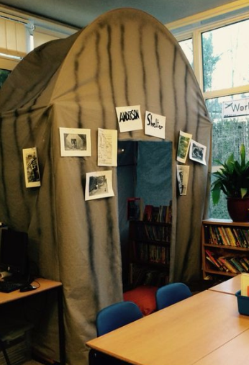
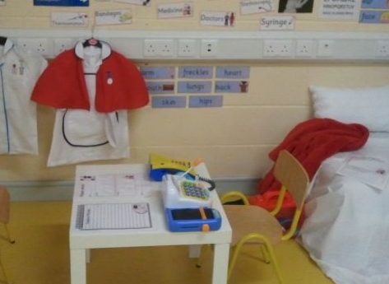
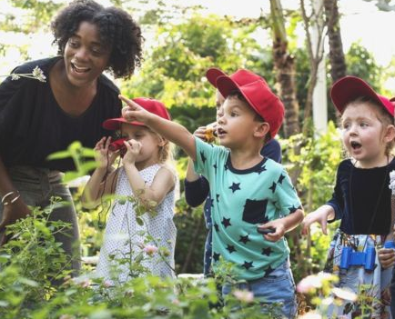
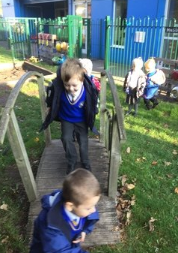
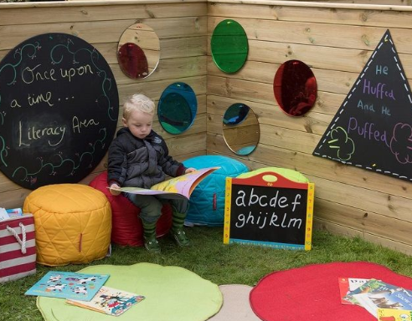
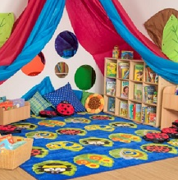
Create a place to talk
Notes:
1. Are there cosy, comfortable places to talk? Can you see people’s faces when they are talking? Can
you rearrange the layout of the room to suit different opportunities for talking – as pairs, or in small
or large groups
2 What is the general level of noise like? Are there noisy distractions from inside or out? Are there
ways to gain people’s attention? Can everyone hear and be heard? Are there times of quietness?
3 Signs, symbols, photographs and sometimes writing are features of many approaches to a
communication-friendly classroom. How widely and consistently are they used? Are they used as
labels, to support routines, or as timetables? Are parents shown how they work? Is there the right
amount and kind of visual support for the age and development of the children or young people?
4. How does the classroom environment help children to know what to expect and when? How well
are visual supports used to help children understand and follow routines?

Slide 24
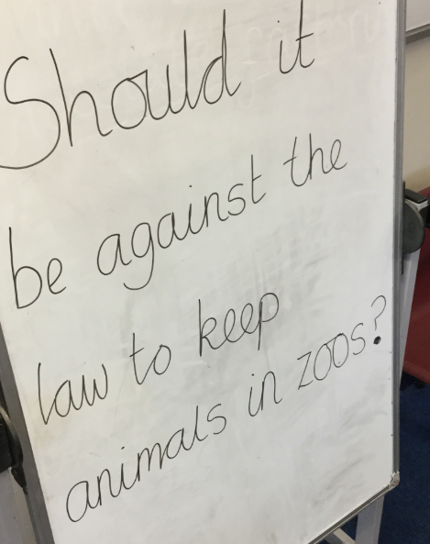
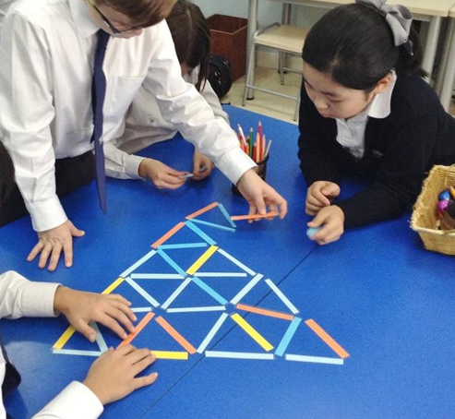
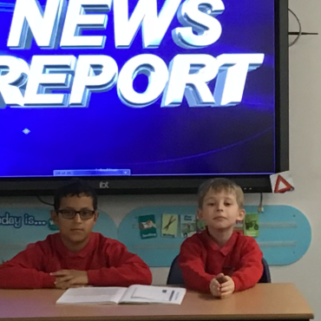
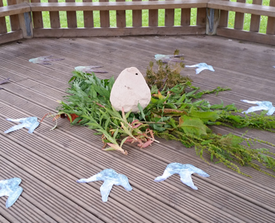
Give children a reason to talk
Exciting events
Interesting items
Drama
Role play
Talk games
Barrier games
Questions about a piece of art
Ask me stickers
Notes:
Typical pupil contributions to whole class discussions = 4 words
Average child 6-18 only asks 1 question per month for each subject they attend – teacher asks 291 per day
Be available to facilitate small group work, group discussions and structured conversations.
Be available to facilitate interactive book reading.
Use a ‘Talking Partners’ system, to provide opportunities for children to talk to each other in structured situations.
Almost all events, encounters or activities within the day can support speech, language and
communication, so a communication-friendly school looks to make sure all these opportunities are
planned for and used. Alongside this, activities specifically designed to focus on communication
should be planned.
Parkside, Bradford – talk threads displayed on banner and website for whole school homework.

Slide 25
Learning to talk is much more than a yearly presentation when children want to be a school councillor, or even ‘talk partners’…
presenting
discussing
justifying
debating
narrating
explaining
speculating
exploring
evaluating
arguing
reasoning
questioning
hypothesising
Talk needs to be more than children recalling information or guessing what the teacher is thinking!
Notes:
Lots of evidence to show that employment opportunities and economic benefits place a high value on communication skills.
NEED ACTIVTIES FOR THE CLASSROOM TO DEMONSTRATE THESE SKILLS.
Creating and planning opportunities for presenting information at the end of a unit of work… monologue / poems / presentation of facts / explanation / persuasive talk / dragon’s den pitch / green screen video.
Demonstrates subject knowledge in history / geography / science etc…

Slide 26
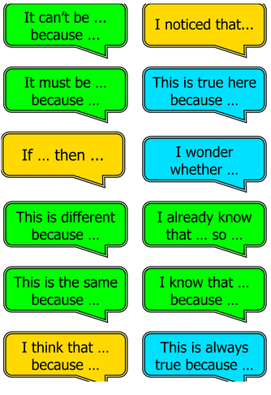
Support different types of talking using ‘sentence stems’.

Slide 27
Model the talk expected from pupils
Make sure all staff talk in full sentences which are grammatically accurate.
Make corrections to children’s mistakes by repeating and emphasising how it should be spoken.
Provide pupils with feedback both on what they say and how they say it
Verbal and immediate feedback has the biggest impact.
Notes:
CONSISTENCY ACROSS SCHOOL IS KEY. (PAGE 48 ORACY REPORT FINAL)
Professor Robin Alexander – Dialogic teaching.
Principles adopted by Voice 21.
ground rules: active listening, turn taking, respect, etc…
Allow thinking time. Move away from teaching talking…and more children talking.
Sentence stems from Tower Hamlet.
Roles or ‘talk moves’ from voice 21.
Groupings for different activities. Planned activities.
Videoing the children so that they can see themselves interacting with each other…helps them develop and improve their skills (eye contact/ active listening).

Slide 28
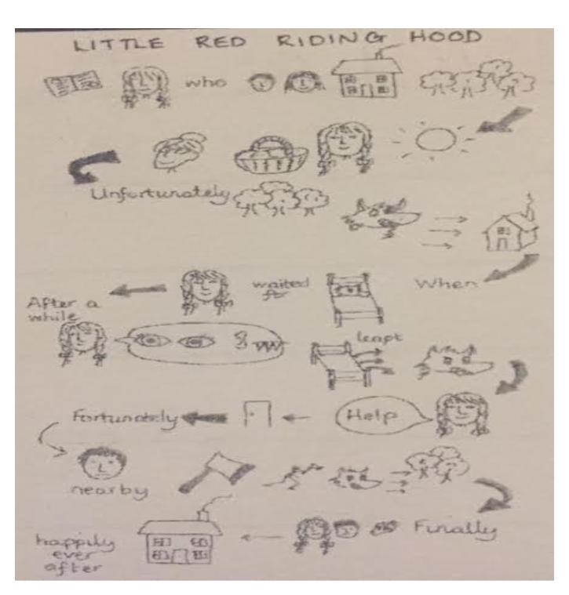
Retell a story

Slide 29
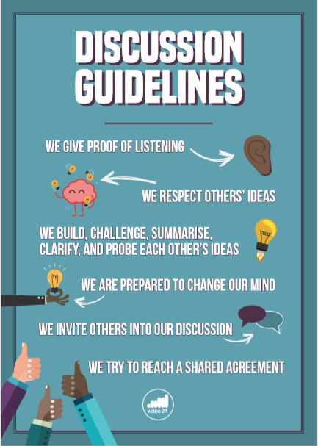
Set clear rules and expectations for talk in lessons.

Slide 30
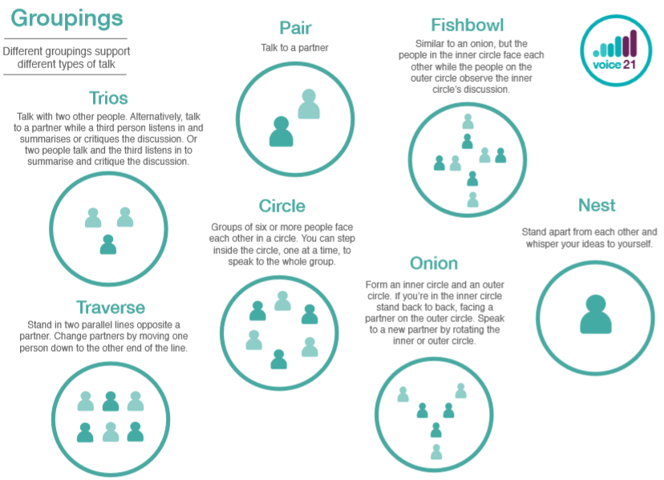
Try: “Kagan structures”
Consider grouping

Slide 31
Teach vocabulary
incidental and explicit teaching
incidental teaching of vocabulary
explicit teaching of vocabulary
vs
briefly mentioning word meanings if obviously tricky ones come up
(ie class novels or topic texts)
deliberately teaching targeted words within context and giving children multiple opportunities to use them.

Slide 32
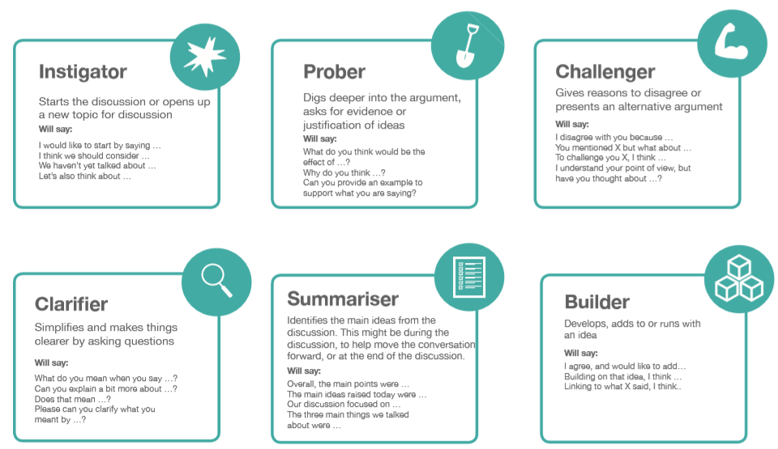
Support language using…
discussion roles
chairperson
reporter
challenger
builder
clarifier
summariser

Slide 33
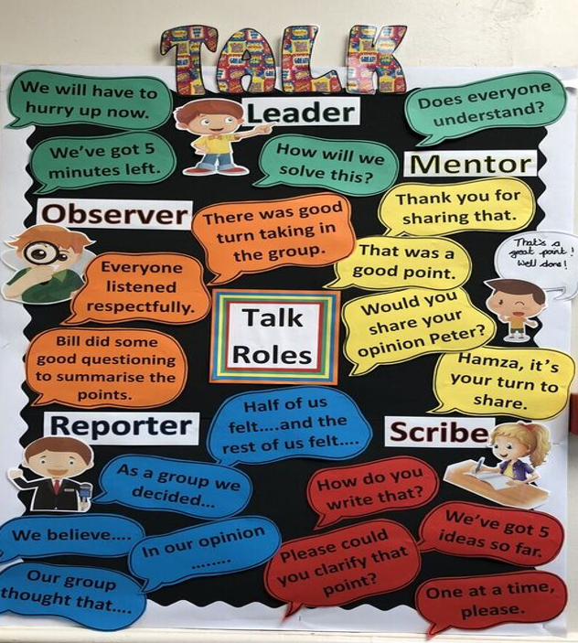

Slide 34
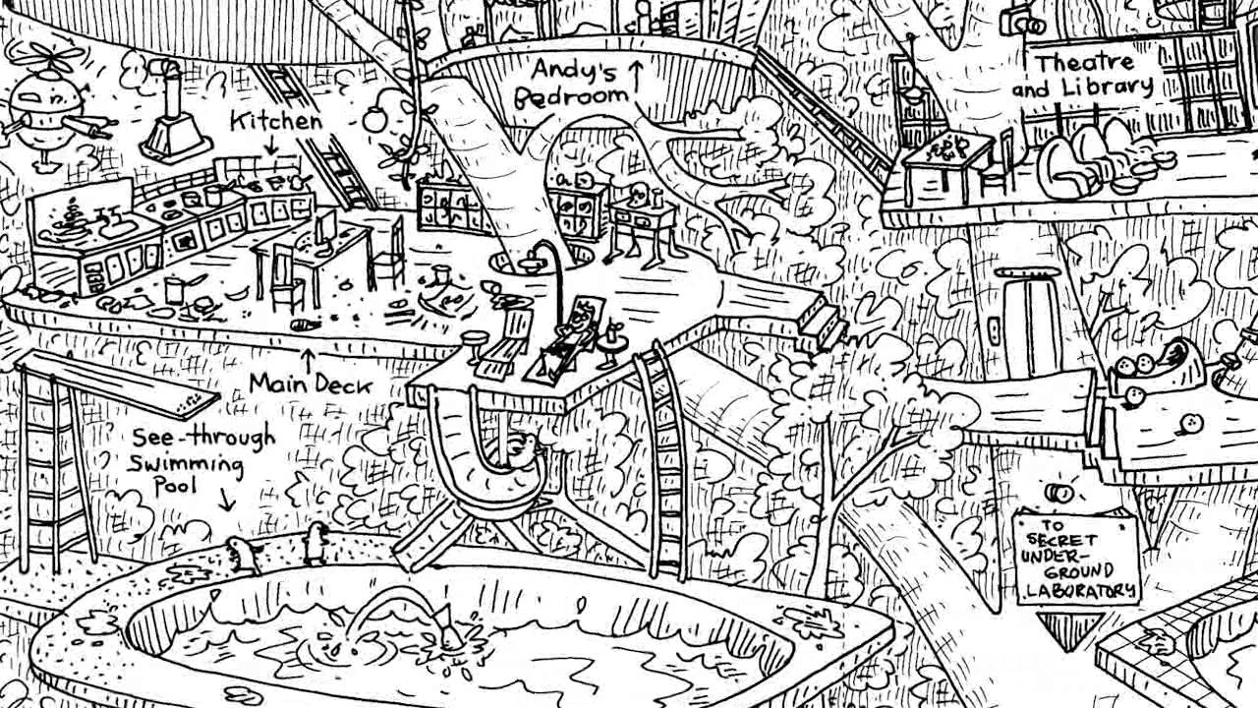
Virtual tours

Slide 35
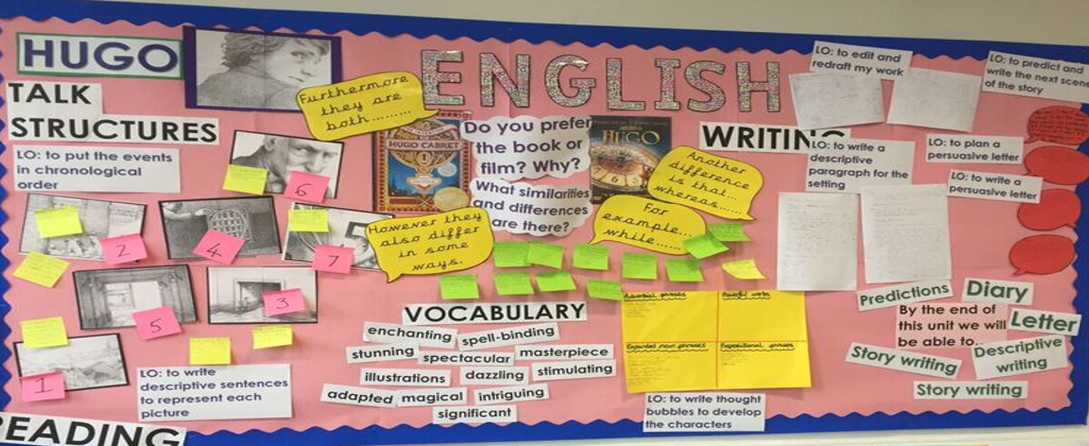
Use your classroom environment
/

Slide 36
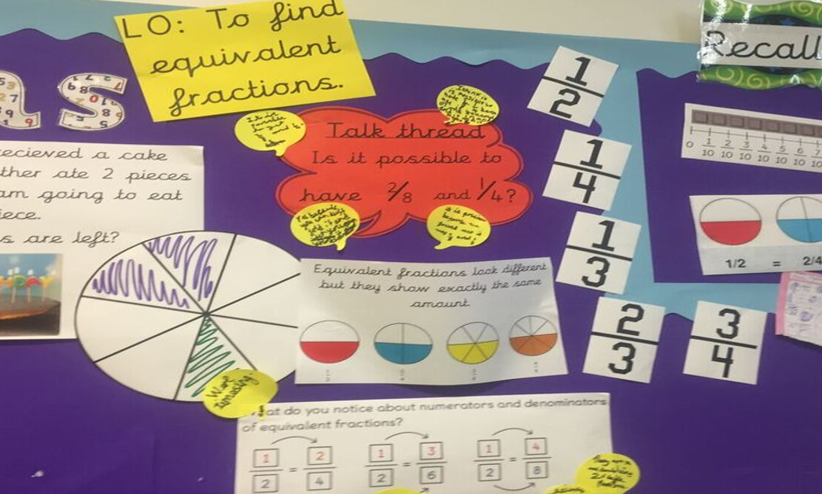
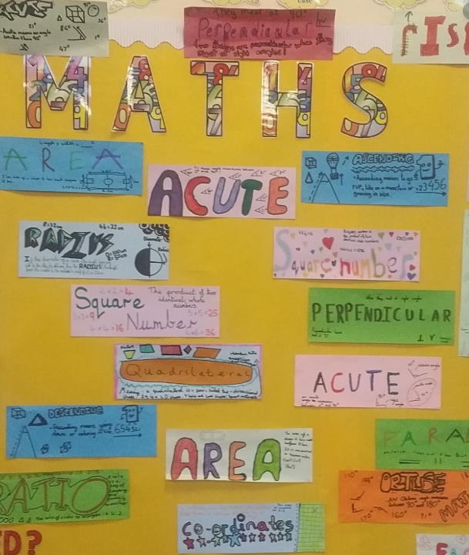
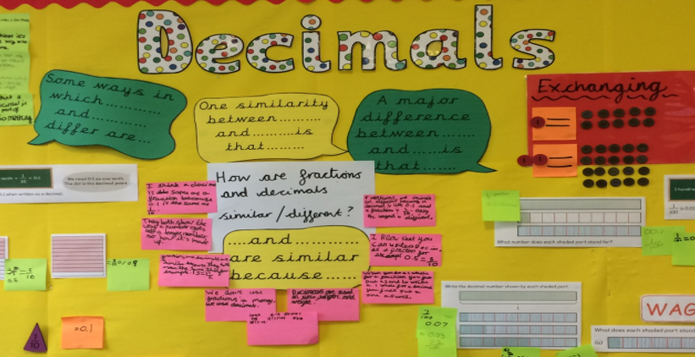
Use your classroom environment

Slide 37
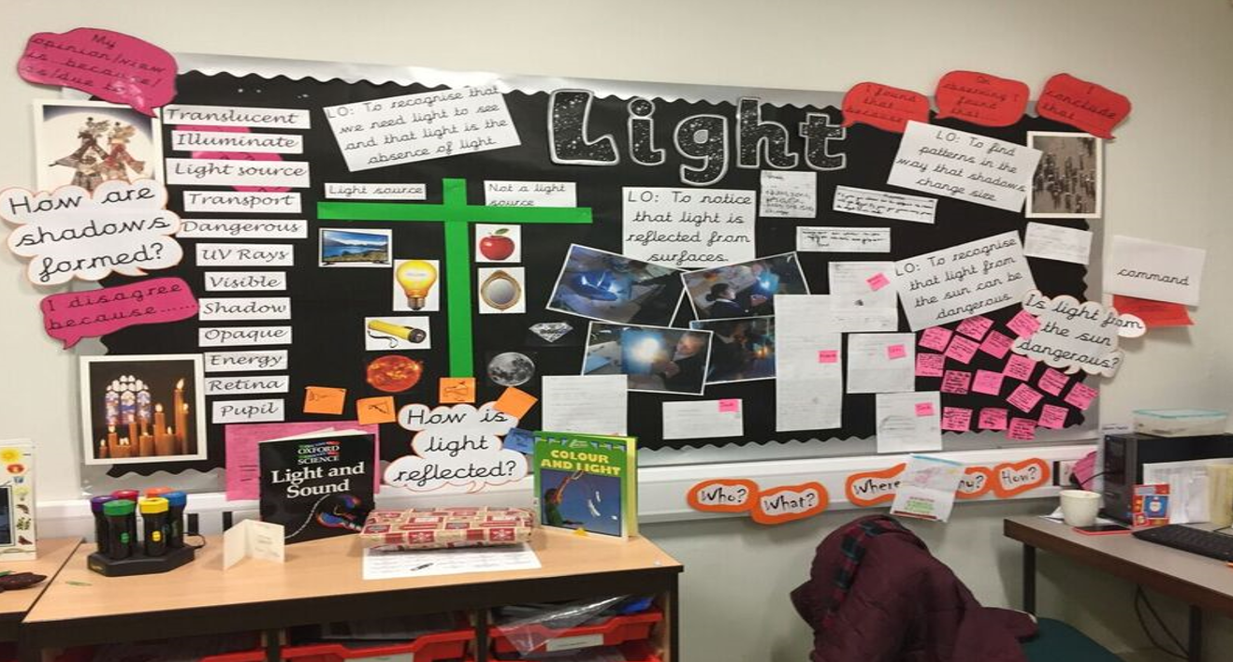
Use your classroom environment
/

Slide 38
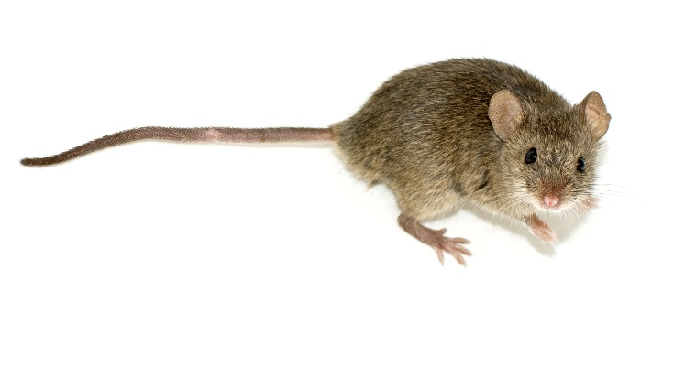
Just a minute
In small groups, with one stopwatch each, one pupil begins to speak.
No…
hesitation (Er…)
deviation (talk about something different)
repetition (Dogs… Dogs…)
If a mistake is made, stop the speaker and time.
If the challenge is correct the challenger takes over the speaking.
Whoever is speaking at the end of the timed minute is the winner.
Good for developing…
presentation skills
listening skills
several points on one topic

Slide 39
How can we make sure that
this is a whole school approach?

Slide 40
Actions:
Make sure oracy the same status as reading, writing and maths on the school curriculum.
Audit it – identify target areas.
Plan to improve it.
Teach it in different subjects, NOT just English.
Make it essential in English lessons.
Use a consistent approach across school.

Slide 41
Actions:
Progress skills across school.
Plan for it in lessons / timetables.
Use classroom environments to support oracy.
Including it as a focus for lesson observations in any subject.
Report children’s progress in oral language to parents.

Slide 42
Further research / reading:
https://www.voice21.org/
https://educationendowmentfoundation.org.uk/projects-and-evaluation/projects/talk-for-writing/
https://impact.chartered.college/article/millard-importance-of-oracy-in-teaching-learning
http://www.talkingpoint.org.uk/
https://www.thecommunicationtrust.org.uk/
http://www.ckspeechtherapy.com/speech-language-development
https://www.esu.org/oracy/
https://www.bbc.co.uk/programmes/articles/4FmG38zP0GNJKwrMkG9pqMC/welcome-to-comedy-classroom-for-primary-schools
https://literacytrust.org.uk/
https://literacytrust.org.uk/resources/comedy-improvisation-comic-relief/
https://www.ican.org.uk/
https://schoolsweek.co.uk/oracy-fits-in-with-the-three-rs-says-gibb/
https://schoolsweek.co.uk/use-cpd-funding-to-boost-pupil-oracy-mps-told/
https://www.lkmco.org/wp-content/uploads/2016/11/Oracy-Report.pdf
https://noisyclassroom.com/oracy-across-the-curriculum/
Towards Dialogic teaching - rethinking classroom talk by Professor Robin Alexander.
Word Aware – Teaching vocabulary across the day, across the curriculum by Stephen Parsons and Anna Branagan.
Bringing words to life by Isabel Beck, Margaret McKeown and Linda Kucan.
Time to talk by Jean Gross
ELKLAN – Language builders

