Slide 1
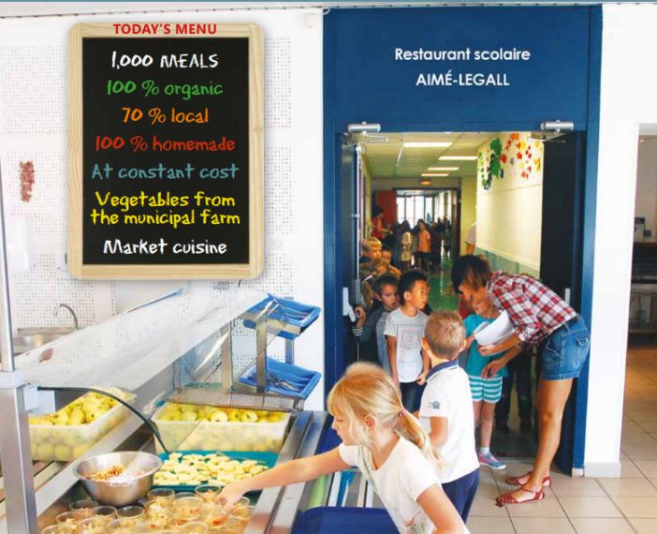
Pilot project in Jelgava Local Municipality – how did we start?
Experience in UBACT project AGRI-URBAN – Mollet del Valles (Spain), Sodertalje (Sweden), Moans-Sartoux (France)
Healthy, seasonal, local and bio food in school catering
… «In Mouans-Sartoux all children in their schools and daycare centers have been eating 100% organically since January 1st, 2012 (first city in France with a number of inhabitants above 10 000). There are 1000 meals served per day or 152 000 meals per year. Costs of products consists 2.04 EUR (in 2016); when calculating also taxes and other costs, it constitutes 10.57 EUR. Family contribution towards meal cost depends on each family’s income: from 2.00 € to 6.20 € (average price: 3.13 €). Special attention is drawn to the food waste, they have been weighted and menus have been analyzed. By reducing the food waste, the costs could be reduced dramatically.»
http://restauration-bio-durable-mouans-sartoux.fr/wp-content/uploads/2017/10/Brochure-Mouans-Sartoux-english-version.pdf

Slide 2
Pilot project in Jelgava Local Municipality (02.2020.-05.2021.)
Aim: more healthy, seasonal, local products in school catering
Cross-sectoral work approach: meetings with representatives of different sectors – Education unit, Welfare unit, Planning and development department, Procurement unit, PR, management of the municipality, elected municipal council members, school directors, farmers, schools` catering companies
Partners: 2 schools of the municipality – Aizupe elementary school and Zaļenieki Commercial and craft secondary school (around 200 children took part in pilot activities); 2 catering companies – Rubīns, Ltd. and Ēdiens.lv, Ltd.

Slide 3
Activities Spring 2020
Attracted certified nutritionist:
Analysis of the menus of 2 educational establishments of Jelgava Local Municipality carried out by nutritionists – evaluation of nutritional journals (5 days) of two school menus
Development of new menus and technological cards (5 menus per each season – autumn, winter and spring, 15 menus altogether), considering Regulations No 172 of Cabinet of Ministers from 13 March 2012, «Nutrition norms for Educational establishments, customers of Social Care and Social Rehabilitation Institutions and patients of Medical Institutions»

Slide 4
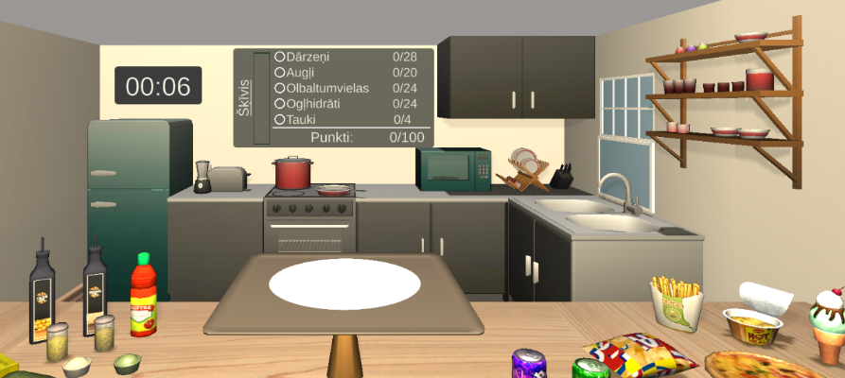
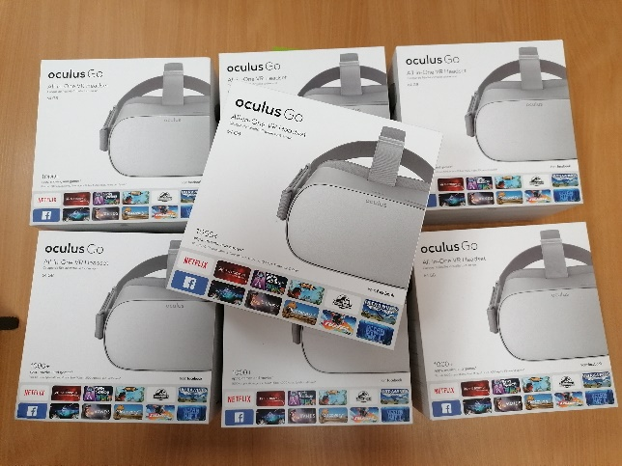
Activities Spring 2020
Repeated information for parents and children in e-klase.lv
Virtual reality game PRO-portion for school pupils
Video lecture to parents about healthy food https://www.youtube.com/watch?v=y6ZPHmix7Mo
Activities in schools (trainings and masterclasses for children and cooks) canceled due to the COVID 19

Slide 5
Activities Autumn/Winter 2020
Repeated information for parents and children in e-klase.lv
Posters at schools
2 & 9 October – lecture and masterclass for school chefs (for all municipal schools)
26 October & 2 November – lecture and masterclass for pupil
12 November – online lecture for parents
17 December – progress evaluation and feedback workshop with school directors, school catering companies and nutritionist

Slide 6
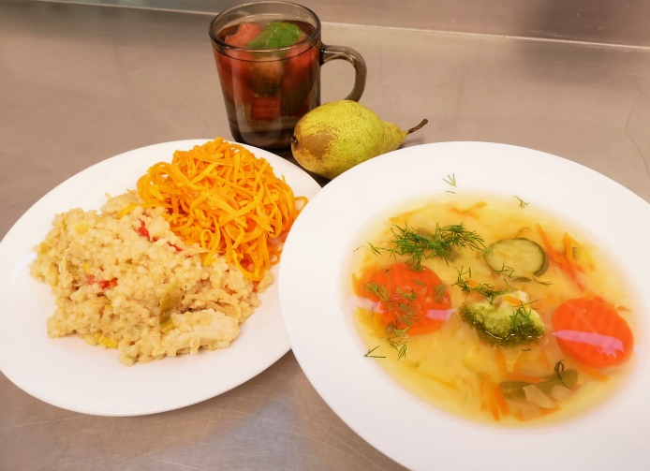
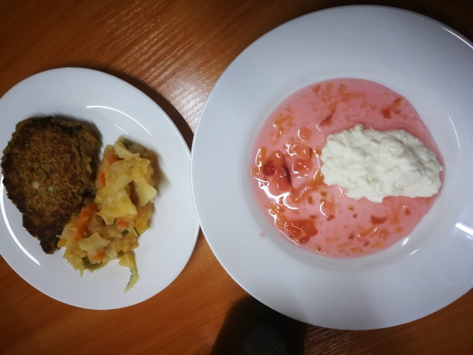
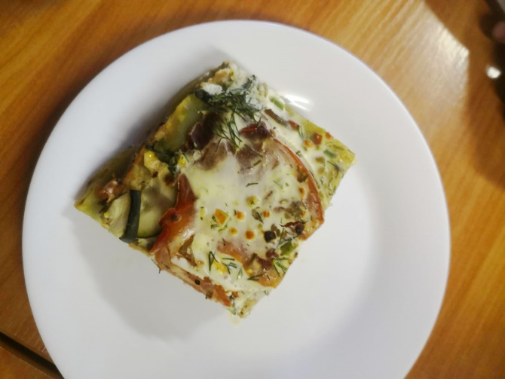
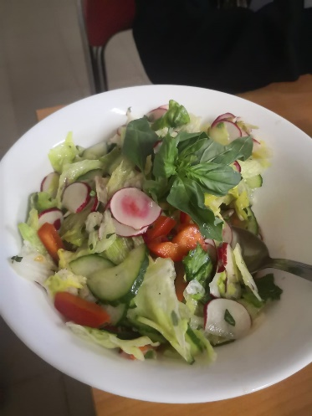
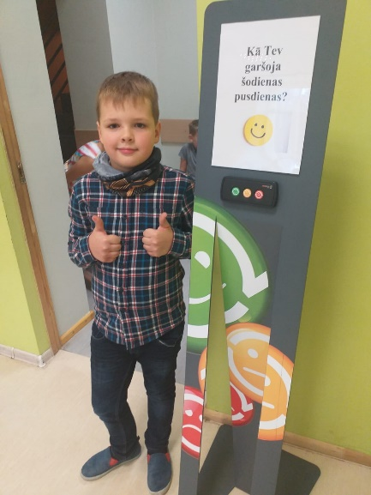
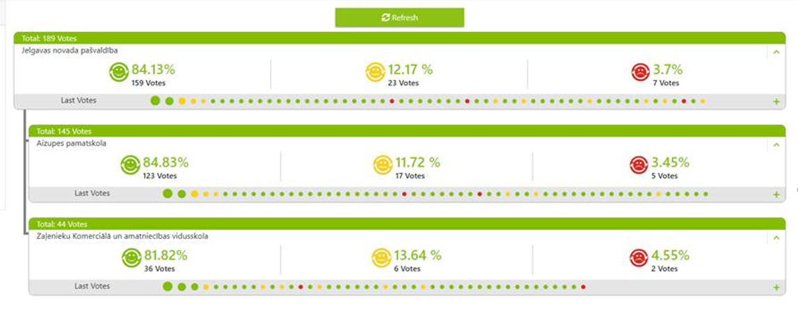
Activities Autumn/Winter 2020
Introduction of new meals at schools
5 weeks – 5 Fridays from 13 November – 11 December, 2020
Most beloved:
- Chicken pilaf, pickled cucumber, rye bread, curd cream with apple-blackcurrant sauce, fresh apple (liked by 84.13% pupils)
Notes:
Most beloved:
- Chicken pilaf, pickled cucumber, rye bread, curd cream with apple-blackcurrant sauce, fresh apple (liked by 84.13% pupils)
- Fish soup with broccoli, sour cream and greens, lentil patties with vegetable stew and spices, fresh tomato and leek salad, sweet-and-sour bread, kefir (liked by 67,86% pupils)

Slide 7
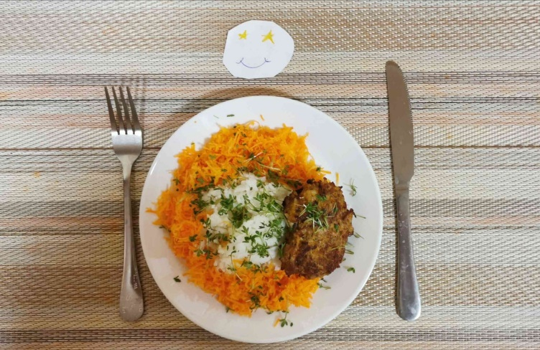
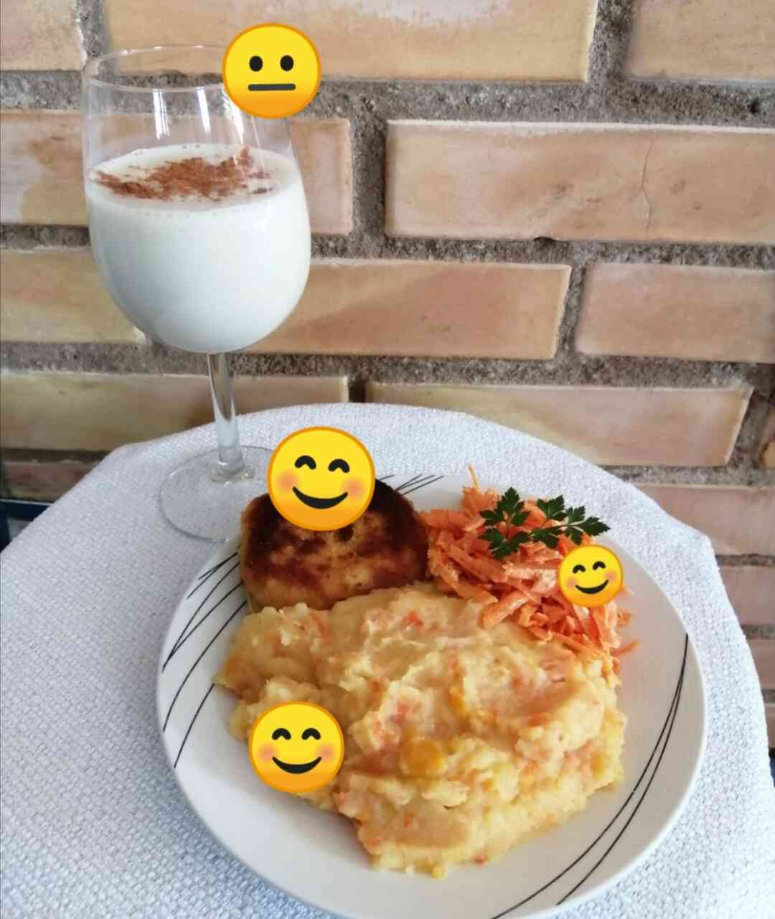
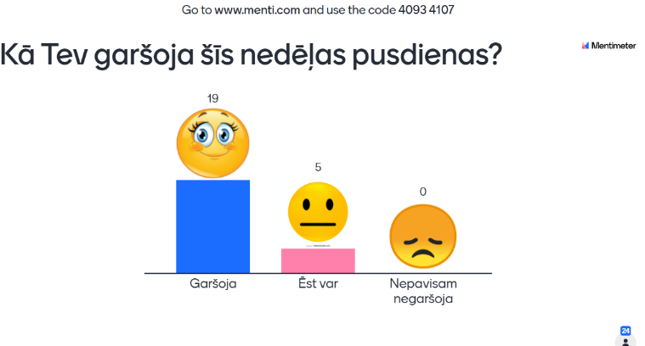
Activities Winter/ Spring 2021
Repeated information for parents and children in e-klase.lv
Video lecture for parents regarding food allergies
https://www.youtube.com/watch?v=Wc2F9_eGM38
Short video lecture for pupils
Schools are closed again; cooking took place at home (according to short and simple photo recipes prepared by nutritionist)
Questionnaires for parents/ children
Gustavs said that for potato-carrot puree and fish he would give average score (😐), but for banana – milk shake the smiley face or highest score (😊). The oldest daughter liked everything, and she gave the highest score

Slide 8
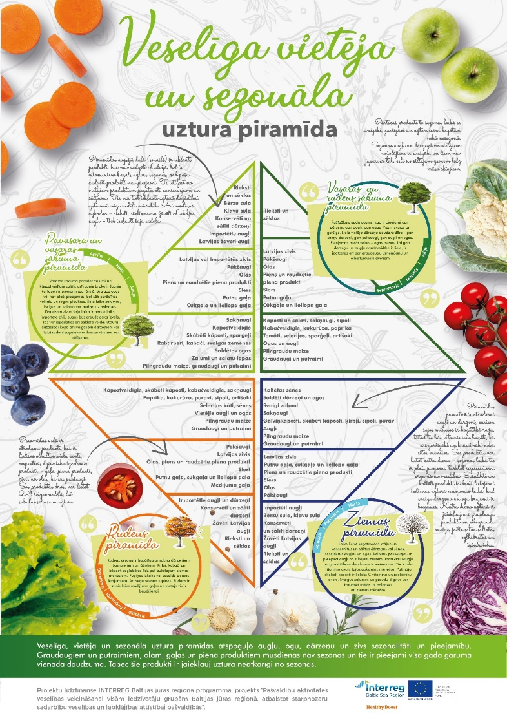
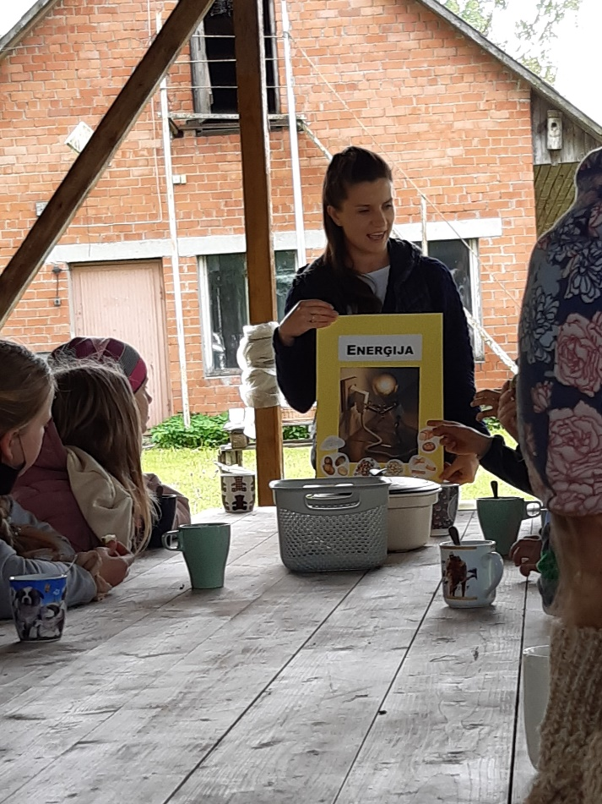
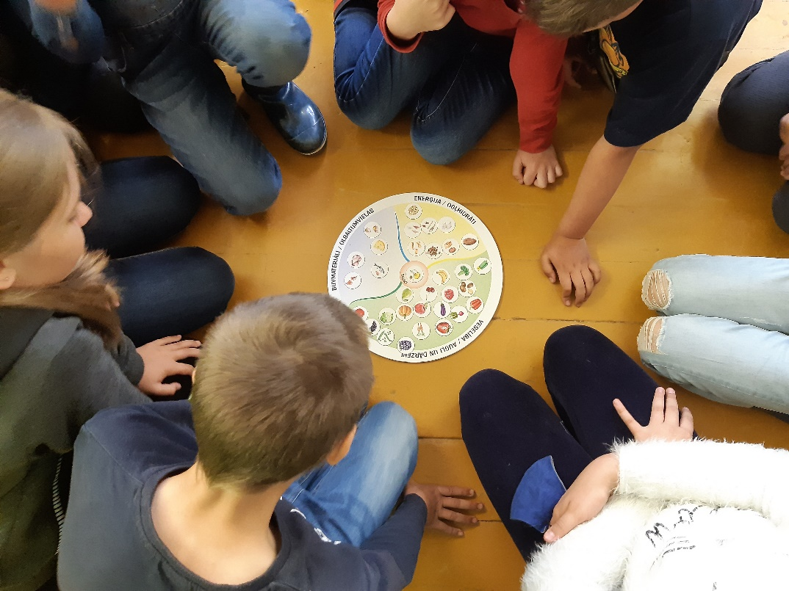
Activities Spring/Summer 2021
Video lecture for parents about children` meals in summer
Healthy lifestyle school – educative, practical and creative workshops for 40 children
Development of seasonal Food Pyramids
Final co-creation workshop on 10th June 2021

Slide 9
Conclusions and next steps
The Model for cross-sectoral cooperation has been a great support in pilot implementation
Due to the project municipality is involved in different working groups to solve catering issues at national level where results of the pilot project are being discussed and adapted
We see the potential to further develop healthy, local and seasonal catering at schools as the shift in children’s mindset has taken place – a significant number of children have reported their consumption of fruit and vegetables has increased
We wish our children to be healthy and happy as healthy is the new happy 😊

Slide 10
Time for questions & answers
Jelgava Local Municipality
International Project Manager Anita Škutāne
anita.skutane@jelgavasnovads.lv; +371 63048446
Health Promotion Coordinator Dace Mauliņa
dace.maulina@jelgavasnovads.lv; +371 25627518

